Slide 1
The Plan of Salvation
What happened in my pre-mortal life? What is the purpose of life?

Slide 2
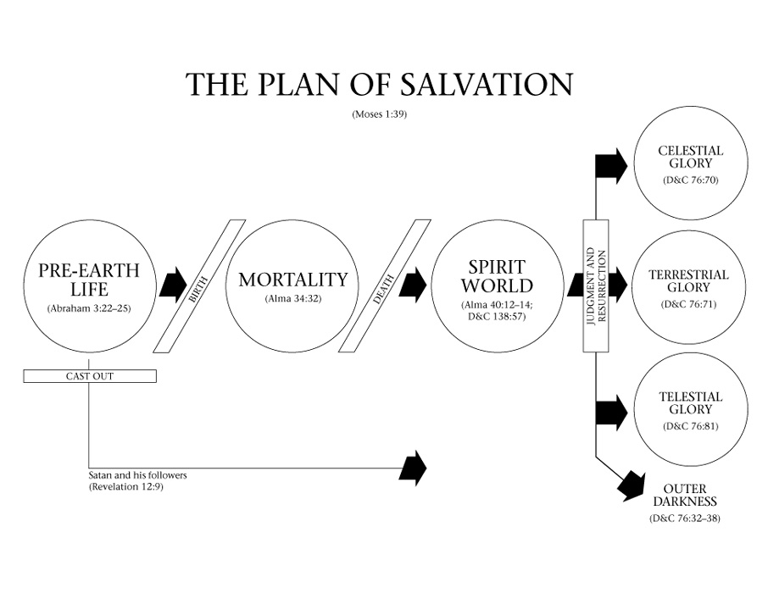
I bet you’ve all seen a diagram like this before… BUT…Do you know how to answer these questions:

Slide 3
What is the plan of salvation? What happened in my pre-mortal life? What is the purpose of life?

Slide 4
What is the Plan of Salvation?
Suggest some ways you could answer this question.
Continue thinking about your answers as we learn about the plan of salvation in today’s lesson.

Slide 5
What is a blueprint? How is a blueprint like the Plan of Salvation?
blue·print [bloo-print] noun a detailed outline or plan of action

Slide 6
Why is it important to have a blueprint before you start a project?
Like the designers and builders of our time, our loving and kind Father in Heaven and His Son have prepared plans, tools, and other resources for our use so that we can build and frame our lives to be sure and unshaken. The plan is the plan of salvation, the great plan of happiness. The plan lays out for us a clear picture and understanding of the beginning and the end and the essential steps, including ordinances, which are necessary for each of Father’s children to be able to return to His presence and dwell with Him forever. Elder Dean Davies

Slide 7
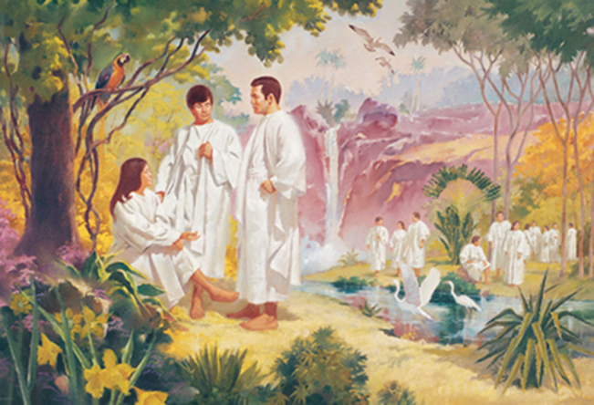
The Plan of Salvation
In the premortal existence, Heavenly Father prepared a plan to enable us to become like Him and receive a fulness of joy. The scriptures refer to this plan as “the plan of salvation”, “the great plan of happiness”, “the plan of redemption”, “the plan of mercy”

Slide 8
You are a participant in Heavenly Father’s plan, and your eternal experience can be divided into three main parts:
premortal life, mortal life, and life after death.
As you come
to understand the plan, you find answers to questions asked
by so many: Where did we come from? Why are we here?
Where do we go after this life?

Slide 9
Premortal Life
Quote#1 Before we were born, we lived with Heavenly Father as His spirit children. In the Council in Heaven, the Father presented to us His plan of salvation, and Jesus Christ was chosen to be our Savior. Satan sought to amend the plan, taking away our agency, and he and his followers were cast out. We accepted our Father’s plan and chose to follow Jesus Christ.
Revelation 12:7-9, 11

Slide 10
Premortal Life
Quote #2 Throughout your premortal life, you developed your identity and increased your spiritual capabilities. Blessed with the gift of agency, you made important decisions, such as the decision to follow Heavenly Father’s plan. These decisions affected your life then and now. You grew in intelligence and learned to love the truth, and you prepared to come to the earth, where you could continue to progress.
Abraham 3:22-23

Slide 11
Choices: Then & Now
Think about any righteous choices you have made in the past and how those decisions bless your life now.
Name a choice you made before you were born. How has this choice affected your life?
How can a knowledge of the premortal life affect the choices you make in this life?

Slide 12
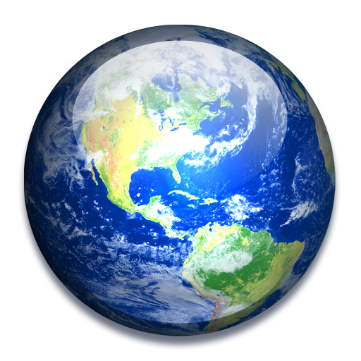
Mortal Life
You are now experiencing mortal life. Your spirit is united with your body, giving you opportunities to grow & develop in ways that were not possible in your premortal life.
This part of your existence is a time of learning in which you can prove yourself, choose to come unto Christ, & prepare to be worthy of eternal life. It is also a time when you can help others find the truth & gain a testimony of the plan of salvation.

Slide 13
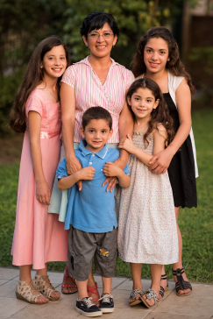
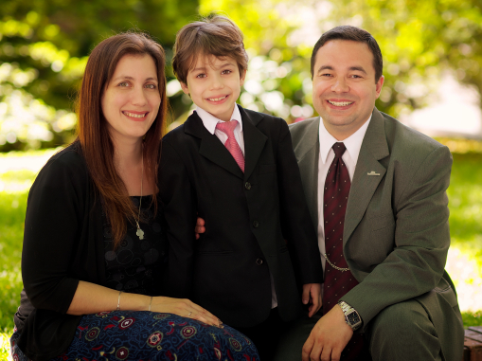
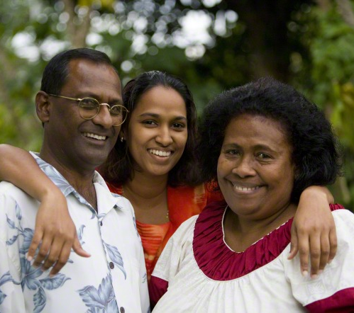
What is the purpose of life?
During this life we obtain physical bodies & are tested to see if we will obey God’s commandments. We came to earth to prepare to have an eternal family, bless God’s children, & build His kingdom. Our experiences during mortality are meant to help us become more like our Heavenly Father.

Slide 14
What is the purpose of life?
World’s View
Gospel’s View
Eat, drink & be merry
Have fun
Be wealthy
Be popular
Look attractive
Stay in fashion
Experience everything
Just relax
Have joy (2 Nephi 2:25)
Prepare to meet God (Alma 34:32)
Keep commandments (Abraham 3:25-26)
Learn to be Christlike (3 Nephi 12:48)
Build God’s Kingdom Serve Others (D&C 138:56)

Slide 15
We came to this Earth to gain a body. We also have the opportunity to participate in sacred ordinances & covenants & to exercise agency
In addition, As Daughters of our Heavenly Father We play a very special role in this mortal life.

Slide 16
We are essential to Heavenly Father’s Plan
Sisters, you are an essential part of our Heavenly Father’s plan for eternal happiness; you are endowed with a divine birthright. You are the real builders of nations wherever you live, because strong homes of love and peace will bring security to any nation. I hope you understand that, and I hope the men of the Church understand it too. Pres. Uchtdorf

Slide 17
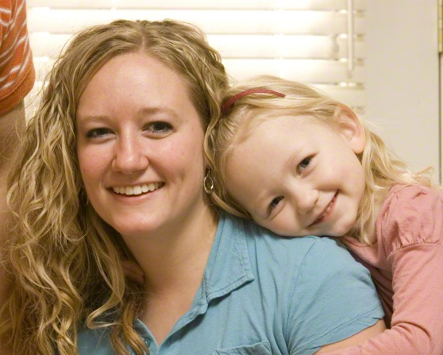
What you sisters do today will determine how the principles of the restored gospel can influence the nations of the world tomorrow. It will determine how these heavenly rays of the gospel will light every land in the future.
Though we often speak of the influence of women on future generations, please do not underestimate the influence you can have today.

Slide 18
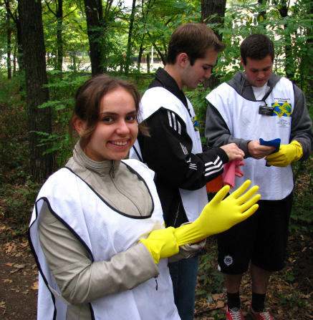
“Some of us look forward to a time in the future—salvation & exaltation in the world to come— but today is part of eternity.”
Live each day with purpose!
Be anxiously engaged in a good cause!
Have NO REGRETS!

Slide 19
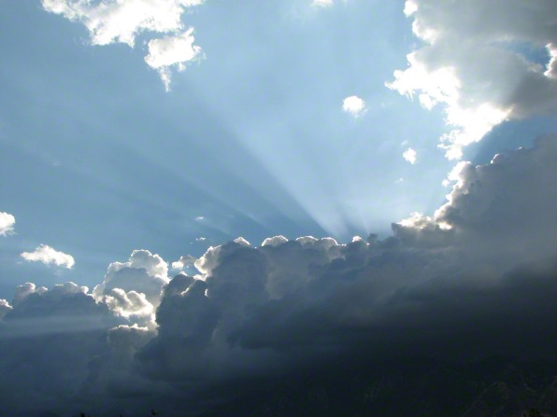
Life after Death
When you die, your spirit will enter the spirit world and await the resurrection. At the time of the resurrection, your spirit and body will reunite, and you will be judged and received into a kingdom of glory. The glory you inherit will depend on the depth of your conversion and your obedience to the Lord’s commandments. It will depend on the manner in which you have “received the testimony of Jesus”

Slide 20
My brothers and sisters, we know that death is not the end. This truth has been taught by living prophets throughout the ages. It is also found in our holy scriptures. In the Book of Mormon we read specific and comforting words:
“Now, concerning the state of the soul between death and the resurrection—Behold, it has been made known unto me by an angel, that the spirits of all men, as soon as they are departed from this mortal body, yea, the spirits of all men, whether they be good or evil, are taken home to that God who gave them life. “And then shall it come to pass, that the spirits of those who are righteous are received into a state of happiness, which is called paradise, a state of rest, a state of peace, where they shall rest from all their troubles and from all care, and sorrow.” (President Monson)

Slide 21
Many of the difficult choices we have to make become easier when we understand the plan of salvation. Knowing that we lived with our Heavenly Father before we were born and that He sent us here with a divine purpose can help us view our trials and challenges with an eternal perspective.

Slide 22
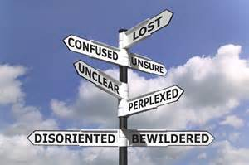
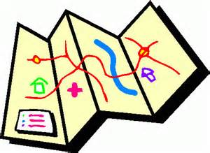
The Plan of Salvation keeps our lives focused. We know who we are, why we are here, & where we are going. Without this knowledge we could become lost.

Slide 23
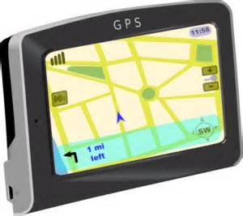
Because our Heavenly Father loves us, He sent us here with a very clear map back home. If you or someone you know feels a little lost… remind them about Heavenly Father’s GPS (Gospel Plan of Salvation)

