Slide 1
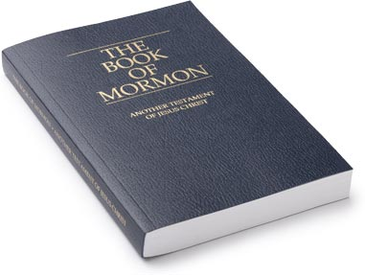
Why Do We Need The Book Of Mormon?

Slide 2
The Book of Mormon
The Book of Mormon was written for our day. It testifies of Jesus Christ, contains the fullness of His gospel, and restores truths lost through the Apostasy. Joseph Smith taught that the Book of Mormon is “the keystone of our religion, and a man would get nearer to God by abiding by its precepts, than by any other book”

Slide 3
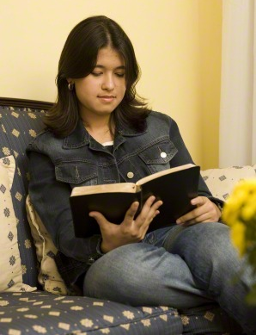
The Book of Mormon Testifies of Christ
How can we come to believe that Jesus Christ is our Savior if we don't know who He is or what He did? We can develop faith in Jesus Christ by reading about Him in the scriptures and praying to know if what we've read is true.

Slide 4
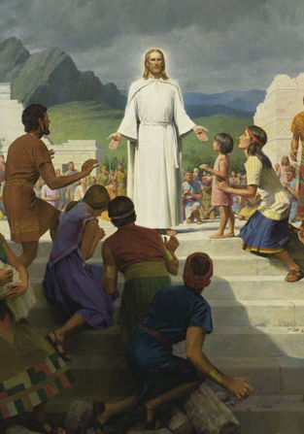
The Book of Mormon Testifies of Christ
The title page states that the Book of Mormon’s purpose is to convince all of us "that JESUS is the CHRIST, the ETERNAL GOD, manifesting himself unto all nations." It was written to help us develop a true knowledge of Jesus Christ and His mission on earth. The Book of Mormon reaffirms what we learn from the Bible, that Jesus Christ is the Son of God who came to earth to help us overcome our sins.

Slide 5
The Book of Mormon & The Bible Support Each Other
Some people think that because we read the Book of Mormon, we don't read the Bible. That's just not true. It's like saying that we don't eat oranges because we eat apples. Both are good fruit! The Book of Mormon is not a replacement for the Bible.
In fact, because the Book of Mormon and the Bible both contain the gospel of Jesus Christ as it was revealed to different civilizations, studying them together can clarify some concepts that are difficult to understand. The Book of Mormon tells us to read the Bible and affirms that its message is true.

Slide 6
The Book of Mormon & The Bible Support Each Other
The Book of Mormon is another witness of Jesus Christ and confirms the truths found in the Holy Bible. Far from undermining the Bible, the Book of Mormon supports its testimony of Jesus Christ. One passage says that the Book of Mormon “shall establish the truth” of the Bible “and shall make known to all kindreds, tongues, and people, that the Lamb of God is the Son of the Eternal Father, and the Savior of the world; and that all men must come unto him, or they cannot be saved” ( 1 Nephi 13:40).

Slide 7
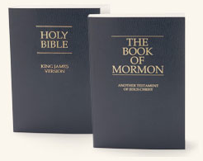
The Book of Mormon & the Bible
Both volumes of scripture are a compilation of teachings as recorded by ancient prophets. While the Bible details events in the eastern hemisphere, the Book of Mormon documents the lives of the inhabitants of the ancient Americas.
The book was written by many ancient prophets by the spirit of prophecy and revelation. “Their words, written on gold plates, were quoted and abridged by a prophet-historian named Mormon.

Slide 8
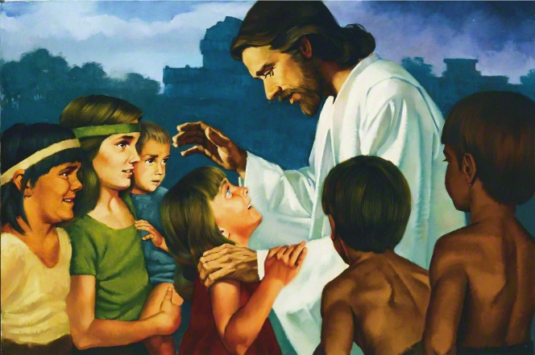
The Book of Mormon & The Bible Support Each Other
The Book of Mormon makes it clear that Jesus Christ's message and His atonement are not for one group of people at one time. They are for everyone, everywhere, from the beginning of the earth to the end. Having the Book of Mormon as another testament of Jesus Christ reminds us that He is mindful of every one of us.

Slide 9
The Book of Mormon Answers Questions of the Soul
Most of us have some hard questions in the back of our minds — the kind no one else can really answer for us. Some are far-reaching questions about the nature of our existence like the following:
Is there really a God?
Does God love me?
Does my life have purpose?
Did I exist before I was born?
What happens after I die?

Slide 10
The Book of Mormon Answers Questions of the Soul
As we read the Book of Mormon, we learn about the gospel and God’s Plan of Happiness. A knowledge of these things puts our questions in an eternal perspective.
From the scripture that says this life is "a time to prepare to meet God," for example, we learn that we will continue to exist after we die, and that by keeping the commandments we can return to heaven (Alma 12:24).

Slide 11
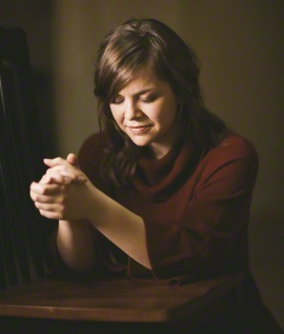
The Book of Mormon Answers Questions of the Soul
We also learn that repentance, forgiveness and the covenant to serve others are essential to our eternal salvation. Any of these questions of the soul can be answered by applying the gospel of Jesus Christ as it’s written in the Book of Mormon.

Slide 12
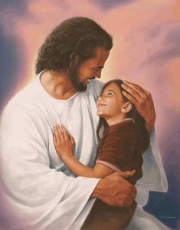
The Book of Mormon Draws People Closer to God.
Some descriptions of God make Him sound abstract & unapproachable, or angry & vengeful, but we learn in the Book of Mormon that "God is mindful of every people" (Alma 26:37) & that like the Book of Mormon prophet Lehi, we can be "encircled about eternally in the arms of his love" (2 Nephi 1:15).

Slide 13
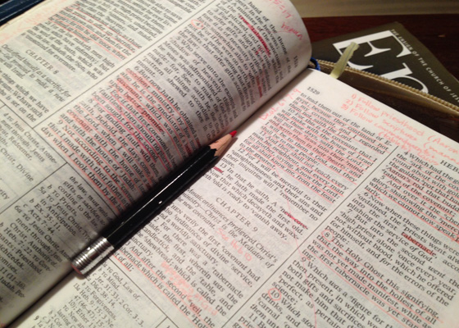
The Book of Mormon Draws People Closer to God.
Though we might not get to speak with God face-to-face in this life, He has given us the scriptures to help us draw closer to Him. Of the Book of Mormon, Joseph Smith said, "a man would get nearer to God by abiding by its precepts, than by any other book."
We get nearer to God by
building faith in Him, & we
build faith in Him when we
learn about His plan and
keep His commandments.

Slide 14
The Book of Mormon Draws People Closer to God.
The Book of Mormon teaches us God's plan and shows us how those who live according to His counsel are blessed in this life and the next. When we read prayerfully, the Holy Ghost can teach us, deep in our hearts, that the words in the Book of Mormon are a message to us from our Heavenly Father, sent to help us through this life.

Slide 15
Book of Mormon Video

Slide 16
How Can We Know The Book of Mormon Is True?
Of course it's one thing to read the Book of Mormon and another to believe deep in our hearts that what it says is true. This sincere belief, or testimony, in the truth of the Book of Mormon comes when God sends His Spirit to confirm the truth of what we read.
Through honest study and humble prayer, we can each know for ourselves that the Book of Mormon really is the word of God.

Slide 17
How Can We Know The Book of Mormon Is True?
We can feel a confirmation from the Holy Ghost when we study the Book of Mormon with diligence and faith, as we are promised in the following scripture:
"And when ye shall receive these things, I would exhort you that ye would ask God, the Eternal Father, in the name of Christ, if these things are not true; and if ye shall ask with a sincere heart, with real intent, having faith in Christ, he will manifest the truth of it unto you, by the power of the Holy Ghost. " (Moroni 10:4)

Slide 18
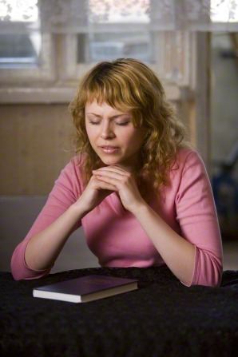
Heavenly Father’s Method
God's method is simple: we read the Book of Mormon; we pray and ask Him to tell us that what we've read is true and He answers us through feelings of peace and assurance given by the Holy Ghost.

Slide 19
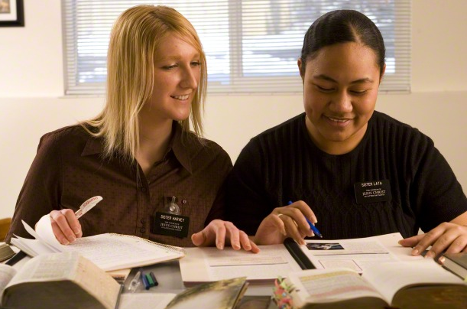
How Can We Know The Book of Mormon Is True?
First of all, we have to study the Book of Mormon diligently, applying its principles to our own lives and doing our best to understand the lessons that God wants us to learn.

Slide 20
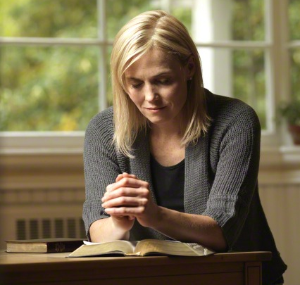
How Can We Know The Book of Mormon Is True?
Second, we have to pray "with a sincere heart, with real intent, having faith in Christ." We need to hope and believe that God will answer us, and we may have to pray more than once.

Slide 21
How Can We Know The Book of Mormon Is True?
Last, we need to be willing to accept the answer when it comes, however it may come. Believing that the Book of Mormon really contains the word of God means that we will be willing to live up to the standards of faith and obedience He describes in it.
God has promised that He will bless us with much more than it takes to live up to His high standards.

Slide 22
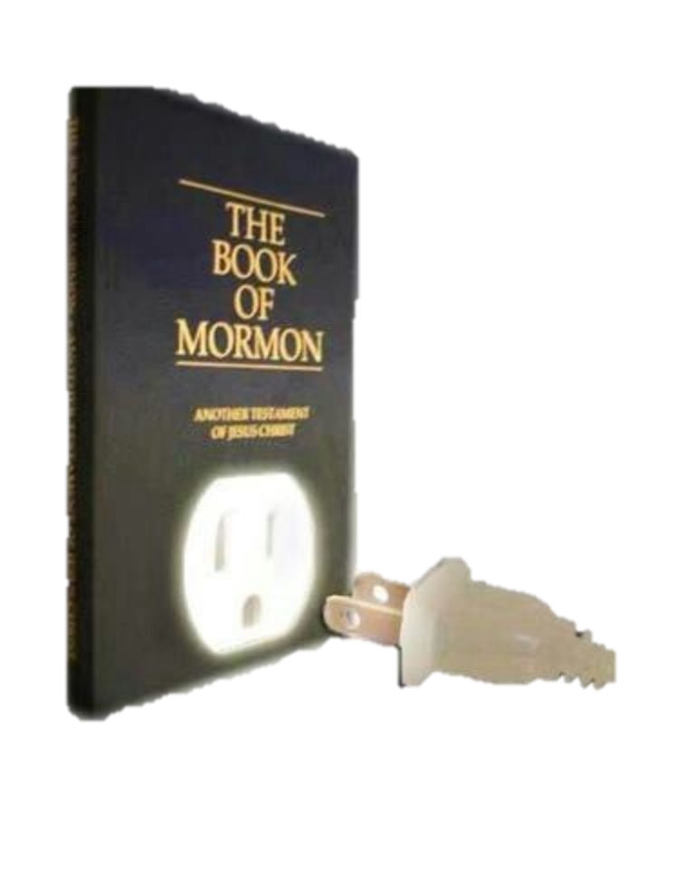
Power in the Book of Mormon
There is a power in the book which will begin to flow into your lives the moment you begin a serious study of the book. You will find greater power to resist temptation. You will find the power to avoid deception. You will find the power to stay on the strait and narrow path. Ezra Taft Benson

Slide 23
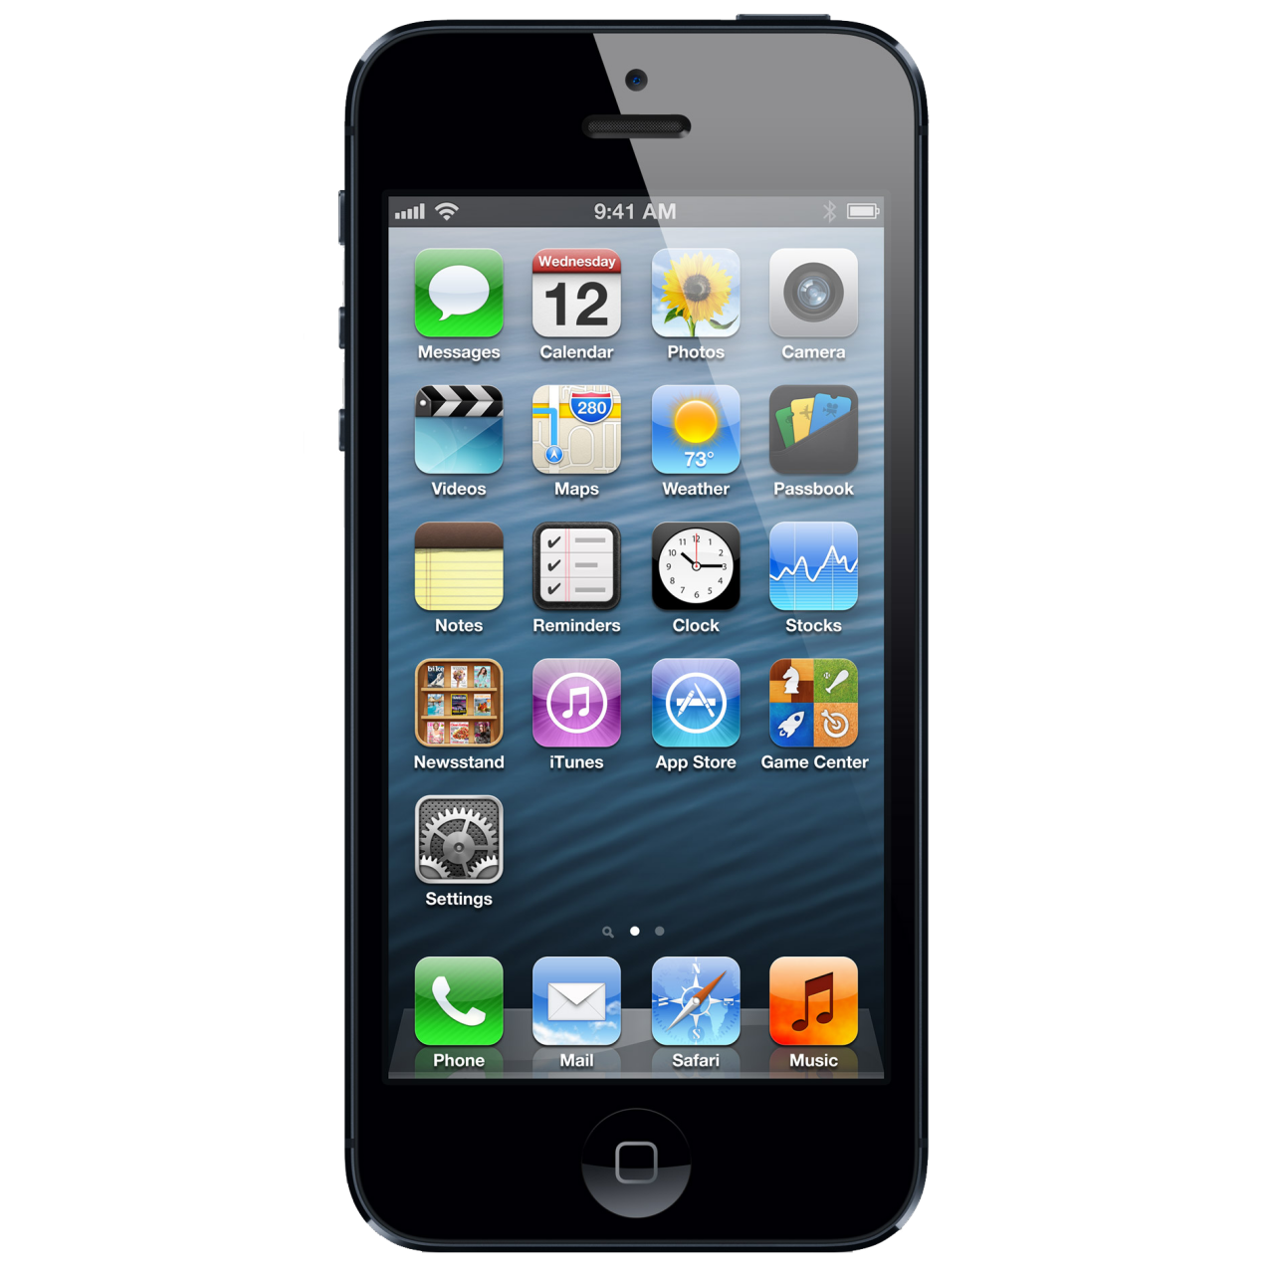
Book of Mormon vs. Cell Phones
I wonder what would happen if we treated our Book of Mormon like our cell phones? What if we carried it around in our purses or pockets? What if we turned back to get it if we forgot it? What if we flipped through it whenever we had a free second? What if we spent an hour or more using it each day? What if we used it to receive answers and ask questions? What if we treated it like we couldn't live without it? What if we used it as we traveled? What if we used it in case of an emergency? What if we felt lost without it!

Slide 24
You should feel lost without the Book of Mormon!
In Lehi’s vision of the tree of life we learn that the IRON ROD represents the word of God.
We know that by clinging to the rod we can avoid being lost in the mists of darkness.
The Book of Mormon and the Bible are the word of God. “Get A Grip!” Hang onto the rod like your life depends on it! Because it does!!!!

