Slide 1
Why Is Family Important?

Slide 2
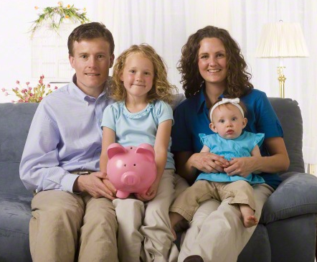
The Family
The family is ordained of God and is central to His plan for the eternal destiny of His children. This divine plan makes it possible for individuals to return to His presence and for families to be united eternally.

Slide 3
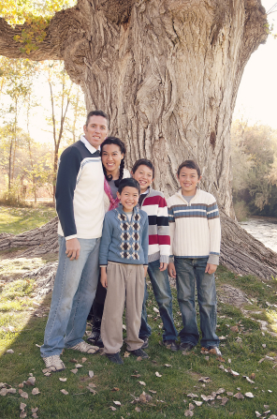
Family
Why is your family important to you?
Why do you think families are central to Heavenly Father’s plan of salvation?

Slide 4
Families are Blessings
Being part of a family is a great blessing. Your family can provide you with companionship and happiness, help you learn correct principles in a loving atmosphere, and help you prepare for eternal life.

Slide 5
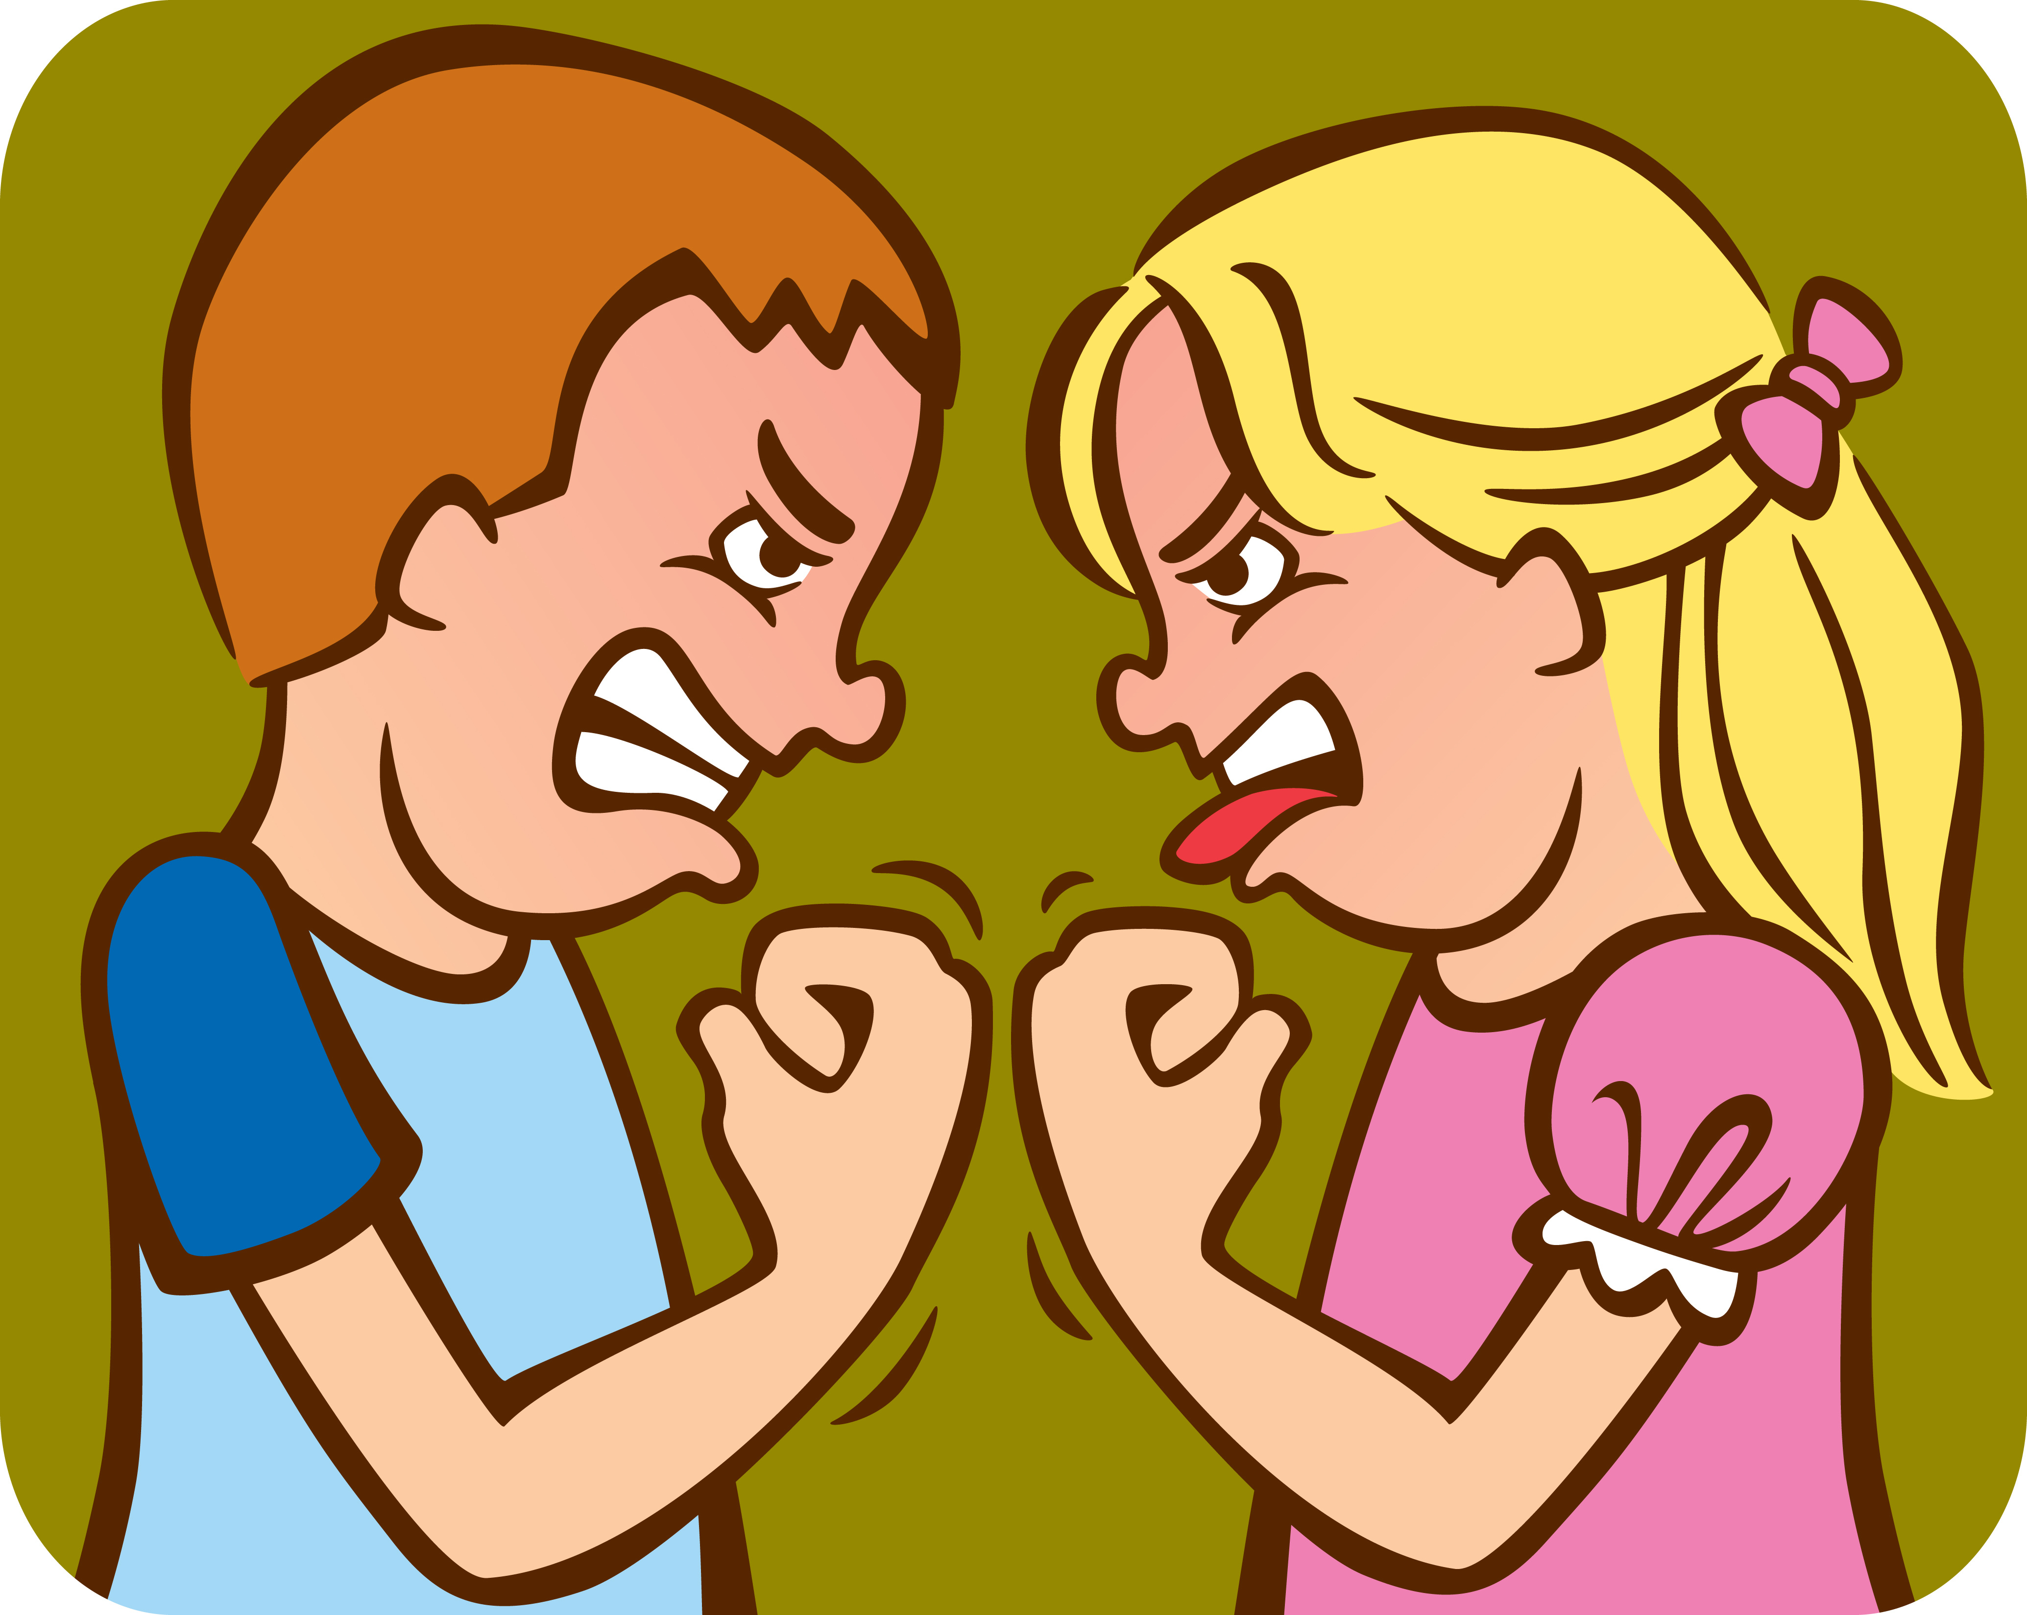
Do Your Part!
Strong families require effort. Your family will be blessed as you do your part to strengthen it. Be cheerful, helpful, and considerate of family members. Many problems in the home come from family members speaking and acting selfishly or unkindly. Seek to be a peacemaker rather than to tease, fight, and quarrel.

Slide 6
Show Love
Show love for your family members each day. Share your testimony with your family through words and actions. Your righteous example can make a difference in strengthening your family.

Slide 7
Honor & Obey
Honor your parents by showing love and respect for them. Obey them as they lead you in righteousness. Willingly help in your home.

Slide 8
Strengthen & Unify
Participate in wholesome family activities and traditions. Join your family in family prayer, family scripture study, and family home evenings. Keeping these commandments strengthens and unifies families.

Slide 9
Be an Example To Your Family
If your family does not do these things together, pray and study the scriptures yourself. Your example may encourage your family members to join you.

Slide 10
Be An Example To Those Around You!
Did you know that you can help change the world during your teenage years? You have the power within you to stand up for eternal truths that are being attacked in one of Satan’s biggest battles.
How can you do it? You can make a huge difference by being a defender of the family and letting those around you know that “the family is ordained of God. It is the most important unit in time and in eternity” (Administering the Church [2010], 2).

Slide 11
Defend The Family!
You can help change the world by standing up for what prophets have taught about the family.
You can help counter the destructive forces of Satan by standing up for the family through your actions and in your conversations at home, in the community, and even online. Here are several ways you can defend the family every day.

Slide 12
Put Family Time First
With so many sporting events, parties, school functions, and other activities in your schedule, it’s easy to say, “I’ll spend time with my family later—when things slow down.” But you’ll soon find that life will never slow down, so it’s important to give high priority to family activities now. Don’t underestimate the way you can defend the family unit just by participating in your family unit.

Slide 13
Strengthen Family Members
Look for ways to make life easier for your siblings and parents. Find something they need help with and do it, such as giving a hug to a brother who had a hard day at school or helping your sister when it’s her turn to do the dishes. When you support one another in your needs, your family will grow stronger as one. Remember that family happiness is a team effort.

Slide 14
Be An Example of Good Family Life
Do your part to make your home a holy place where others can feel the Spirit (see D&C 88:119) and where they can see what God’s plan for families is all about. Consider inviting friends over when your family spends time together so they can see the joy of family friendships.

Slide 15
Stand Up For Your Family
When conversations come up in school, work, and other activities—or even in text messages, e-mails, social networking sites, or online articles—where truths about the family are attacked, have the courage to defend the doctrines about Heavenly Father’s plan for families. The world continues to attack these eternal doctrines, and it’s up to you to be a voice of truth. The Spirit will help you know what to say.

Slide 16
Be Aware of How Media Portrays Families
“Satan uses media to deceive you by making what is wrong and evil look normal, humorous, or exciting. He tries to mislead you into thinking that breaking God’s commandments is acceptable and has no negative consequences for you or others. … Have the courage to walk out of a movie, change your music, or turn off a computer, television, or mobile device if what you see or hear drives away the Spirit” ([2011], 11).
When you choose media that support the principles of an eternal family, it will be easier to strengthen the family and also prepare for a future temple marriage.

Slide 17
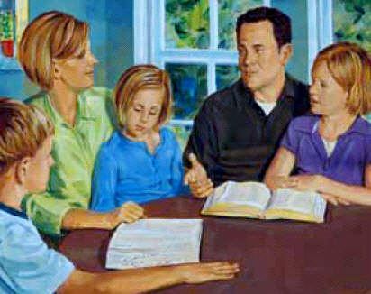
Develop Habits Today That You Want In Your Future Family
Even if you don’t come from a strong family, you can make your future family strong as you prepare for and worthily marry in the temple and seek to raise a righteous family of your own. Think about the types of things you want to do in your future family, and start those habits today. For example, even if your family doesn’t have daily scripture study, you can study the scriptures on your own each day.
By forming that habit now, it will be easy to hold family scripture study when you get married.

Slide 18
Defender of The Family
Sister Julie B. Beck, Relief Society general president, has said to the young members of the Church, “This generation will be called upon to defend the doctrine of the family as never before” (“Teaching the Doctrine of the Family,” Ensign, March 2011, 17).
When you do this and live as a defender of the family, you can change your future and your family’s future and also be a part of a generation that can change the future of the world as you protect the family together. Even if you don’t see immediate results, your actions will be an influence for good in supporting Heavenly Father’s plan for eternal families.

