Slide 1
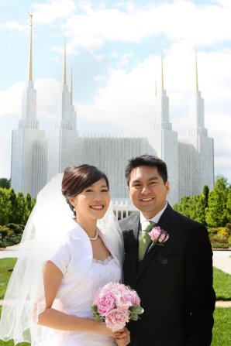
Why Is Temple Marriage Important?

Slide 2
Why Temple Marriage? August 2013 New Era, Joshua Perkey
There’s been a lot of talk lately about marriage—what it is, why we have it, the role it plays in society. In church we talk a lot about temple marriage. You know it’s important because you’ve heard about this since you were taught your first lessons about the gospel...

Slide 3
You Want To Know In Your Heart & Mind!
Some of you may be wondering, “Why?” To you it may be more than a question of what temple marriage is all about. You want to know—in your heart, not just in your mind—why you should work so hard to marry in the temple, especially when marriage as an idea and institution seems to be weakening in societies all over the world.

Slide 4
In the world today, many people dismiss & even mock marriage & the family. Amid such confusing & destructive voices, the First Presidency & Quorum of the Twelve Apostles provide the consistent voice of truth. They “solemnly proclaim that marriage between a man & a woman is ordained of God & that the family is central to the Creator’s plan for the eternal destiny of His children”

Slide 5
Greater Possibilities For Happiness
[The] proclamation on the family helps us realize that celestial marriage brings greater possibilities for happiness than does any other relationship. Russell M. Nelson

Slide 6
Joy Is Found In the Family
Life’s greatest joys are found in the family. Strong family relationships require effort, but such effort brings great happiness in this life and throughout eternity.
Even if you have not had a happy family life in the past, you can seek to have a happy, eternal marriage and a loving relationship with family members.

Slide 7
The Doctrine of The Family

Slide 8
Doctrine of the Family...
“The Family: A Proclamation to the World” states, “Marriage between a man and a woman is ordained of God and … the family is central to the Creator’s plan for the eternal destiny of His children.” In other words, when we talk about why we are here on the earth and what we are meant to accomplish and become, it’s all tied to the idea that we are part of a family and can marry and establish new families.

Slide 9
It’s Why We Are Here On Earth
The earth was created and this Church was restored so that families could be formed, sealed, and exalted eternally. Russell M. Nelson

Slide 10
Doctrine of the Family...
The family proclamation also states: “The divine plan of happiness enables family relationships to be perpetuated beyond the grave. Sacred ordinances and covenants available in holy temples make it possible for individuals to return to the presence of God and for families to be united eternally.”

Slide 11
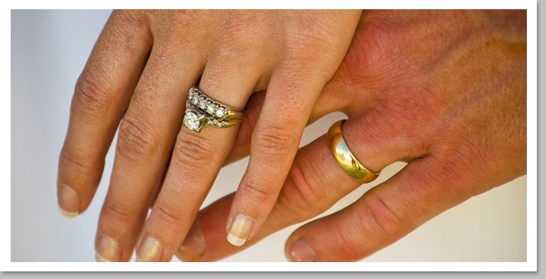
What Happens When We Die?
But what happens to our families when we die? If you are married by the law of your state or country, will that law have any authority over you when you die? No, because those laws are made by man and have authority only as long as you live under that authority. August 2013 New Era

Slide 12
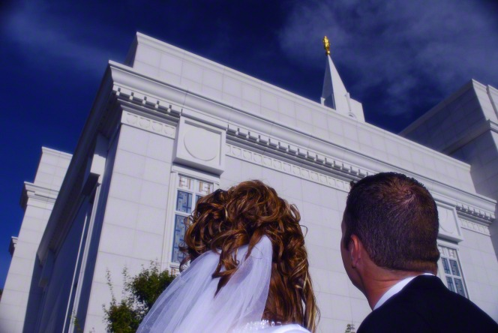
For marriage relationships to continue after you die, those marriages must be sealed together in the right place with authority that lasts through the eternities. That place is the temple, & that authority is the priesthood (D&C 132:7, 15–19). By choosing a temple marriage and keeping those covenants, you choose to be able to live forever with your spouse.

Slide 13
Temple Marriage Brings True Joy
Maybe you already know that doctrine, and yet you still wonder, “But why else does it matter so much?” Maybe it’s not a matter of understanding the doctrine. Maybe it’s more a simple question of what marriage and family mean in your heart.
The simple answer is that the greatest happiness and joy available to us come through living the gospel and gaining and maintaining a temple marriage.

Slide 14
True Joy
In this world abounding with misery, we are truly thankful for God’s “great plan of happiness.” His plan declares that men and women are “that they might have joy.” That joy comes when we choose to live in harmony with God’s eternal plan. (Russell M. Nelson)

Slide 15
Happiness & Joy
In the April 2013 general conference, Elder L. Whitney Clayton of the Presidency of the Seventy explained it this way: “No other relationship of any kind can bring as much joy, generate as much good, or produce as much personal refinement.”
We also know that “happiness in family life is most likely to be achieved when founded upon the teachings of the Lord Jesus Christ.”

Slide 16
Follow The Gospel Path
The gospel is what life is all about. It’s the whole reason we are here. When we follow the gospel path, it leads to joy. And that path leads to a temple marriage, either in this life or in the life to come. No blessings will be withheld from the Father’s faithful children.

Slide 17
“The most important single thing that any Latter-day Saint ever does in this world is to marry the right person, in the right place, by the right authority.” Bruce R. McKonkie

Slide 18
The Most Important Covenant
If you think about it, you’ll spend a large part of your life preparing for big changes that come along. The most important covenant we prepare for is being sealed in the temple.

Slide 19
Continue In Faithfulness
After receiving the sealing ordinance and making sacred covenants in the temple, a couple must continue in faithfulness in order to receive the blessings of eternal marriage and exaltation.

Slide 20
The important choice [of marriage] may be illustrated by a homespun concept that came to mind one day when I was shopping in a large retail store. I call it “patterns of the shopper.” Russell M. Nelson
“Patterns of a Shopper”

Slide 21
Wise Shoppers
Wise shoppers study their options thoroughly before they make a selection. They focus primarily on the quality and durability of a desired product. They want the very best.

Slide 22
Bargain Shoppers & Those Who Splurge
In contrast, some shoppers look for bargains, and others may splurge, only to learn later—much to their dismay—that their choice did not endure well.

Slide 23
Shoplifters
And sadly, there are those rare individuals who cast aside their personal integrity and steal what they want. We call them shoplifters.

Slide 24
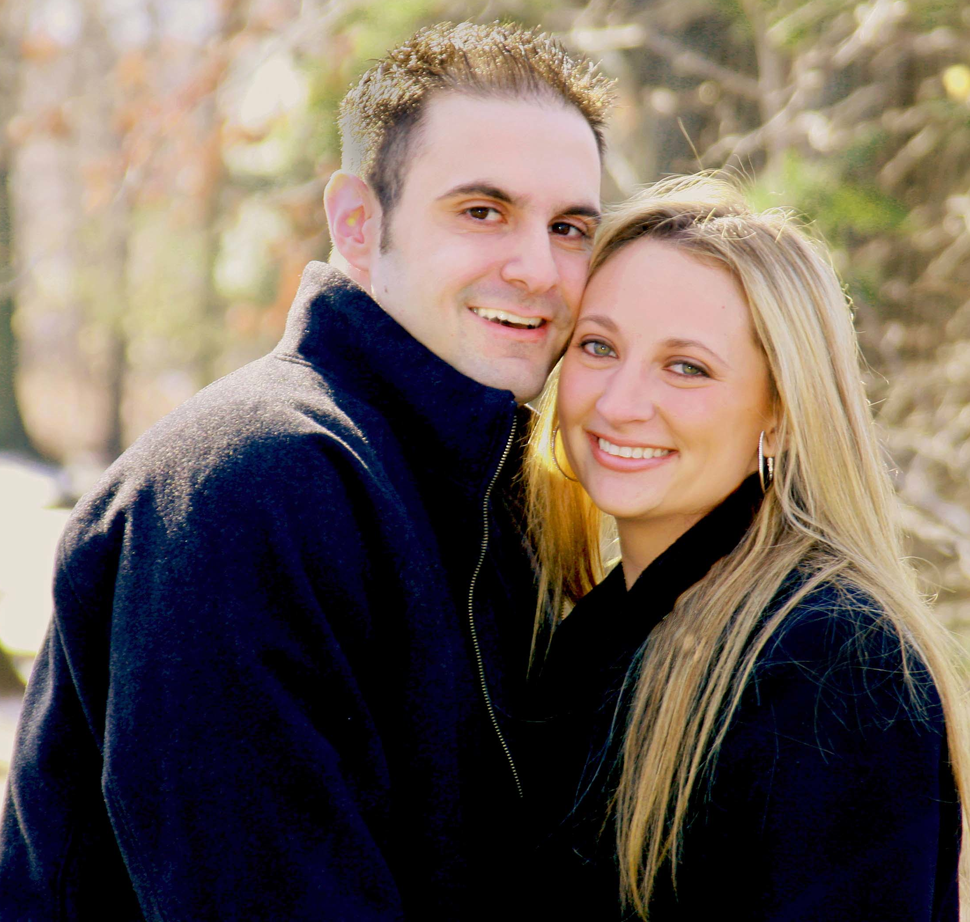
The patterns of the shopper may be applied to the topic of marriage. A couple in love can choose a marriage of the highest quality or a lesser type that will not endure. Or they can choose neither and brazenly steal what they want as “marital shoplifters.”
VS.

Slide 25
Russell M. Nelson
My purpose in speaking out on this topic is to declare, as an Apostle of the Lord, that marriage between a man and a woman is sacred—it is ordained of God. I also assert the virtue of a temple marriage. It is the highest and most enduring type of marriage that our Creator can offer to His children.

Slide 26
Necessary For Exaltation
While salvation is an individual matter, exaltation is a family matter. Only those who are married in the temple and whose marriage is sealed by the Holy Spirit of Promise will continue as spouses after death and receive the highest degree of celestial glory, or exaltation.
Celestial Glory Terrestrial Glory Telestial Glory

Slide 27
Choose For Ourselves
God’s plan of happiness allows us to choose for ourselves. As with the patterns of the shopper, we may choose celestial marriage or lesser alternatives. Some marital options are cheap, some are costly, and some are cunningly crafted by the adversary. Beware of his options; they always breed misery!

Slide 28
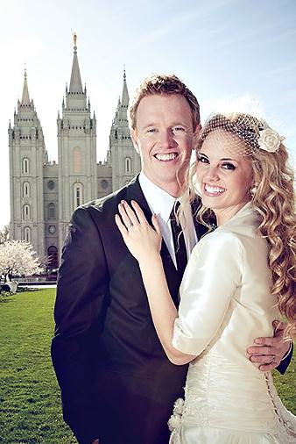
This Goal Is Glorious!
The noblest yearning of the human heart is for a marriage that can endure beyond death. Fidelity to a temple marriage does that. It allows families to be together forever.
This goal is glorious.

Slide 29
