Slide 1
Why is Chastity Important?

Slide 2
What Is Chastity Anyway?
Chastity is sexual purity and involves being morally clean in thoughts, words, and actions.
Sexual intimacy is ordained of God for the creation of children and for the expression of love between husband and wife.
God has commanded that sexual intimacy be reserved for marriage.
When we are sexually pure, we qualify for the companionship of the Holy Ghost, and we are protected from the emotional and spiritual damage of sexual sin.

Slide 3
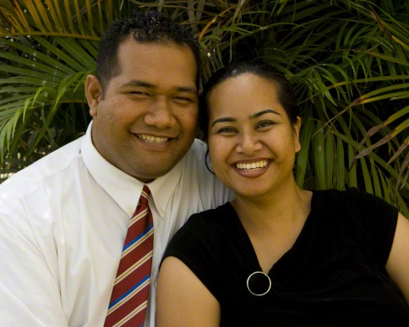
Undeviating Standards
The Church of Jesus Christ of Latter-day Saints has a single, undeviating standard of sexual morality: intimate relations are proper only between a man and a woman in the marriage relationship prescribed in God’s plan. Such relations are not merely a curiosity to be explored, an appetite to be satisfied, or a type of recreation or entertainment to be pursued selfishly. They are not a conquest to be achieved or simply an act to be performed. (Elder Bednar)

Slide 4
Bridle Our Passions
Intimate relations are in mortality one of the ultimate expressions of our divine nature and potential and a way of strengthening emotional and spiritual bonds between husband and wife.
That is the test. Every appetite, desire, propensity, and impulse of the natural man may be overcome by and through the Atonement of Jesus Christ. We are here on the earth to develop godlike qualities and to bridle all of the passions of the flesh. (Elder Bednar)

Slide 5
Satan Will Tempt Us
Because a physical body is so central to the Father’s plan of happiness and our spiritual development, Lucifer seeks to frustrate our progression by tempting us to use our bodies improperly.
One of the ultimate ironies of eternity is that the adversary, who is miserable precisely because he has no physical body, entices us to share in his misery through the improper use of our bodies. (Elder Bednar)

Slide 6
Counterfeit Companionship
Violating the law of chastity is a grievous sin and a misuse of our physical tabernacles. To those who know and understand the plan of salvation, defiling the body is an act of rebellion (see Mosiah 2:36–37; D&C 64:34–35) and a denial of our true identity as sons and daughters of God. As we look beyond mortality and into eternity, it is easy to discern that the counterfeit companionship advocated by the adversary is temporary and empty. (Elder Bednar)

Slide 7
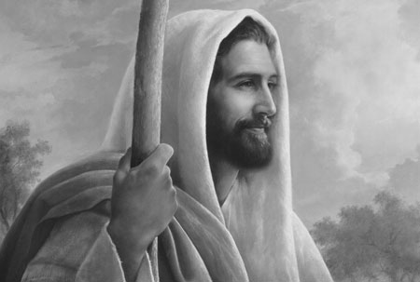
The Soul Is At Stake
Please, never say: “Who does it hurt? Why not a little freedom? I can transgress now and repent later.” Please don’t be so foolish & so cruel. Why? Well, for one reason because of the incalculable suffering in both body & spirit endured by the Savior of the world so that we could flee ( D&C 19:15–20). We owe Him something for that. Indeed, we owe Him everything for that. In sexual transgression the soul is at stake—the body & the spirit. (Elder Holland)

Slide 8
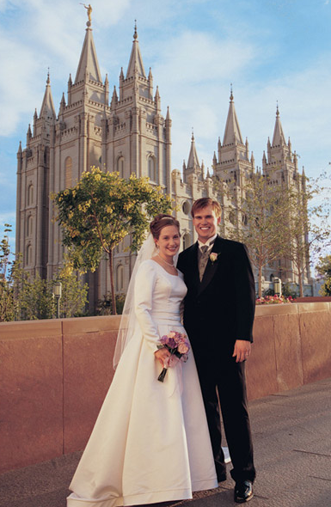
You Must Wait!
In matters of human intimacy, you must wait! You must wait until you can give everything, and you cannot give everything until you are legally and lawfully married.

Slide 9
Blessings Will Come

Slide 10
Blessings of being chaste
“Here is … the Savior’s promise: ‘Let virtue garnish thy thoughts unceasingly; then shall thy confidence wax strong in the presence of God’ (D&C 121:45)” (“Trust in the Lord,” Ensign, May 1979, 42).
When you are sexually pure, you prepare yourself to make and keep sacred covenants in the temple. You prepare yourself to build a strong marriage and to bring children into the world as part of an eternal and loving family.

Slide 11
Blessings of Being Chaste
You protect yourself from the spiritual and emotional damage that come from sharing sexual intimacy outside of marriage.
You also protect yourself from harmful diseases.
Remaining sexually pure helps you to be confident and truly happy and improves your ability to make good decisions now and in the future. (For The Strength of The Youth)
VIRTUE

Slide 12
Promised Blessings
We also are promised that, as we pursue the pathway of virtue, “the Holy Ghost shall be [our] constant companion” (D&C 121:46). Thus, living the law of chastity invites some of the greatest blessings men and women can receive in mortality: appropriate spiritual confidence in the presence of family, friends, Church associates, and, ultimately, the Savior.

Slide 13
Increase Our Happiness
The Lord’s truth is not altered by fads, popularity, or public opinion polls. I promise that obedience to the law of chastity will increase our happiness in mortality and make possible our progress in eternity. Chastity and virtue are now, always have been, and always will be “most dear and precious above all things” (Moroni 9:9).

Slide 14
Reserved For Marriage

Slide 15
Terrible Risks
If you persist in pursuing physical satisfaction without the sanction of heaven, you run the terrible risk of such spiritual, psychic damage that you may undermine both your longing for physical intimacy and your ability to give wholehearted devotion to a later, truer love.

Slide 16
Your Very Best Gift
You may discover to your horror that what you should have saved you have spent, and that only God’s grace can recover the virtue you so casually gave away. On your wedding day the very best gift you can give your eternal companion is your very best self—clean and pure and worthy of such purity in return.

Slide 17
But What If We Love Each Other?
Sometimes people try to convince themselves that sexual relations outside of marriage are acceptable if the participants love one another. This is not true. Breaking the law of chastity and encouraging someone else to do so is not an expression of love. People who love each other will never endanger one another’s happiness and safety in exchange for temporary personal pleasure.

Slide 18
But what if we “love” each other?
When people care for one another enough to keep the law of chastity, their love, trust, and commitment increase, resulting in greater happiness and unity.
In contrast, relationships built on sexual immorality sour quickly. Those who engage in sexual immorality often feel fear, guilt, and shame. Bitterness, jealousy, and hatred soon replace any positive feelings that once existed in their relationship.
Our Heavenly Father has given us the law of chastity for our protection. Obedience to this law is essential to personal peace and strength of character and to happiness in the home. (True to the Faith)

Slide 19
Reserved For Marriage
Human intimacy is reserved for a married couple because it is the ultimate symbol of total union, a totality and a union ordained and defined by God. From the Garden of Eden onward, marriage was intended to mean the complete merger of a man and a woman—their hearts, hopes, lives, love, family, future, everything.

Slide 20
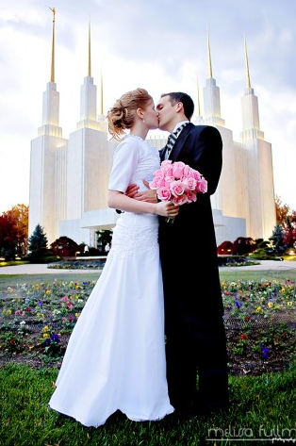
Physical intimacy is beautiful and sacred
Physical intimacy between husband and wife is beautiful and sacred. It is ordained of God for the creation of children and for the expression of love within marriage.
In the world today, Satan has led many people to believe that sexual intimacy outside of marriage is acceptable. But in God’s sight, it is a serious sin. It is an abuse of the power He has given us to create life.

Slide 21
What Things Can I Do To Avoid Breaking the Law of Chastity?

Slide 22
Control your thoughts Avoid Pornography Treat others with respect Avoid tempting situations Listen to the Spirit Pray for help Ask for help Make a commitment now!

Slide 23
Control Your Thoughts
Control your thoughts. No one commits sexual sin in an instant. Immoral acts always begin with impure thoughts. If you allow your thoughts to linger on obscene or immoral things, you have already taken the first step toward immorality.
Flee immediately from situations that may lead to sin.
Pray for constant strength to resist temptation and control your thoughts. Make this a part of your daily prayers. (True to The Faith)

Slide 24
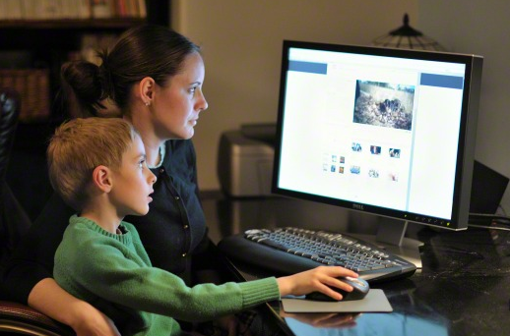
Avoid Pornography of All Kinds
Stay away from pornography. Do not view, read, or listen
to anything that depicts or describes the human body or sexual
conduct in a way that can arouse sexual feelings.
Pornographic materials are addictive and destructive. They
can rob you of your self-respect and of a sense of the beauties
of life. They can tear you down and lead you to evil thoughts
and abusive conduct.

Slide 25
Treat Others With Respect
Treat others with respect, not as objects used to satisfy lustful and selfish desires. Before marriage, do not participate in passionate kissing, lie on top of another person, or touch the private, sacred parts of another person’s body, with or without clothing. Do not do anything else that arouses sexual feelings. Do not arouse those emotions in your own body.(For the strength of the youth) Carefully plan positive and constructive activities so that you and your date are not left alone without anything to do. Stay in areas of safety where you can easily control yourself.

Slide 26
Avoid Tempting Situations
Avoid situations that invite increased temptation, such as late-night or overnight activities away from home or activities where there is a lack of adult supervision. Do not participate in discussions or any media that arouse sexual feelings.

Slide 27
Listen to the Spirit
Pay attention to the promptings of the Spirit so that you can be clean and virtuous. The Spirit of the Lord will withdraw from one who is in sexual transgression.
The Spirit can help you know when you are at risk and give you the strength to remove yourself from the situation. Have faith in and be obedient to the righteous counsel of your parents and leaders.

Slide 28
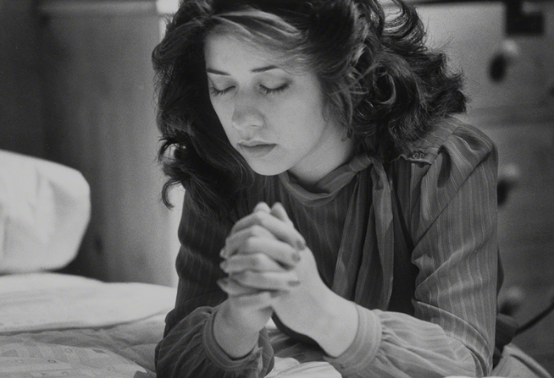
Pray for Help
Pray to your Father in Heaven, who will help you resist temptation and overcome inappropriate thoughts and feelings. No matter how strong temptations seem, the Lord will help you withstand them if you choose to follow Him.
The Apostle Paul declared, “There hath no temptation taken you but such as is common to man: but God is faithful, who will not suffer you to be tempted above that ye are able; but will with the temptation also make a way to escape, that ye may be able to bear it” (1 Corinthians 10:13).

Slide 29
Ask for Help
If you are tempted to commit any form of sexual transgression, seek help from your parents and bishop.
Your church leaders and righteous friends can also help you avoid temptations.

Slide 30
Make Your Commitment Now!
Decide now to be chaste. You need to make this decision only once. Make the decision now, before the temptation comes, and let your decision be so firm and with such deep commitment that it can never be shaken. Determine now that you will never do anything outside of marriage to arouse the powerful emotions that must be expressed only in marriage. Do not arouse those emotions in another person’s body or in your own body. Determine and commit now that you will keep the law of chastity.
(True to the Faith)

Slide 31
Personal Purity
My beloved young friends, can you see why personal purity is such a serious matter? Don’t be deceived and don’t be destroyed. Unless such powers are controlled and commandments kept, your future may be burned; your world could go up in flames. Penalty may not come on the precise day of transgression, but it comes surely and certainly enough. (Elder Holland)

Slide 32
Spiritual Scars
The body is something to be kept pure and holy. Do not be afraid of soiling its hands in honest labor. Do not be afraid of scars that may come in defending the truth or fighting for the right, but beware scars that spiritually disfigure, that come to you in activities you should not have undertaken, that befall you in places where you should not have gone.

Slide 33
The Savior’s Atonement
If some few of you are carrying such wounds—and I know that you are—to you is extended the peace and renewal of repentance available through the atoning sacrifice of the Lord Jesus Christ.
In such serious matters the path of repentance is not easily begun nor painlessly traveled. But the Savior of the world will walk that essential journey with you.
He will strengthen you when you waver. He will be your light when it seems most dark. He will take your hand and be your hope when hope seems all you have left. His compassion and mercy, with all their cleansing and healing power, are freely given to all who truly wish complete forgiveness and will take the steps that lead to it. (Elder Holland)

Slide 34
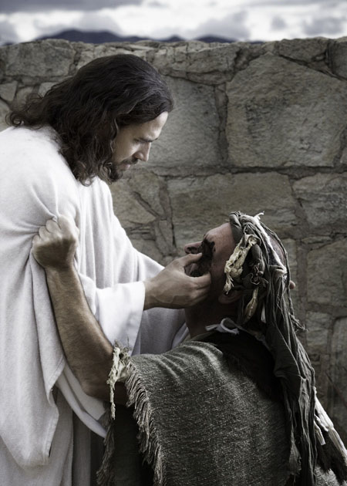
Principle of Repentance
The Savior is often referred to as the Great Physician, and this title has both symbolic and literal significance. All of us have experienced the pain associated with a physical injury or wound. When we are in pain, we typically seek relief and are grateful for the medication and treatments that help to alleviate our suffering.

Slide 35
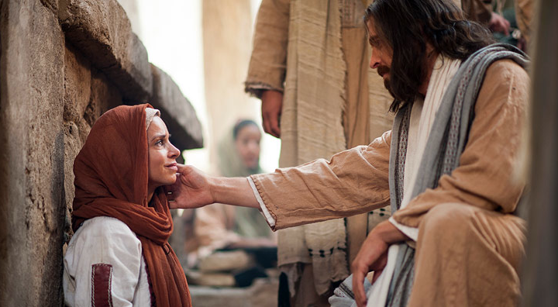
Principle of Repentance
Consider sin as a spiritual wound that causes guilt.
Guilt is to our spirit what pain is to our body—a warning of danger & a protection from additional damage.
From the Atonement of the Savior flows the soothing salve that can heal our spiritual wounds and remove guilt. However, this salve can only be applied through the principles of faith in the Lord Jesus Christ, repentance, and consistent obedience. The results of sincere repentance are peace of conscience, comfort, & spiritual healing and renewal.

Slide 36
Summary...
Hopefully after hearing this lesson you can answer the following questions:
What is Chastity?
What is the Church’s standards?
Why must we wait?
What Blessings come from being chaste?
Why is human intimacy reserved for marriage?
What can I do to keep myself chaste?
What do I do if I’ve made mistakes?

