Slide 1
How Can I Invite Others To Come Unto Christ?

Slide 2
Does It Make You Nervous?
In the October 2013 general conference, President Thomas S. Monson reminded us how important it is to help others come unto Christ. For many of us, sharing the gospel can feel intimidating, though. After all, have you ever felt nervous about talking to others about the gospel or the Church? (March 2014 New Era)

Slide 3
We Want To Share...
Most active members of the Church want the blessings of the gospel to be part of the lives of others whom they love, even those whom they have never met. But we also know that many members hesitate to do missionary work and share the gospel for two basic reasons.
The first one is fear. Many members do not even pray for opportunities to share the gospel, fearing that they might receive divine promptings to do something they think they are not capable of doing.
The second reason is misunderstanding of what missionary work is.
M. Russell Ballard

Slide 4
Replace Fear With Faith
Elder M. Russell Ballard of the Quorum of the Twelve Apostles taught that there is a way to overcome that fear. He said, “Fear will be replaced with faith and confidence when members and the full-time missionaries kneel in prayer and ask the Lord to bless them with missionary opportunities.
Then we must watch for opportunities to share the gospel. Don’t force it... Responses will flow as a natural result of our love for our brothers and sisters. Just be positive, and those whom you speak with will feel your love.”

Slide 5
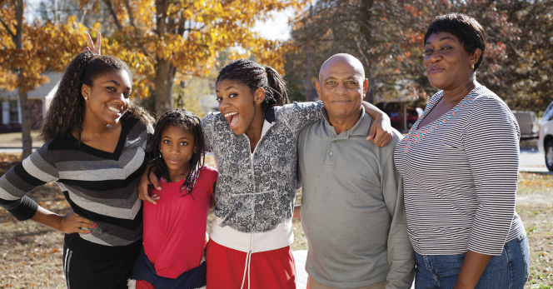
Love Others

Slide 6
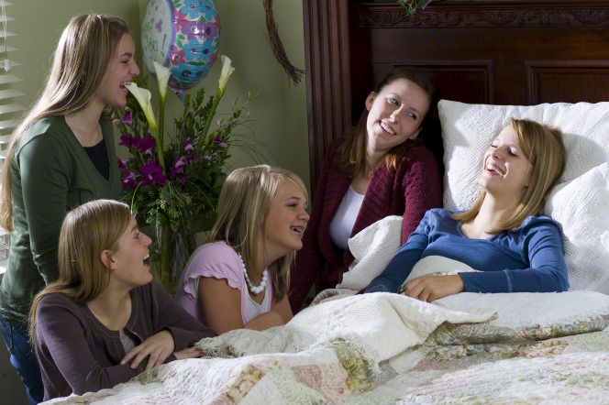
Sincerely Love
How can each of us become such a significant influence? We must be sure to sincerely love those we want to help in righteousness so they can begin to develop confidence in God’s love. (Richard G. Scott)

Slide 7
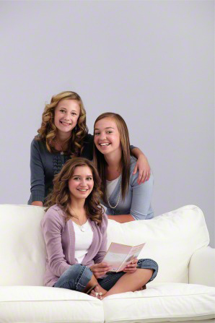
Love
For so many in the world, the first challenge in accepting the gospel is to develop faith in a Father in Heaven, who loves them perfectly. It is easier to develop that faith when they have friends or family members who love them in a similar way. (Richard G. Scott)

Slide 8
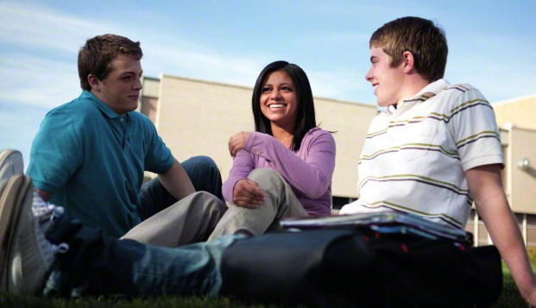
Ask Questions
Encourage those you love to seek to understand what the Lord would have them do. One way to do this is to ask them questions that make them think and then allow them sufficient time—whether hours, days, months, or more—to ponder and seek to work out the answers for themselves. (Richard G. Scott)

Slide 9
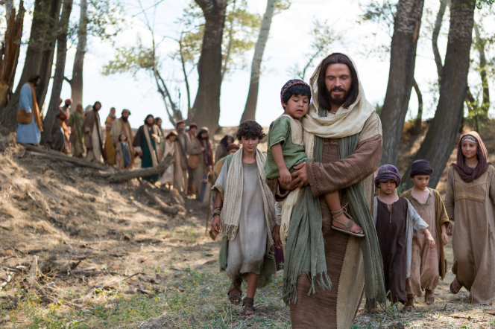
The Lord Needs Our Help

Slide 10
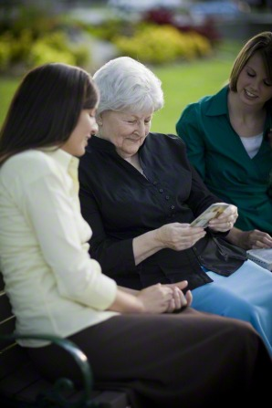
It’s Our Responsibility
Each member of the Church has the responsibility to help others come unto Christ and receive the blessings of His restored gospel.

Slide 11
On The Lord’s Errand
It is impossible for us to fail when we do our best when we are on the Lord’s errand. While the outcome is a result of the exercise of one’s agency, sharing the gospel is our responsibility. (M. Russell Ballard)

Slide 12
Reach Out To The “One”
We are not asking everyone to do everything. We are simply asking all members to pray, knowing that if every member, young and old, will reach out to just “one” [lives will be changed] (M. Russell Ballard)

Slide 13
Be Thou An Example
Our testimonies and our good examples can inspire our friends and neighbors to want to learn more about the Savior and His gospel.
1 Timothy 4:12
12 Let no man despise thy youth; but be thou an example of the believers, in word, in conversation, in charity, in spirit, in faith, in purity.

Slide 14
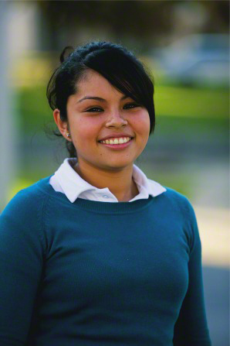
Can I Really Make A Difference?

Slide 15
What Can I Do?
Pray for opportunities
Invite friends to youth activities
Invite friends to seminary
Invite friends to play church sports
Be a positive example
Live your standards
Listen to others when they talk about their beliefs.
Smile. Really. It’s just that simple sometimes.
Always treat people kindly, even when they are unkind to you.
Strengthen your testimony—pray, study the scriptures, and participate fully in the Church. The depth of your conversion will shine through.
Use social media to spread goodness.
What are some other ideas?

Slide 16
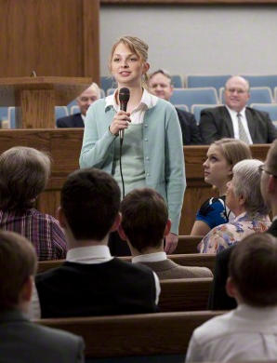
Your Testimony Is A Powerful Tool
Your personal testimony of the Atonement of Jesus Christ is a powerful tool. Accompanying resources are prayer, the Book of Mormon and the other scriptures, and your commitment to priesthood ordinances. All of these will facilitate the direction of the Spirit, which is so crucially important for you to rely upon. (Richard G. Scott)

Slide 17
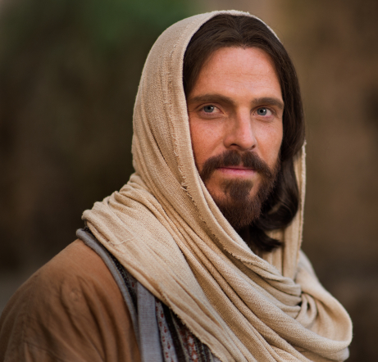
The Atonement
To be effective and to do as Christ has done, concentrate on this basic principle of the gospel: the Atonement of Jesus Christ makes possible our becoming more like our Father in Heaven so that we can live together eternally in our family units.
There is no doctrine more fundamental to our work than the Atonement of Jesus Christ. (Richard G. Scott)

Slide 18
Focus On Basic Principles
Sometimes...we become so consumed by mundane responsibilities that we lose sight of God’s objectives. As you consistently focus your life on the most basic principles, you will gain an understanding of what you are to do, and you will produce more fruit for the Lord and more happiness for yourself. (Richard G. Scott)

Slide 19
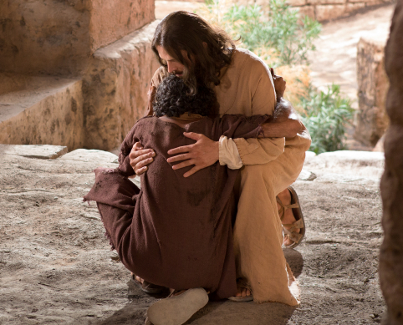
Jesus Is Our Example
We best serve our Father in Heaven by righteously influencing others and serving them. The greatest example who ever walked the earth is our Savior, Jesus Christ. His mortal ministry was filled with teaching, serving, and loving others. (Richard G. Scott)

Slide 21
Using Social Media

Slide 22
Social Media
Social media is a tool that can personally and positively impact lots of people quickly!
I believe the time has come for us as disciples of Christ to use these inspired tools appropriately and more effectively to testify of God the Eternal Father, His plan of happiness for His children, and His Son, Jesus Christ, as the Savior of the world; to proclaim the reality of the Restoration of the gospel in the latter days; and to accomplish the Lord’s work. (Elder Bednar)

Slide 23
Genuine Love
Brothers and sisters, share the gospel with genuine love and concern for others. Be courageous and bold but not overbearing in sustaining and defending our beliefs, and avoid contention. As disciples our purpose should be to use social media channels as a means of projecting the light and truth of the restored gospel of Jesus Christ into a world that increasingly is dark and confused. (Elder Bednar)

Slide 24
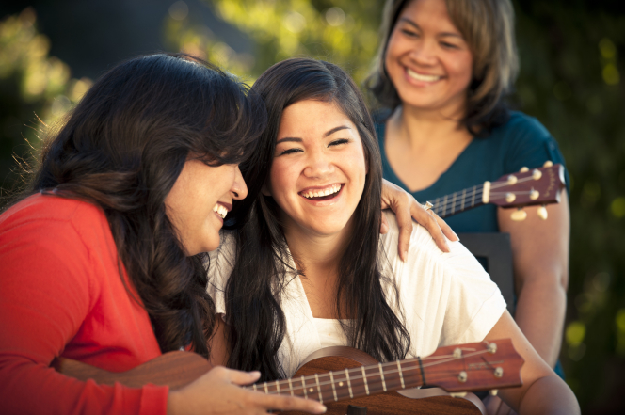
Be Real!!!
First, we are disciples and our messages should be authentic. A person or product that is not authentic is false, fake, and fraudulent. Our messages should be truthful, honest, and accurate. We should not exaggerate, embellish, or pretend to be someone or something we are not. Our content should be trustworthy and constructive.
Authenticity is strengthened through consistency. The gospel messages you share will be accepted more readily if your Christlike example is evident in the ongoing pattern of your posts. (Elder Bednar)

Slide 25
Enthusiastic & Eager
Many of us use social media everyday. Think of the positive influence we can have for good when we use social media to spread the good news of the gospel.
missionary adjective: very enthusiastic and eager about doing a job or supporting a cause (Merriam Webster dictionary)
You can become an effective missionary by “enthusiastically” sharing your testimony with others through your actions, your words, & social media

Slide 26
Missionaries
From time to time we need to remind ourselves why we have missionaries. It is because of a commandment from the Lord, who said:
“Go ye therefore, and teach all nations, baptizing them in the name of the Father, and of the Son, and of the Holy Ghost:
“Teaching them to observe all things whatsoever I have commanded you: and, lo, I am with you always, even unto the end of the world.” (Russell Nelson)

Slide 27
Followers of Jesus Christ
Each exemplary follower of Jesus Christ can become an effective member missionary. Members and full-time missionaries may walk arm in arm in bringing the blessings of the gospel to cherished friends and neighbors. (Russell M. Nelson)

Slide 28
Our Simple Desire
The invitations we extend to others to learn about and test our message, grow out of the positive effects the gospel of Jesus Christ has had in our lives.
Our simple desire is to share with others the truths that are of greatest worth to us. (Elder Bednar)

Slide 29
Joy
Members who share the gospel experience joy and have the Spirit of the Lord more abundantly. As we share the gospel, we appreciate how precious and meaningful it is to us, and we feel a greater love for God and others. (Preach My Gospel)

