Slide 1
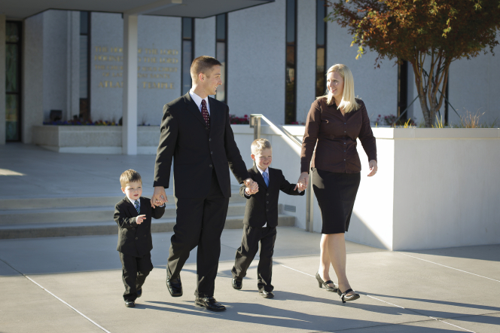
How can I prepare to establish a Christ-centered home?

Slide 2
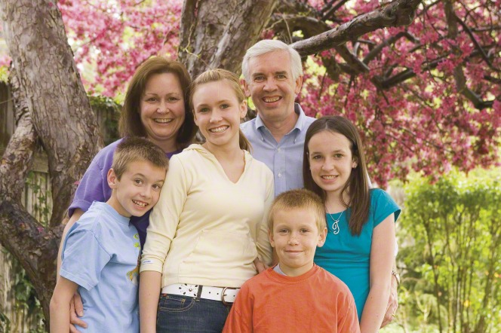
Building the Kingdom of God - Family
Building the kingdom of God begins with building a righteous home and family. The family is the most important unit of the Church.

Slide 3
As members of the Church, we should establish a home where the Spirit is present.
What can we do to invite the Spirit into our home?
Be a peacemaker
Use soft voices, avoid yelling
Family and personal prayer
Family and personal scripture study
Family Home Evening
Appropriate music, TV shows, movies
Try to get a long with siblings and parents
Willingly help keep the home clean and organized
Willingly help and serve each other
Can you think of any others?

Slide 4
A Christ-centered home offers us a place of defense against sin, refuge from the world, and committed, genuine love.

Slide 5
Strength of a family – toothpick object lesson

Slide 6
Whether our home is large or small, it can be a “house of prayer, a house of fasting, a house of faith, a house of learning, a house of glory, a house of order, a house of God” D&C 88:119
Prayer, fasting, faith, learning, glory, order, House of God

Slide 7
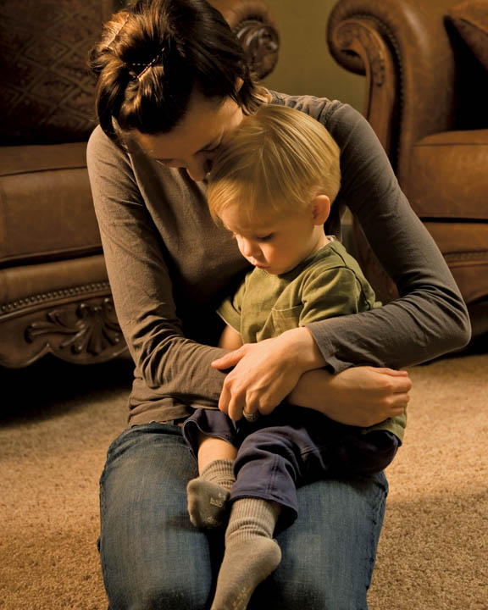
What does it mean to have a house of prayer?
Personal and family prayer
We should pray always, to give thanks and ask for help.
Heartfelt prayers are offered without “vain repetition”

Slide 8
What does it mean to have a house of fasting?
Teach family members “how” to fast
Begin and end with prayer
Fast with a purpose
2 consecutive meals
Pay fast offerings
“If you don’t feed your spirit, fasting is just starvation”

Slide 9
What does it mean to have a house of faith?
1 Nephi 7:12
Teach about Jesus Christ so family members develop trust in Him.
Priesthood blessings give us an opportunity to exercise faith.
We need to have the faith to be obedient, to keep trying, and to keep a positive outlook.
Learn and study about faithful prophets in the scriptures:
Nephi-returning for the plates, building the boat
Alma-praying for his wayward son
Joseph Smith-Restoration of the gospel

Slide 10
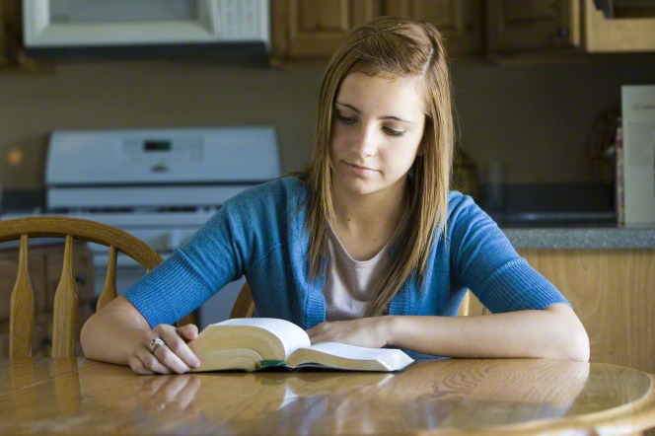
What does it mean to have a house of learning?
Scripture study (study not just reading!)
Teach by example
Teach gospel principles & values during weekly FHE
Support learning and education
Encourage reading, studying and learning new things
Help each other with homework. Parents and older siblings can help tutor younger siblings.
Study spiritual and temporal things
By study and faith and sometimes by trial and error!

Slide 11
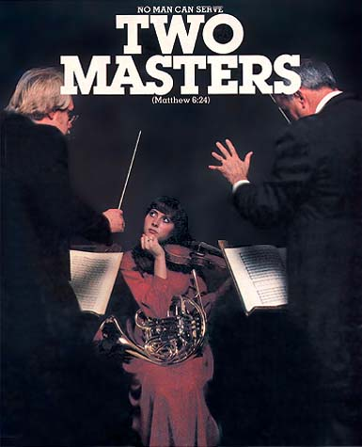
What does it mean to have a house of glory?
Our house is to be a house of glory. For our house to be such, we need to be square with God, fair with others, and honest with ourselves. One cannot be one person and pretend to be another? Thomas S. Monson
What does this mean?
Matthew 6:24

Slide 12
What does it mean to have a house of order?
Early in this dispensation, the Lord instructed his people to “organize yourselves; … establish a house, even … a house of order, a house of God” (D&C 88:119). Order is characteristic of the Lord’s work. “Mine house is a house of order, saith the Lord God, and not a house of confusion” (D&C 132:8).
Next to the temple, our homes are the most sacred place for our family.
The temple is our pattern of a “House of Order”
We have a lifetime to strive to have our homes feel and look as close to the temple as possible. We do NOT have to be perfect. We just need to keep trying and inviting the Spirit into our homes.
Parenting is teamwork…whenever possible, Mother and Father should work together as equal partners.
Mothers are primarily responsible for the nurture of their children.

Slide 13
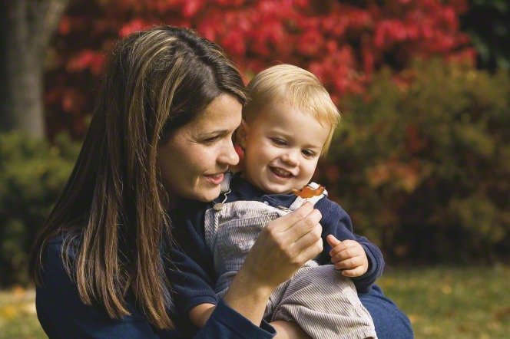
Motherhood: An Eternal Partnership with God.
Watch VIDEO

Slide 14
What were some of the messages from this video?
Motherhood is hard but worth it!
Through the “thick & thin and occasional tears” remember you are doing “God’s Work”
Motherhood is an eternal partnership with God.
Heaven sends angels to watch over us and our little ones.
You will be magnified and made better than you think you can be.
Motherhood is a great responsibility but the Lord trusts you.
There is nothing more important than this partnership in the work and glory of God!
Prepare now to be the kind of Mother God knows you can be!
We do this by developing a personal relationship with
Jesus Christ.

Slide 15
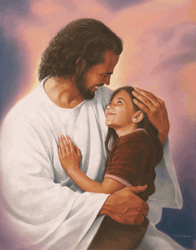
A House of God…
…If you will make your home a house of prayer and fasting, faith, learning and glory, and order, it can become a house of God. If you build your homes on the foundation rock of our Redeemer and the gospel, they can be sanctuaries where your families can be sheltered from the raging storms of life. Elder Wirthlin
We can influence our present homes by trying to be an example to our families. Whether your home is the kind of home you dream of, or one you’d like to improve upon, we can try each day to make a positive impact on our surroundings.
By developing our testimonies now we are preparing to build a Christ Centered home.

Slide 16
Let’s look at the “Home” we built from blocks…
I asked all of you to build a house just like mine…
Why are they different?
You couldn’t see my example so it was impossible to build them the same way…
We need to “see” how to build our homes correctly before we can actually do it.
Who has shown us the way by His example?

Slide 17
…Living an obedient life, firmly rooted in the gospel of Jesus Christ, provides the greatest assurance for peace and refuge in our homes. There will still be plenty of challenges or heartaches, but even in the midst of turmoil, we can enjoy inner peace and profound happiness.
Richard G. Scott

