Slide 1
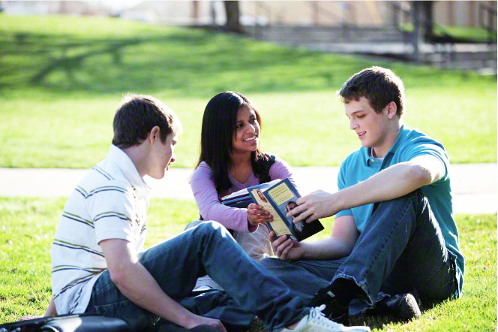
What can I do to help new members of the church & my less active friends?

Slide 2
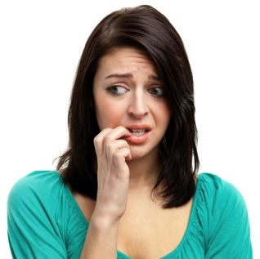
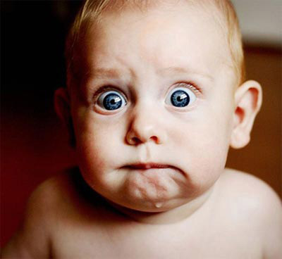
How does it feel?
First day of school
Joining a new club or team
First day at a new job.
How much better do you feel when you are not alone?
Scared
Nervous

Slide 3
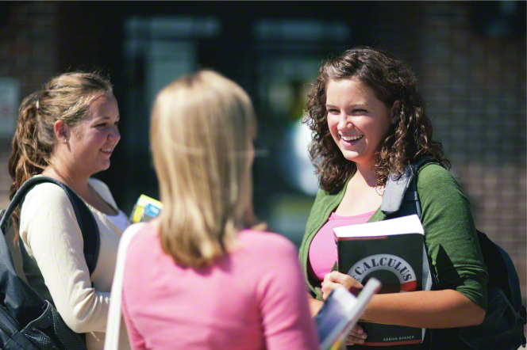
New Members of the Church and those who may be inactive often feel nervous and scared to come to church.
The Lord is counting on us to help!

Slide 4
John 21:15-17
So when they had dined, Jesus saith to Simon Peter, Simon, son of Jonas, lovest thou me more than these? He saith unto him, Yea, Lord; thou knowest that I love thee. He saith unto him, Feed my lambs.
16 He saith to him again the second time, Simon, son of Jonas, lovest thou me? He saith unto him, Yea, Lord; thou knowest that I love thee. He saith unto him, Feed my sheep.
17 He saith unto him the third time, Simon, son of Jonas, lovest thou me? Peter was grieved because he said unto him the third time, Lovest thou me? And he said unto him, Lord, thou knowest all things; thou knowest that I love thee. Jesus saith unto him, Feed my sheep.

Slide 5
If ye love me…Feed my sheep
What does it mean to “Feed His Sheep?”
Who are His Sheep?
How are new members and inactive members like his Sheep?
What specific things can we do to help new members & less active members of the Church?

Slide 6
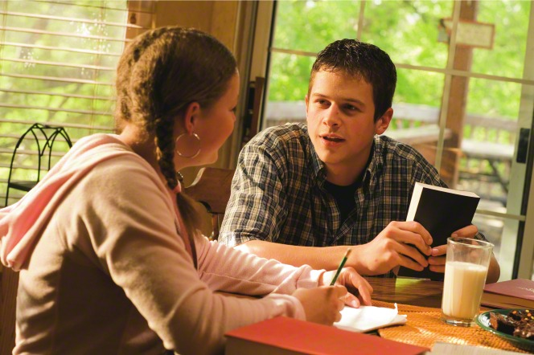
Luke 22:32
But I have prayed for thee, that thy faith fail not: and when thou art converted, strengthen thy brethren.
All of us have so many opportunities to strengthen others. It may be our own brothers and sisters. It may be our own friends. It may be a neighbor or a new acquaintance. It may even be our own parents.

Slide 7
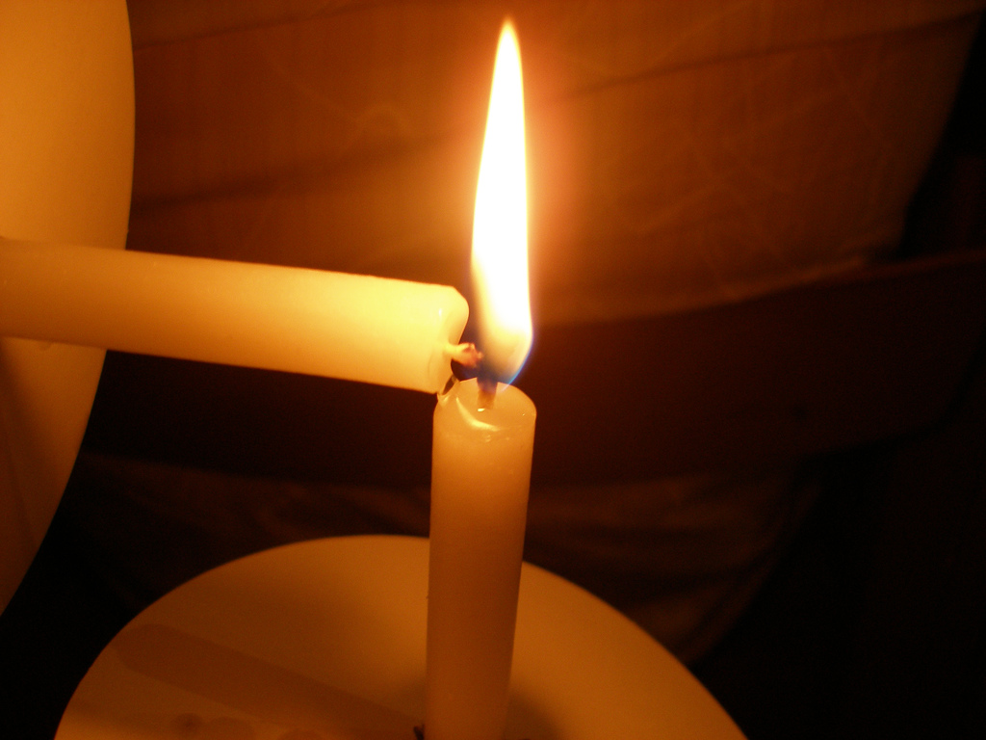
Be converted so you can strengthen others
“The time is here when each of you must stand on your own feet. Be converted, because no one can endure on borrowed light. You will have to be guided by the light within yourself.” Harold B. Lee
Let the Spirit kindle the light within you, then share it with others.

Slide 8
What can we do to be converted?
Conversion takes place as we are diligent about saying our prayers, studying our scriptures, attending church, and being worthy to participate in temple ordinances.
Conversion comes as we act upon the righteous principles we learn in our homes and in the classroom. Conversion comes as we live pure and virtuous lives and enjoy the companionship of the Holy Ghost.
Conversion comes as we understand the Atonement of Jesus Christ, acknowledge Him as our Savior and Redeemer, and allow the Atonement to take effect in our lives. Sister Oscarson - October 2013

Slide 9
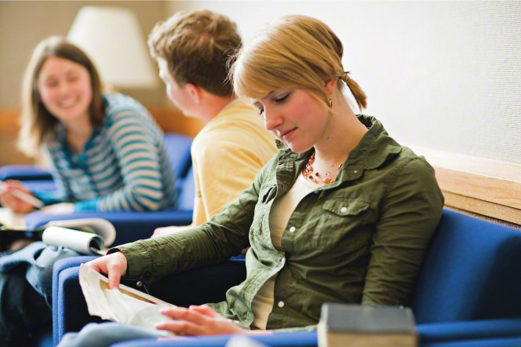
True Conversion
It is possible to have a testimony of the gospel without living it. Being truly converted means we are acting upon what we believe and allowing it to create “a mighty change in us, or in our hearts.” Sister Oscarson

Slide 10
When you are converted…strengthen they brethren…But how?
D&C 108:7, Therefore, strengthen your brethren in all your conversation, in all your prayers, in all your exhortations, and in all your doings.
Have you ever prayed for your friends? How might that help them?
Do your conversations and actions strengthen your friends?

Slide 11
What we say & do…sticks!
Post-it Note Activity

Slide 12
“What we say and do…Sticks!”
We have a strong influence on our friends and new members of the Church. We need to be aware of the impression we are making!
President Eyring said: “All of us will be tested. And all of us need true friends to love us, to listen to us, to show us the way, and to testify of truth to us.” These words of President Hinckley energize me: “I hope, I pray, I plead with you, every one of you, to embrace every new member of the Church. Make a friend of him or her. Hold onto them.”

Slide 13
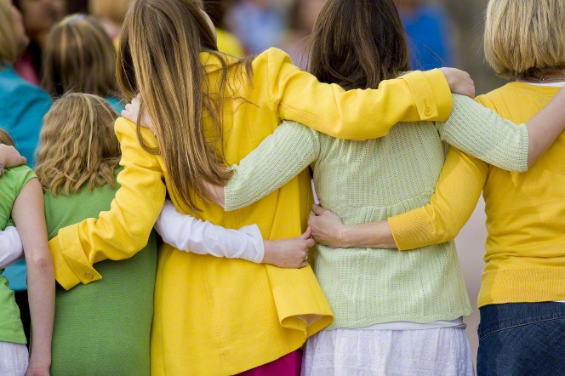
Embrace and hold onto them!
Love
Listen
Show them the way
Testify of truth (in word and actions)
Embrace them
Be a TRUE friend
Hold onto them!

Slide 14
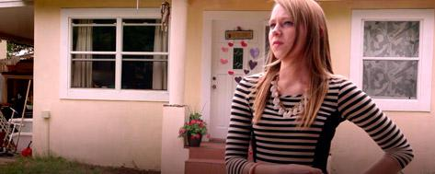
Video:
The Faith of Youth: The Ennis Family

Slide 15
Thoughts from the video:
Youth have a tremendous influence on others.
“When someone new moves in, go find out who they are!”
The daughter felt alone so the YW got involved!
They heart attacked her door with positive notes.
It had an immediate impact on her!
They gave her rides to activities and church
They didn’t think about being missionaries…they thought about being a FRIEND!
“We’ve made really good friends through missionary work, just by being who we are.”

Slide 16
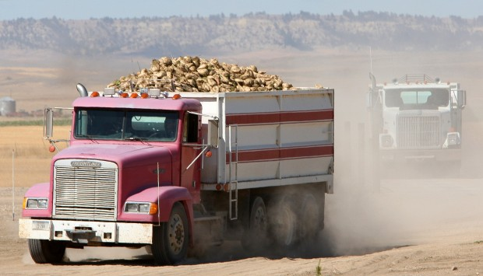
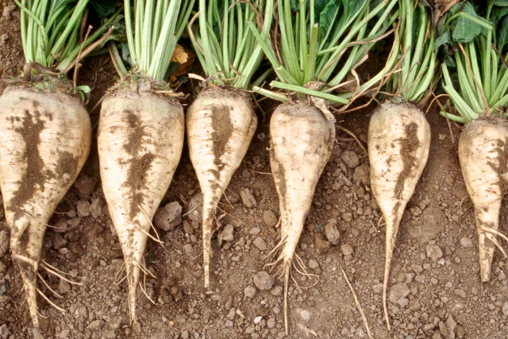
Sugar Beets & the Worth of Souls
The Farmer instructs his helpers. “There’s just as much sugar in those which have slipped off. Let’s go back and get them!”

Slide 17
The Worth of ALL Souls is great in the sight of God!
Paraphrasing the farmer’s comments concerning the sugar beets, I say of these souls, precious to our Father and our Master: “There’s just as much value in those who have slipped off. Let’s go back and get them!” President Monson
Please Read:
Alma 31:34-35
D&C 18:10-16
What do these scriptures teach about how Heavenly Father feels about ALL His children?

Slide 18
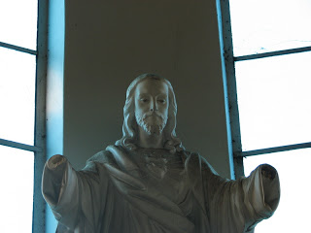
You are my hands…Pres. Uchtdorf
“As disciples of Jesus Christ, our Master, we are called to support and heal rather than condemn.”
With this in mind, let our hearts and hands be stretched out in compassion toward others, for everyone is walking his or her own difficult path.

Slide 19
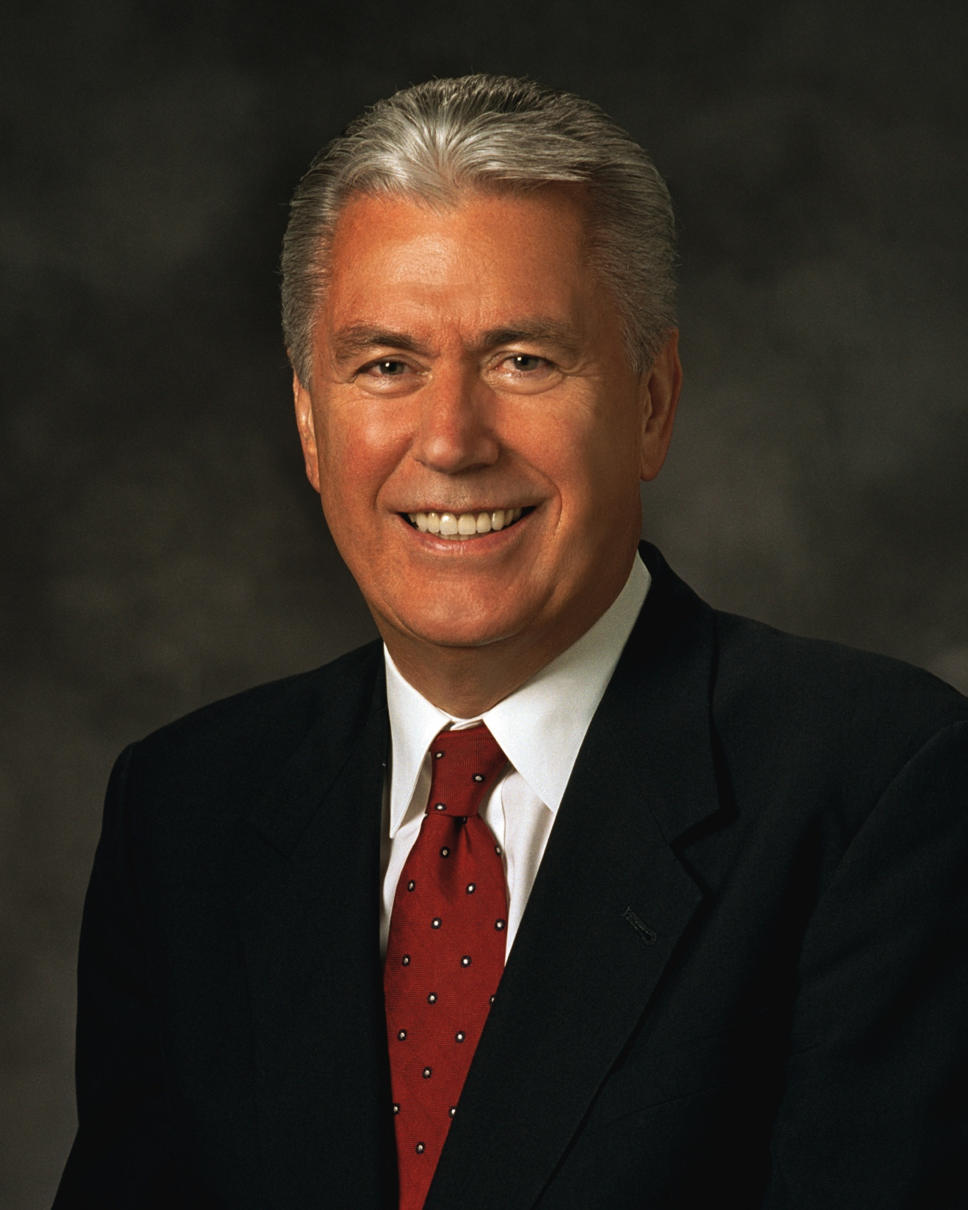
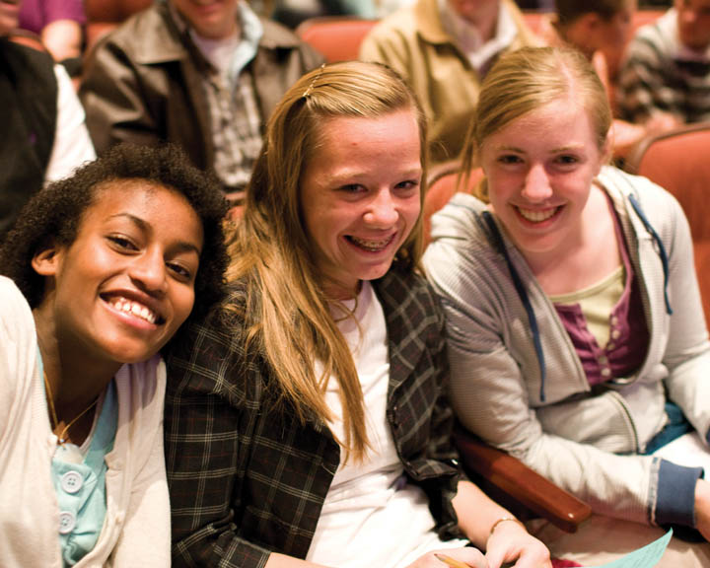
I hope that we welcome and love all of God’s children, including those who might dress, look, speak, or just do things differently. It is not good to make others feel as though they are deficient. Let us lift those around us. Let us extend a welcoming hand. Let us bestow upon our brothers and sisters in the Church a special measure of humanity, compassion, and charity so that they feel, at long last, they have finally found home.

Slide 20
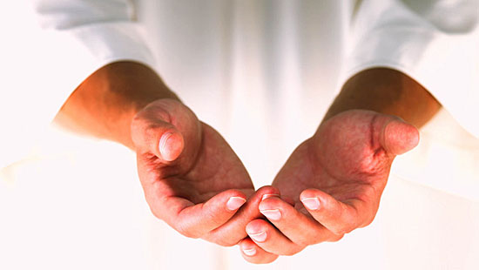
Christ knows how to minister to others perfectly. When the Savior stretches out His hands, those He touches are uplifted and become greater, stronger, and better people as a result.
If we are His hands, should we not do the same?

