Slide 1
Building The Kingdom of God
What does it mean to “stand as a witness of God?”
How does Heavenly Father want me to use my spiritual gifts?

Slide 2
You are part of the building crew!
You young women were sent to the earth at this specific time to help prepare the world for the Second Coming of the Savior. You have special gifts and talents that the Lord wants you to use to help build His kingdom and share His gospel. The lessons this month will help you develop your gifts as you prepare to become leaders and teachers in the Church and in the kingdom of God.

Slide 3
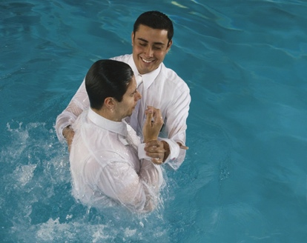
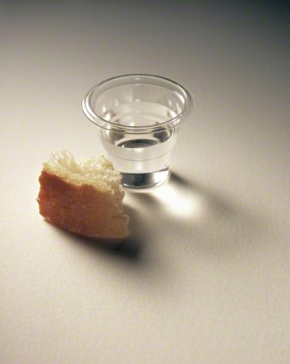
Stand As A Witness
When we are baptized, we covenant to “stand as witnesses of God at all times and in all things, and in all places that [we] may be in” (Mosiah 18:9).
We renew this covenant each week with the sacrament.
Our testimonies of the gospel and our good examples can inspire our friends and neighbors to want to learn more about the Savior and His gospel.

Slide 4
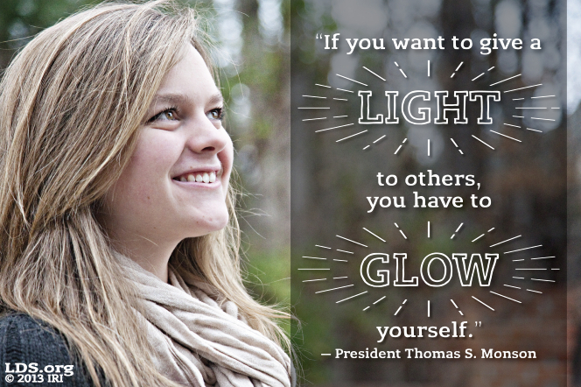
Does my example really matter? Who is really watching me?
Siblings
Parents
Friends
Teachers
Kids at school
Younger kids in my ward
Neighbors
Non-members or inactive members

Slide 5
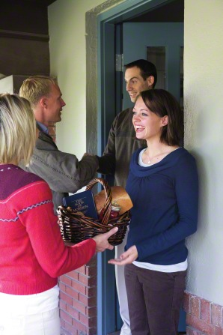
The truest mark of a religion is its people…. unknown

Slide 6
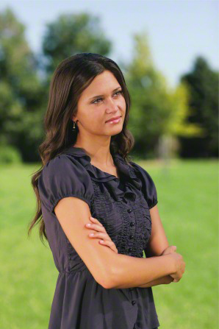
What do your actions tell others about The Church of Jesus Christ of Latter-day Saints?
Do you gossip?
Do you make fun of others?
Do you leave people out?
Are you judgmental?
Are you Christ like?
Do you swear?
Do you laugh at inappropriate jokes?
Do you listen to good music?
Do watch clean movies?

Slide 7
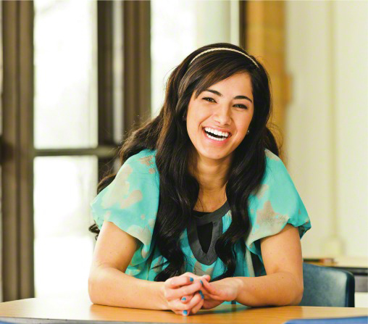
In April 2000 Sister Margaret Nadauld said “standing as a witness in all things means the "big things, little things, in all conversations and jokes. In games played and books read and music listened to. In causes supported, service rendered, clothes worn, friends made.”…That means not only in public places, but in private places as well…Church, school, home, or cars... Stand as an example of a worthy daughter of God in all places."
1 Timothy 4:12 …be thou an example of the believers, in word, in conversation, in charity, in spirit, in faith, in purity.

Slide 8
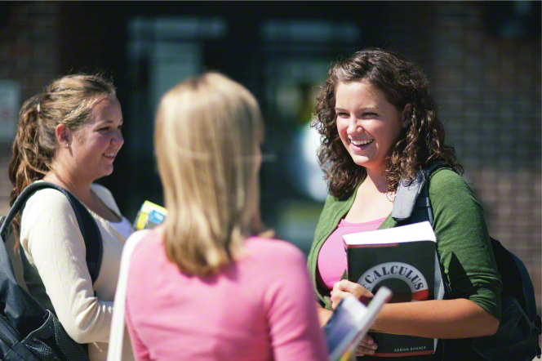
“Be The First”
Sister Naudauld counseled young women to “Be The First”
"being kind in all things, being the first to say hello, being the first to smile, being the first to make the stranger feel a part of things, being helpful. Thinking of others' feelings. Being inclusive.

Slide 9
What a difference we can make, and what an example we will set as we choose to “Be The First…”

Slide 10
Jess’s Story
-What was it that gave Jess the courage to stand for what was right?
-How do you think Jess felt?
-What do you think the other students thought about Jess?
-How does Abraham 3:25 apply to this story?

Slide 11
I’m a Mormon, I Know it, I live it, I love it.
Sister Dibb taught us: “The scriptures teach that we must be “doers of the word, and not hearers only.” We live the gospel and become “doers of the word” by exercising faith, being obedient, lovingly serving others, and following our Savior’s example.
We act with integrity and do what we know is right “at all times and in all things, and in all places” no matter who may or may not be watching.

Slide 12
How does Heavenly Father want me to use my Spiritual Gifts?

Slide 13
How does Heavenly Father want me to use my spiritual gifts?
Spiritual gifts are blessings or abilities that are given by the power of the Holy Ghost. As children of Heavenly Father, we all have spiritual gifts. God gives us these gifts so that we can serve others and help build His kingdom. He has commanded us to diligently seek out and develop our spiritual gifts.

Slide 14
D&C 46:11-12
11 For all have not every gift given unto them; for there are many gifts, and to every man is given a gift by the Spirit of God.
12 To some is given one, and to some is given another, that all may be profited thereby.

Slide 15
Watch Video:
“Extraordinary Gift”

Slide 16
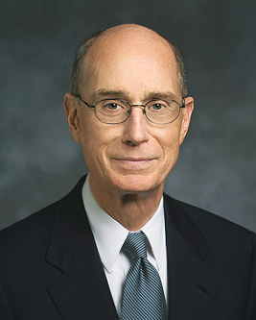
Pres. Henry B. Eyring
“Every person is different and has a contribution to make.”
“No one is destined to fail.”
God knows our gifts. My challenge to you and to me is to pray to know the gifts we have been given, to know how to develop them, and to recognize the opportunities to serve others that God provides us.
What are your gifts?

Slide 17
All gifts are different, some are visible, some are not.
Musical
Forgiving
Loving
Testimony
Teacher
Friendly
Funny
Kind
Compassionate
Unselfish
Bright mind
Physically fit
Creative
Singing
Art
Athletic
Humble
Missionary
Good with kids
Spiritual
Faithful
Committed
Prayerful
Sensitive
Scripture Knowledge
Charismatic
Teachable
Dancer
Poetry/Writing
Obedient

Slide 18
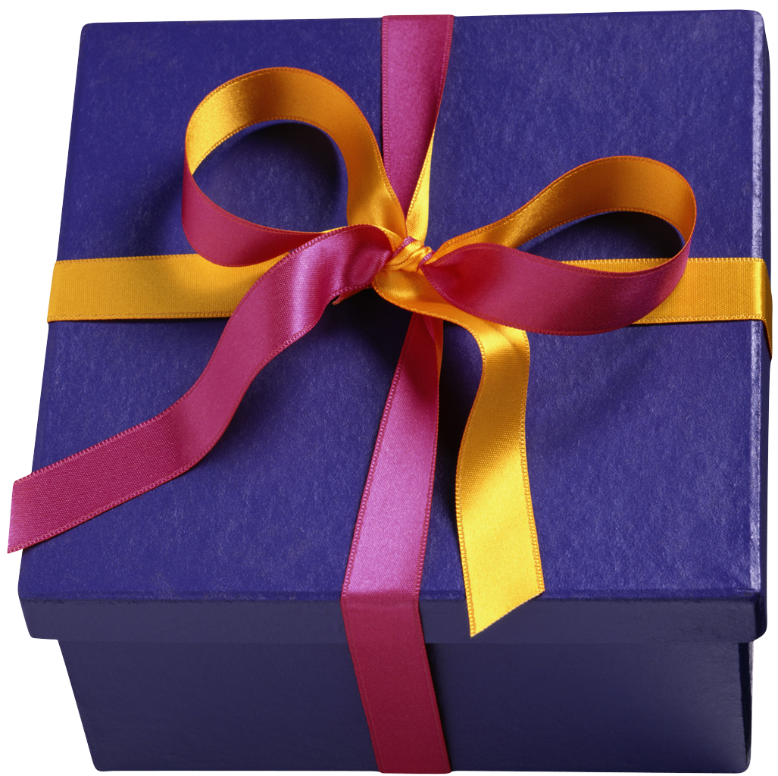
Spiritual Gifts
Spiritual gifts are blessings or abilities that are given by the power of the Holy Ghost. God gives at least one of these gifts to every faithful member of the Church.
As you receive these gifts, they will strengthen and bless you individually
and help you serve others.
The Lord may bless you in other ways depending on your faithfulness
and on your needs and the needs of those you serve.
He has commanded us to work diligently so we can receive
spiritual gifts. (True to The Faith)

Slide 19
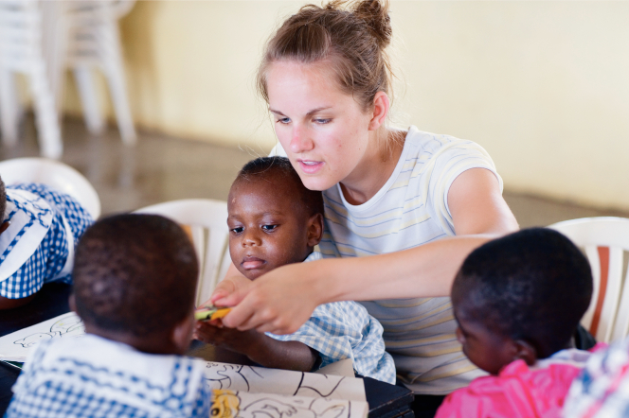
Seek to find YOUR gifts!
To develop our gifts, we must find out which gifts we have. We do this by praying and fasting. We should seek after the best gifts (see D&C 46:8). Sometimes patriarchal blessings will help us know which gifts we have been given.
We must be obedient & faithful to be given our gifts. We then should use these gifts to do the work of the Lord.

Slide 20
Never Compare Yourself to Others!
Sometimes we can feel sad or envious of others because we feel they have more “talents” or “gifts” than us.
The LORD loves all of us equally. He does not bless one young woman over another. Sometimes some gifts are more visible than others. Be patient with yourself.
If there is a gift you would like to have…Pray for help and guidance and work hard to develop it.
The LORD is on your side and will help you as you learn.

Slide 21
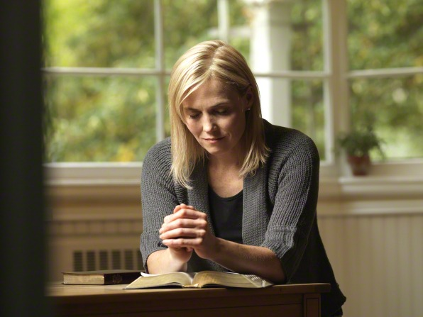
Summary:
Stand as a Witness at all times!
“Be the First to offer…a smile, help, friendship, encouragement!”
Pray and fast to know what Spiritual Gifts the Lord has for you.
Use these gifts to bless your life and those you serve.
Be patient with yourself as you grow and develop.

