Slide 1
Why do the CHOICES I make matter?

Slide 2
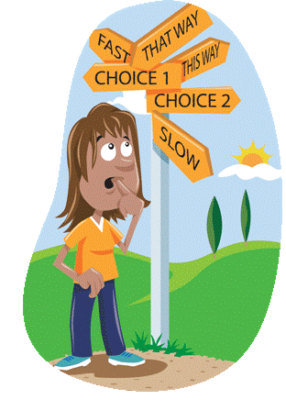
Do my choices really matter?
Every day you have choices to make. Some of those choices don’t have much to do with your eternal salvation (“What color shirt should I wear?”), and some of them have everything to do with it (“Should I break this commandment?”). You may sometimes wonder, “Do my choices really matter?” Or you may even think, “If no one knows what I’m doing, do my decisions really affect anyone?” The answer is yes! Decisions do matter.

Slide 3
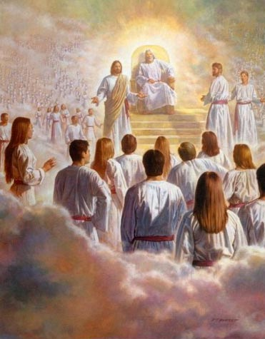
Plan of Salvation
This month we are studying the Plan of Salvation.
What does Agency or the ability to choose have to do with the Plan of Salvation?

Slide 4
Why They Matter
In order to understand why your choices matter, let’s go back to the premortal life. When Heavenly Father presented His plan of salvation, not everyone agreed. Lucifer objected to the plan and “sought to destroy the agency of man” (Moses 4:3).
Because of this, he became Satan & he & those who followed him were cast out of heaven & denied the opportunity to progress by experiencing mortality. Agency was so important in God’s plan that those who wanted to destroy it were cast out of heaven!

Slide 5
Mortality is a Test
Heavenly Father’s plan gives us the opportunity to choose for ourselves because that’s the only way we can learn, grow, and become more like Him. One of the purposes of life is to learn to use our agency wisely. But we weren’t given agency just to do whatever we want.
Choosing to keep the commandments shows God that we love Him and are willing to follow Him. The choices we make—including our attitude in making those decisions—are a big part of the test of mortality.

Slide 6
The 3 “R’s” of Choice President Thomas Monson
Right Responsibility
Results

Slide 7
Right of Choice
Our Loving Heavenly Father gave us the gift of Agency, or the right to choose.
“Next to the bestowal of life itself, the right to direct that life is God’s greatest gift to man.” President David O. McKay What is a “right?”
A right is a freedom that is protected.
How does the right to choose make you free?

Slide 8
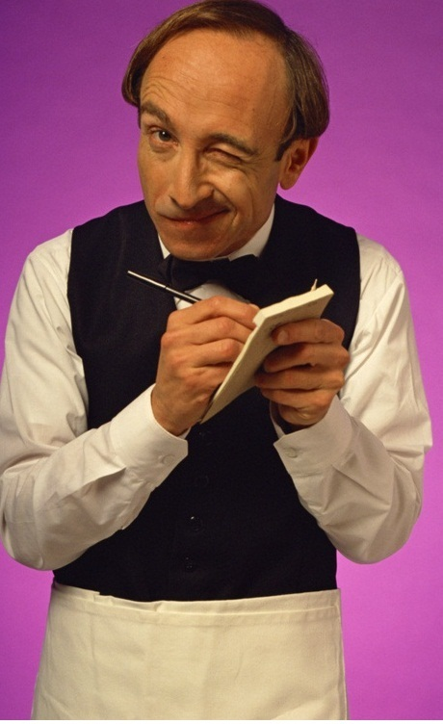
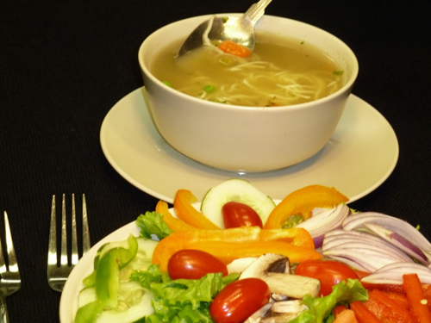
God’s Plan Includes Freedom of Choice Imagine going out to eat & ordering a salad, only to have the waiter tell you that you may not have it, that you must have the soup instead. How would you feel? The choice between soup & salad is a fairly benign one, but it demonstrates a characteristic of human nature: we don't like to be forced into decisions we're capable of making for ourselves.

Slide 9
Even when we face more serious decisions, ones with moral implications, it is important that we choose for ourselves. God gave us our agency & will always respect our freedom to make choices. God has never approved of using force. In fact, God fosters the spirit of freedom and He knows that the human spirit requires freedom to effectively serve & believe in Him. He told Adam and Eve not to eat the forbidden fruit, but He also said, "nevertheless, thou mayest choose for thyself." (Moses 3:17)

Slide 10
Responsibility of Choice
You are responsible for the choices you make. If you make an incorrect choice you cannot blame anyone else but yourself
You are a child of God with great strength. You have the ability to choose righteousness & happiness, regardless of your circumstances

Slide 11
Responsibility of Choice
We cannot be neutral; there is no middle ground. The Lord knows this; Lucifer knows this. As long as we live upon this earth, Lucifer and his hosts will never abandon the hope of claiming our souls. We have to choose which side we are on, who we are going to follow.
V object lesson

Slide 12
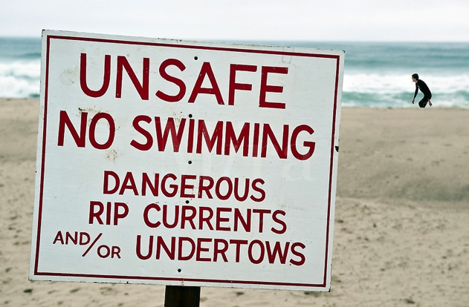
Freedom
It requires discipline to choose the right. The ironic thing is the more disciplined we are & the more righteous our choices, the more freedom we have. Sin limits our future choices: drugs, alcohol, infidelity quickly become addictions that become very difficult to break free from. The addiction becomes the master & we its slave. Abuse of freedom tends to paralyze.
Read: Riptide Analogy

Slide 13
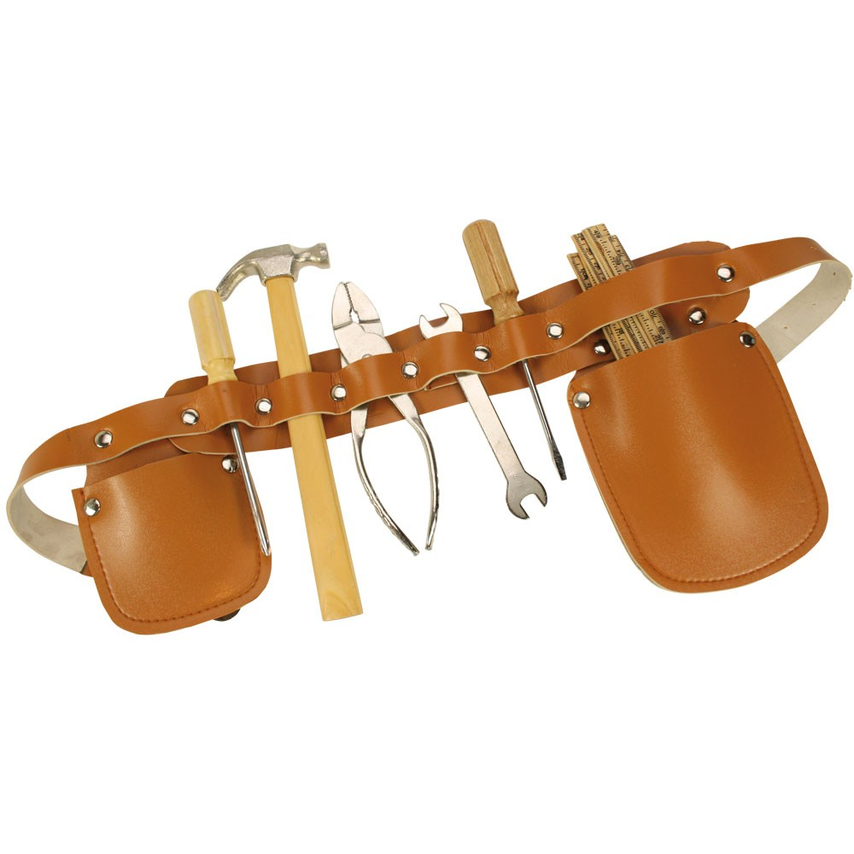
Tools to Help Us
The prophet Mormon tells us, “The Spirit of Christ is given to every man, that he may know good from evil.” I speak of prayer. I speak too of the whisperings from that still, small voice within each of us, and I do not overlook the holy scriptures, written by mariners who successfully sailed the seas we too must cross.

Slide 14
Your Choice of Friends is Very Important
When faced with significant choices, how do we decide? Do we succumb to the promise of momentary pleasure? To our urges and passions? To the pressure of our peers?

Slide 15
Good Friends Can Help Us Make Good Choices
ROLE PLAYS

Slide 16
Results of our Choices
All of our choices have consequences, some of which have little or nothing to do with our eternal salvation and others of which have everything to do with it.
May we keep our eyes, our hearts, and our determination focused on that goal which is eternal and worth any price we will have to pay, regardless of the sacrifice we must make to reach it.

Slide 17
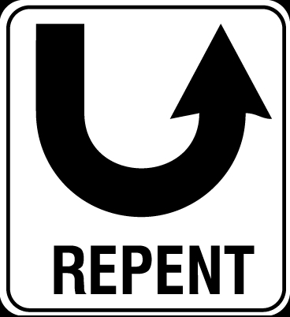
Repentance
Don’t put your eternal life at risk. If you have sinned, the sooner you begin to make your way back, the sooner you will find the sweet peace and joy that come with the miracle of forgiveness.
Our Savior died to provide you & me the blessed gift of repentance. We have all made incorrect choices. If we have not already corrected such choices, the way to peace & forgiveness is repentance.

Slide 18
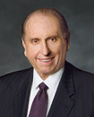
The 3 R’s
May we be filled with gratitude for the right of choice, accept the responsibility of choice, ever be conscious of the results of choice.

Slide 19
Choosing Good
You’ve been taught repeatedly that choosing to disobey God’s commandments brings consequences. But have you considered that the same is true for good choices?
So what are the consequences of good choices? We could probably come up with a large list of blessings that come from making righteous choices. Here are just a few:
“If you keep my commandments and endure to the end = you shall have eternal life” (D&C 14:7); “Observing the Sabbath = will bring you closer to the Lord and to your family” “When you are obedient to [the Word of Wisdom], = you remain free from harmful addictions and have control over your life.”

Slide 20
Anxiously Engaged in a Good Cause
The Lord said that we “should be anxiously engaged in a good cause, & do many things of [our] own free will,” & He promised that we can “bring to pass much righteousness” when we do (D&C 58:27). So we should not only avoid bad things but also actively seek to do good things.
Sometimes we get so worried about all the things that we are not supposed to do that we forget that obedience also includes doing things we are supposed to do.

Slide 21
Decide Now, Make a Plan
So how can you make sure you are making good choices? First, consider what you want from your life. Do you want eternal life? Do you want to be sealed in the temple? Do you want to serve a full-time mission? Do you want to graduate from college and get a good job? If so, how do you get there?
Just like builders need a blueprint to make a skyscraper, you need a plan to build a righteous life.

Slide 22
Write Down Your Goals
Write down some of your goals. Keep the list where you can see it. Then when you do have to make a choice, you can think about your list to make sure you don’t give up what you want most for something you want now. Setting goals also makes your choices deliberate & intentional instead of being haphazard, random, or based on circumstances.

Slide 23
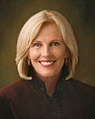
Make Decisions in Advance
“When I was a young woman, I learned that some decisions need to be made only once. I wrote my list of things I would always do and things I would never do in a small tablet. It included things like obeying the Word of Wisdom, praying daily, paying my tithing, and committing to never miss church. I made those decisions once, and then in the moment of decision, I knew exactly what to do because I had decided beforehand. When my high school friends said, ‘Just one drink won’t hurt,’ I laughed and said, ‘I decided when I was 12 not to do that.’ Making decisions in advance will help you be guardians of virtue. I hope each of you will write a list of things you will always do and things you will never do. Then live your list.”
Elaine S. Dalton, former Young Women general president, “Guardians of Virtue,” Ensign or Liahona, May 2011, 123.

Slide 24
Decisions Determine Destiny
“Each of us has the responsibility to choose. You may ask, ‘Are decisions really that important?’ I say to you, decisions determine destiny. You can’t make eternal decisions without eternal consequences.”
President Thomas S. Monson, “Pathways to Perfection,” Ensign, May 2002, 100; Liahona, July 2002, 112.

