Slide 1
Why Do We Have Adversity?

Slide 2
Adversity
Life would be easier without trials, but we wouldn’t learn or grow much.

Slide 3
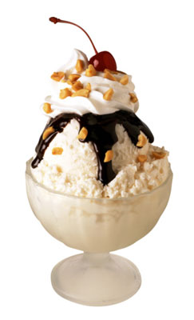
Opposition In All Things
2 Nephi 2:11, D&C 29:39

Slide 4
Adversity will be a constant or occasional companion for each of us throughout our lives. We cannot avoid it. The only question is how we will react to it. Will our adversities be stumbling blocks or stepping-stones? Dallin Oaks

Slide 5
We all know that trials will come. We can’t control when or where. What we can control is our attitude towards trials.
This lesson will hopefully show you that adversity is very necessary. It is part of Heavenly Father’s plan. When we endure our trials in faith, we come across the finish line, stronger and wiser than we were before.

Slide 6
Why?
“Why is it so hard? Why do bad things happen to good people? Why such terrible tribulation? To what end? For what purpose?”
“As we ask these questions, we realize that the purpose of our life on earth is to grow, develop, and be strengthened through our own experiences. How do we do this? The scriptures give us an answer in one simple phrase: we ‘wait upon the Lord.” Elder Hales

Slide 7
“Wait Upon The Lord”
Elder Hales spoke of what it means to wait upon the Lord, noting that in the scriptures, the word wait means to hope, anticipate, and trust.
“To hope & trust in the Lord requires faith, patience, humility, meekness, long-suffering, keeping the commandments & enduring to the end,” Elder Hales

Slide 8
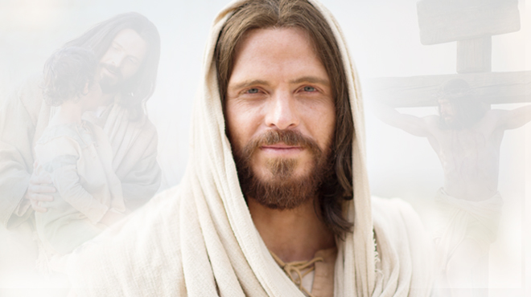
Hope & Trust in the Lord
“Whosoever shall put their trust in God shall be supported in their trials, and their troubles, & their afflictions, & shall be lifted up at the last day” (Alma 36:3).
It’s hard to trust someone you don’t know…that is another reason why it is important to “Come Unto Christ” & develop a personal relationship with Him.

Slide 9
Benefits of Trials
Trials can humble us, help us grow spiritually, and remind us that we need the Lord’s help.
Trials can help us learn to appreciate times of peace.
Most important, they give us opportunities to show the Lord and ourselves that we will be faithful.

Slide 10
Trials Are Part of This Life
Some trials are a part of mortality, like natural disasters or the death of a loved one. Knowing that these things happen, you can prepare for them &, therefore, endure them better.

Slide 11
How do we prepare for trials?
Helaman 5:12 “It is upon the rock of our Redeemer, who is Christ, the Son of God, that ye must build your foundation; that when the devil shall send forth his mighty winds, … it shall have no power over you to drag you down to the gulf of misery & endless wo.”

Slide 12
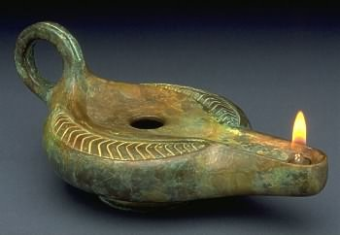
How do we prepare for our trials?
Like the Parable of the 10 Virgins, modern prophets have explained that the oil of preparation is accumulated drop by drop through daily righteous living.
“Regularly attending sacrament meetings adds oil to our lamps. Fasting, praying individually and as a family…, controlling our appetites, learning gospel principles, watching over one another, studying the scriptures. … Keeping the commandments & following the words of the prophet may be the greatest preparation we can make for any eventuality to come” (Barbara W. Winder, former Relief Society general president“Becoming a Prepared People,” Ensign, Nov. 1988, 88).

Slide 13
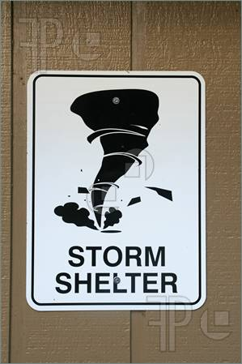
When faced with a trial of faith—whatever you do, you don’t step away from the Church! Distancing yourself from the kingdom of God during a trial of faith is like leaving the safety of a secure storm cellar just as the tornado comes into view.

Slide 14
Stay Strong During Trials
How do you remain “steadfast & immovable” during a trial of faith? You immerse yourself in the very things that helped build your core of faith:
Exercise faith in Christ Pray Ponder the scriptures Keep commandments Repent Serve others
Keep a balanced perspective: even during trials there are still good things in your life.
Ask your parents and bishop or branch president for advice on getting through a trial.

Slide 15
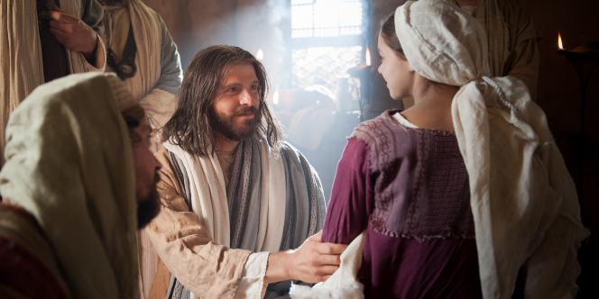
Have you noticed that when you see someone going through a trial that you have gone through, you are more understanding & willing to help that person? The Savior took upon Himself your trials including your pains, sicknesses, temptations, & weaknesses & He is perfectly compassionate & able to help (see Alma 7:11–12). In your trials remember what He said: “Come unto me, all ye that labour & are heavy laden, & I will give you rest” Matthew 11:28).

Slide 16
Learn From Your Trials (D&C 122:7)
Trial
What we can learn?
Patience, faith, Priesthood blessings
Forgiveness, Be strong, Stand up for others
Don’t give up, hard work, faith in Lord’s timing, patience
Unconditional love, kindness, tolerance inner strength
How to make friends, adapting to change, faith, loving family members
Helping your family, needs vs. wants, money management, perseverance
Sickness
Bullying
Not making a team you tryout for
Parents Divorce
Moving
Parent Job loss

Slide 17
Learn From Your Trials
God will not give us adversities we cannot handle, and he will bless us richly for patiently doing the best we can in the circumstances.
“When we are pushed, stung, defeated, embarrassed, hurt, rejected, tormented, forgotten—when we are in agony of spirit crying out ‘why me?’ we are in a position to learn something” (Elaine Cannon, 47).

Slide 18
Weak Things Made Strong
Sometimes trials come from your own poor choices or the poor choices of others, like mistakes or sins.
As you make good choices, you can avoid bringing some of these trials upon yourself.
Enduring trials that are the result of others’ choices is difficult. Maybe a friend betrayed you, or you struggle with the bad language you hear at school. In these types of trials, be forgiving, stay faithful, and pray for the Lord’s help and comfort.
The Lord will help you make your weaknesses, your strengths.
Ether 12:27

Slide 19
Nephi vs. Laman & Lemuel (The Broken Bow Experience) 1 Nephi 16:21-25)
Nephi
Laman & Lemuel
Asked for help
Humble
Faithful
Went to work
Positive
Forgiving
Found solutions
Anger
Complaining
Blaming others
Negative turned from God
Caused problems

Slide 20
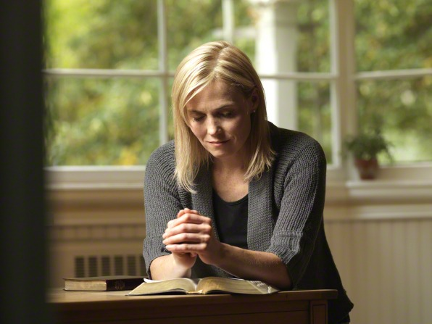
How will you respond to your trials?
How well you endure trials is up to you. Some people become bitter and angry. Those who grow from their trials stay close to the Lord.
The faithful ask themselves: “What can I learn from this?”
Those who feel sorry for themselves in their trials ask, “Why me?”

