Slide 1
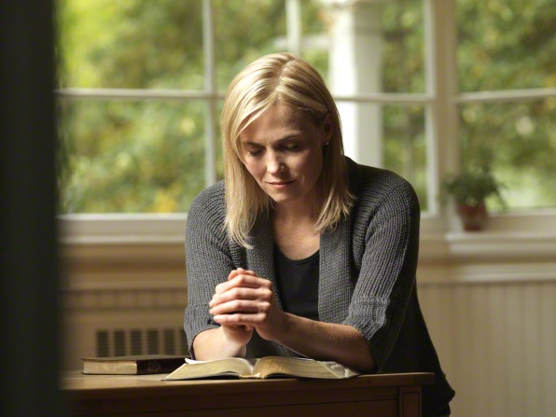
Seeking to know God, Our Heavenly Father, & His Son, Jesus Christ

Slide 2
Think of someone you know really well. What things did you do to develop that relationship?
Talk to them
Listen to them
Spend time with them
Learn about them
How are these things similar to what we need to do to really know Our Heavenly Father and Jesus?

Slide 3
John 17:3
And this is life eternal, that they might know thee the only true God, and Jesus Christ, whom thou hast sent.
There is a difference between knowing ABOUT someone and truly KNOWING them.
Which relationship should we strive for with Heavenly Father and Jesus Christ?

Slide 4
How do we get to know Heavenly Father?
Each person/group read a scripture and tell us ways we get to know God
John 2:3-5, John 4:7-8, Enos 1:4-5, Mosiah 4:9-10, Mosiah 5:13, D&C 88:63, D&C 93:1
Keep His commandments
Love one another
Sincere prayer
Believe in God, Repent
Serve God, Keep Him in your thoughts & heart
Draw near to God, seek Him, turn to Him
Forsake sins, come to Him, obey Him

Slide 5
We are daughters of our Heavenly Father, who loves us and wants us to draw near to Him. He has given us the opportunity to pray to Him and has promised to hear and answer our prayers. We can also come to know Him as we study the scriptures and the words of latter-day prophets and as we strive to become more like Him by following His will.

Slide 6
Read the previous slide again… this time pay special attention to the suggestions it makes for growing closer to Heavenly Father.
Heavenly Father:
We are His daughters
He Loves us He wants us to draw near to Him
He gave us Prayer
He promised to hear and answer our prayers
We can come to know Him by:
Praying to Him
Studying scriptures Studying words of Prophets Strive to become like Him
Strive to do His will.

Slide 7
How can we improve our communication with our Heavenly Father?
Don’t worry about your clumsily expressed feelings. Just talk to your compassionate, understanding Heavenly Father [like you would your earthly Father].
You are His precious child whom He loves perfectly and wants to help. As you pray, recognize that Father in Heaven is near and He is listening. Richard G. Scott

Slide 8
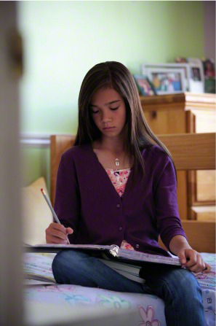
Should you ever feel distanced from our Father, it could be for many reasons. Pray even when you have no desire to pray. Sometimes, like a child, you may make mistakes and feel you cannot approach your Father with a problem. That is when you need to pray most. Never feel you are too unworthy to pray. Richard G. Scott

Slide 9
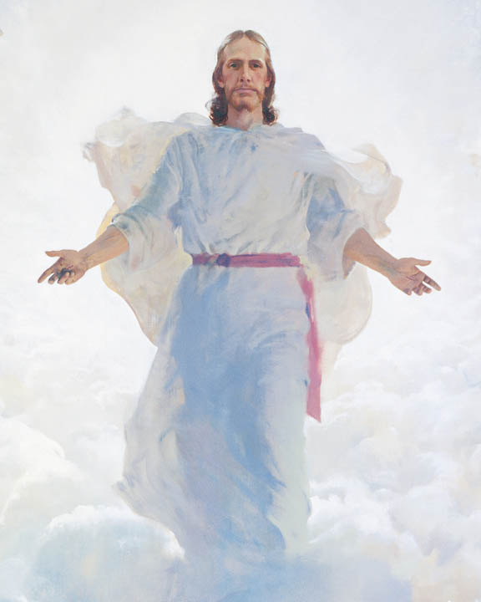
In addition to knowing and developing a relationship with Our Heavenly Father, we have been invited to Come Unto Christ, Our Savior.
The Youth Theme for 2014 is “Come Unto Christ” Our leaders feel like this is the time for us to focus on developing a personal relationship with the Savior.

Slide 10
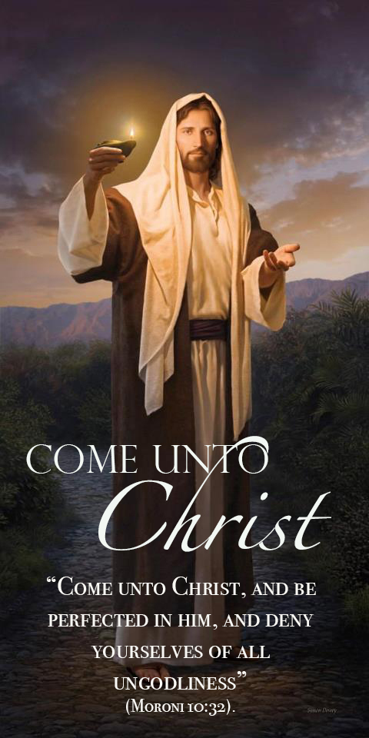
Why is Jesus Christ important in my life?
Look closely at this painting. Do you see the Savior’s gentle invitation for YOU to follow Him? He is holding the light for us so we can see thru the darkness.
The Savior is often referred to as “Light” or the “Light of Christ” for the next 6 slides identify how Christ can be a “light” in our life just like the other sources of light we see daily.

Slide 11
Jesus Christ is the light of the World
Sun: Is the source of life for all things living on earth.
Christ: Provides resurrection & eternal life for all men.
John 8:12
Then spake Jesus again unto them, saying, I am the light of the world: he that followeth me shall not walk in darkness, but shall have the light of life.

Slide 12
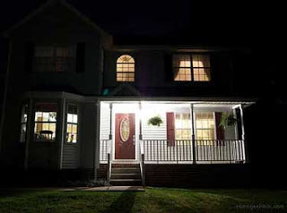
Jesus Christ is the way, the truth, the LIGHT
Porch light: Serves as a beacon to help us find our way home.
Christ: By following Christ’s example we can return to our Heavenly home.
John 12:35
Then Jesus said unto them, Yet a little while is the light with you. Walk while ye have the light, lest darkness come upon you: for he that walketh in darkness knoweth not whither he goeth.

Slide 13
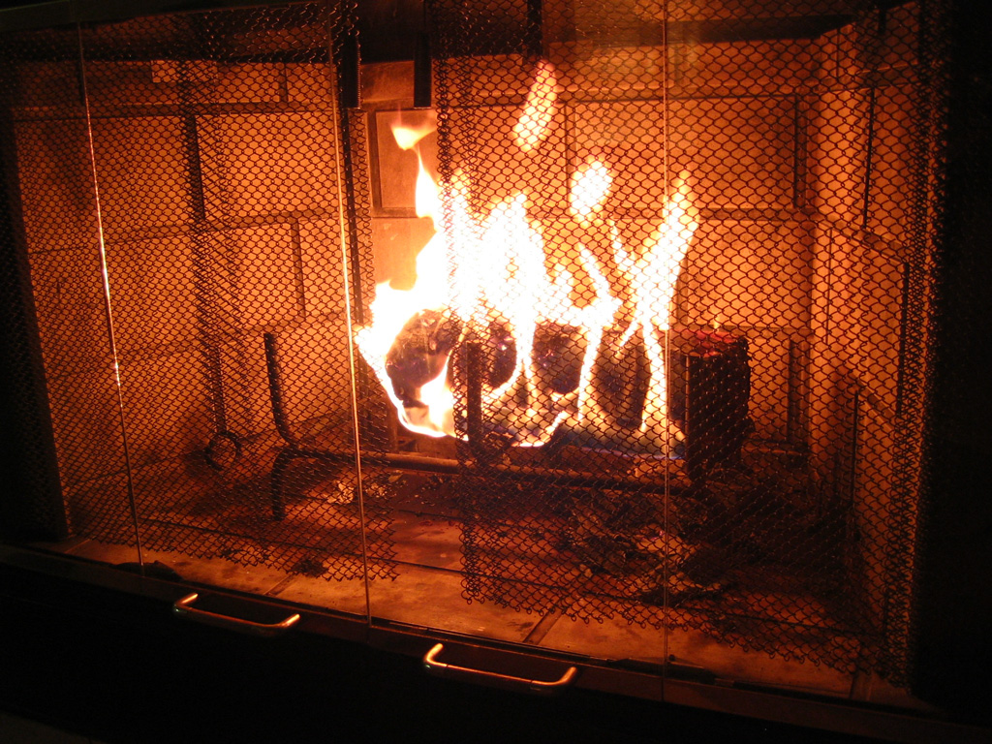
The light of Christ brings comfort
Fireplace: Provides warmth and comfort
Christ: A relationship with the Savior brings comfort & peace to our lives.
John 14:27
Peace I leave with you, my peace I give unto you: not as the world giveth, give I unto you. Let not your heart be troubled, neither let it be afraid.

Slide 14
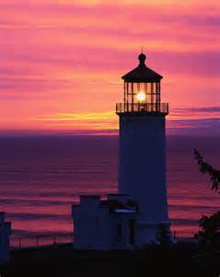
Following Christ provides protection
Lighthouse: Protects ships from danger
Christ: Following Christ will protect us from the dangers of this world. When we follow Christ we have nothing to fear.
Isaiah 41:10 & 13
10: Fear thou not; for I am with thee: be not dismayed; for I am thy God: I will strengthen thee; yea, I will help thee; yea, I will uphold thee with the right hand of my righteousness.
13: For I the Lord thy God will hold thy right hand, saying unto thee, Fear not; I will help thee.

Slide 15
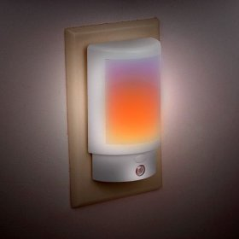
Come unto Christ & find rest
Nightlight: For some a nightlight is the only way they can rest and fall asleep.
Christ: Follow Christ, turn your burdens over to Him and rest from your labors.
Matthew 11:28-30
28) Come unto me, all ye that labour and are heavy laden, and I will give you crest.
29) Take my yoke upon you, and learn of me; for I am meek and lowly in heart: and ye shall find rest unto your souls.
30) For my yoke is easy, and my burden is light.

Slide 16
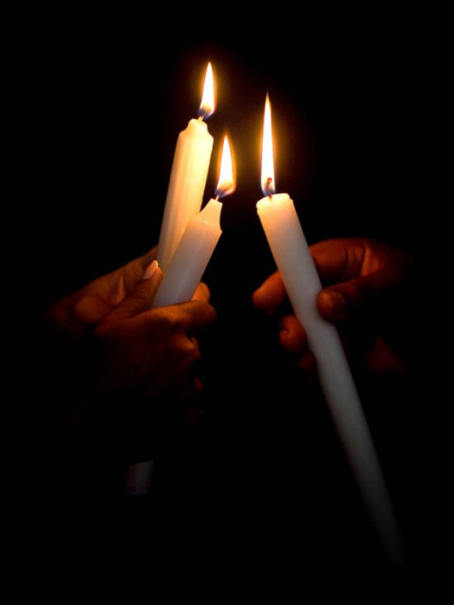
Share the light of Christ
Candle: Light can be shared, and given to others to light their way.
Christ: Once you have developed a love for Christ, & made the decision to follow Him, share that with others & help light their way to Christ.
Luke 22:31–32
“But I have prayed for thee, that thy faith fail not: and when thou art converted, strengthen thy brethren”

Slide 17
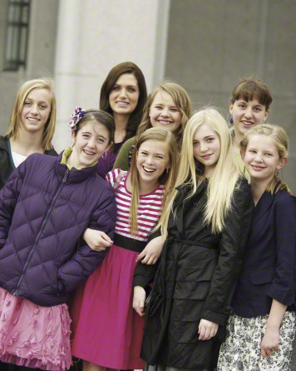
Read testimonies from LDS Youth March 2008 New Era

Slide 18
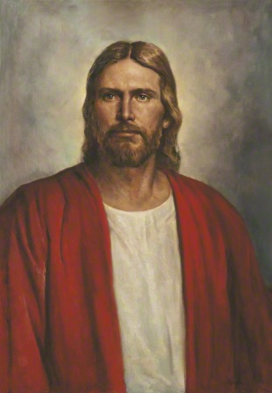
Jesus Christ was chosen to be our Savior. His Atonement makes it possible for us to be resurrected and to repent and be forgiven so we can return to our Heavenly Father’s presence. In addition to saving us from our sins, Jesus Christ, our Savior, also offers us peace and strength in times of trial. He sets the perfect example for us, and His teachings are the foundation for happiness in this life and eternal life in the world to come.

Slide 19
Jesus Christ IS the Only Begotten & Beloved Son of God. He IS our Creator. He IS the Light of the World. He IS our Savior from sin and death.
This is the most important knowledge on earth, and you can know this for yourself… The Holy Ghost…will reveal it to you. Dallin Oaks

Slide 20
Video:
Reclaimed
This video does a great job of reminding us how much we need the Savior in our daily life…especially the blessings of His Atonement

