Slide 1
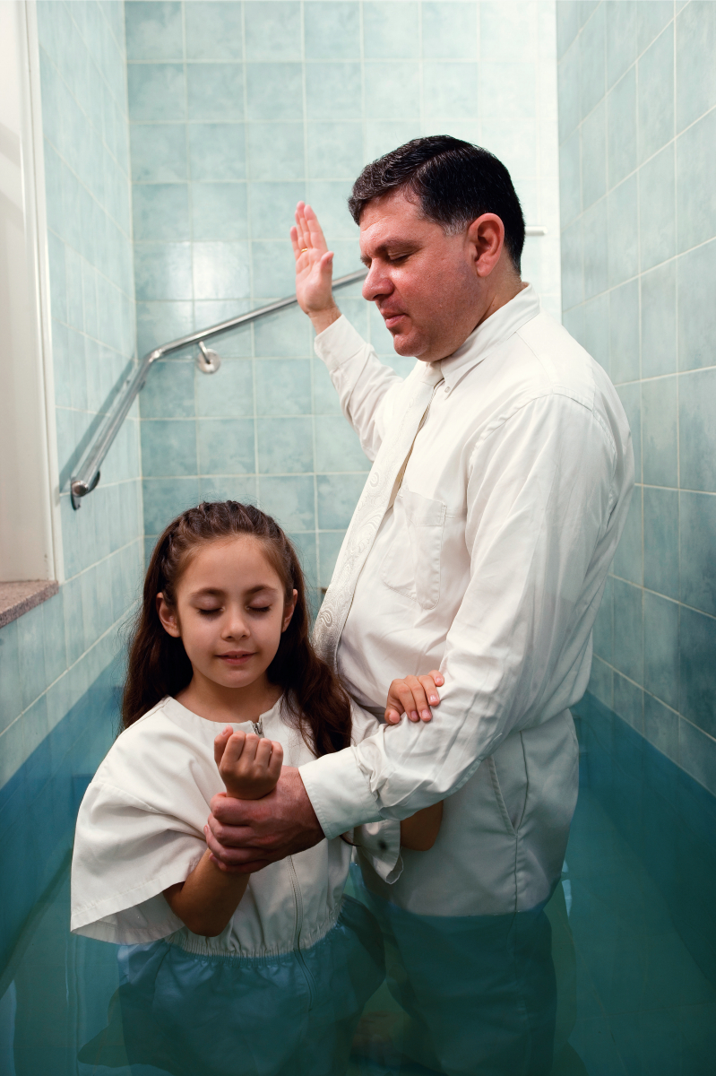
What Covenants Did I Make At Baptism?

Slide 2
Changed Forever
“Many members of the Church do not fully understand what happened when they went into the waters of baptism. It is very important for us to understand the marvelous gift of the remission of sins, but there is much more. Do you understand that when we are baptized we are changed forever?
When we are baptized, we take upon ourselves the sacred name of Jesus Christ. Taking upon us His name is one of the most significant experiences we have in life. Yet sometimes we pass through that experience without having a full understanding.” Robert D. Hales

Slide 3
What Covenants Did I Make At Baptism?
When we were baptized, we entered into a covenant with God. We promised to take upon ourselves the name of Jesus Christ, always remember Him, keep His commandments, and serve Him to the end. We renew this covenant each time we partake of the sacrament.
Remember: A covenant is a sacred agreement between you & God.

Slide 4
Taking upon Yourself the Name of Jesus Christ
When you take upon yourself the name of Jesus Christ, you see yourself as His. You put Him and His work first in your life. You seek what He wants rather than what you want or what the world teaches you to want.
As we follow the example of Jesus, we, too, demonstrate that we will repent and be obedient in keeping the commandments of our Father in Heaven. We humble ourselves with a broken heart and a contrite spirit as we recognize our sins and seek forgiveness of our trespasses We covenant that we are willing to take upon ourselves the name of Jesus Christ and always remember Him.

Slide 5
Keeping the Commandments
Your baptismal covenant is a commitment to come into God’s kingdom, separating yourself from the world and standing as a witness of God “at all times and in all things, and in all places” (Mosiah 18:9).
Your efforts to stand as a witness of God include everything you do and say.

Slide 6
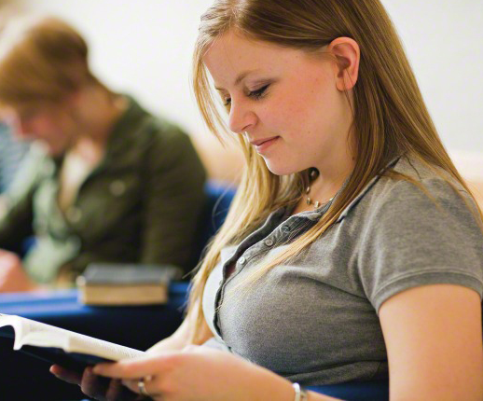
Keeping the Commandments
Strive always to remember and keep the Lord’s commandments. Keep your thoughts, language, and actions pure. When you seek entertainment such as movies, television, the Internet, music, books, magazines, and newspapers, be careful to watch, listen to, and read only those things that are uplifting.
Dress modestly.
Choose friends who encourage you to reach your eternal goals.
Stay away from immorality, pornography, gambling, tobacco, alcohol, and illicit drugs.
Keep yourself worthy to enter the temple.

Slide 7
Serving the Lord
The commandment to separate yourself from the things of the world does not mean that you should isolate yourself from others. Part of the baptismal covenant is to serve the Lord, & you serve Him best when you serve your fellow men.
When the prophet Alma taught about the baptismal covenant, he said that we should be “willing to bear one another’s burdens, that they may be light” & “willing to mourn with those that mourn … & comfort those that stand in need of comfort” (Mosiah 18:8–9). Be kind & respectful to all people, following the example of Jesus Christ in the way you treat others.

Slide 8
Promised Blessings of Baptism
As you keep the covenant you made at baptism, the Lord will bless you for your faithfulness. Some of the blessings you receive are the constant companionship of the Holy Ghost, the remission of your sins, and the privilege of being spiritually reborn.

Slide 9
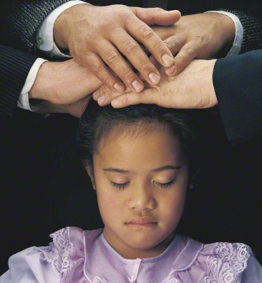
The Constant Companionship of the Holy Ghost
After you were baptized, one or more authorized Melchizedek Priesthood holders laid their hands on your head and gave you the gift of the Holy Ghost. This gift gives you the right to the constant companionship of the Holy Ghost as long as you are worthy. The Spirit’s constant companionship is one of the greatest blessings you can receive in mortality. The Spirit will guide you in the paths of righteousness and peace, leading you to eternal life.

Slide 10
Remission of Sins
Because you have been baptized, you can receive a remission of your sins. In other words, you can be forgiven through the mercy of the Savior. With this blessing, you can be permitted eventually to live in the presence of Heavenly Father.
To receive a remission of your sins, you must exercise faith in Jesus Christ, be sincerely repentant, and strive always to keep the commandments.
You “retain a remission of your sins” as you continue to humble yourself before God, call upon Him daily in prayer, remain steadfast in the faith, and serve those in need

Slide 11
Being Born Again
Through the ordinances of baptism and confirmation, you were born again into a new life. You began a new life when you entered into the baptismal covenant. You can grow in spirituality and become more like the Savior by keeping your baptismal covenant, partaking of the sacrament to renew your covenant, and repenting of your sins. The Apostle Paul taught that when we have been baptized, we “should walk in newness of life” (Romans 6:4).

Slide 12
Enduring to the End
Now that you are baptized and have received the gift of the Holy Ghost, you must continue in righteousness, for these ordinances mark only the beginning of your journey back to dwell with your Heavenly Father. The prophet Nephi taught:
“After ye have gotten into this strait and narrow path, I would ask if all is done? Behold, I say unto you, Nay; for ye have not come thus far save it were by the word of Christ with unshaken faith in him, relying wholly upon the merits of him who is mighty to save.
“Wherefore, ye must press forward with a steadfastness in Christ, having a perfect brightness of hope, and a love of God and of all men. Wherefore, if ye shall press forward, feasting upon the word of Christ, and endure to the end, behold, thus saith the Father: Ye shall have eternal life” (2 Nephi 31:19–20)

Slide 13
Our Baptismal Covenant Can Change Our Lives
“When we understand our baptismal covenant and the gift of the Holy Ghost, it will change our lives and will establish our total allegiance to the kingdom of God. When temptations come our way, if we will listen, the Holy Ghost will remind us that we have promised to remember our Savior and obey the commandments of God.” Robert D. Hales

Slide 14
Video Presentation
A Mighty Change: Conversion
Pay attention to the ways baptism has changed Alejandra’s life

Slide 15
Questions to Ponder
In what ways should being baptized change our lives?
How has it changed your life?
What do the you feel you can do to more fully keep your baptismal covenants at all times and in all places?

Slide 16
Our Baptismal Covenants & Difficult Choices
Write down a difficult choice that youth face and then put your paper into a container.
We will take turns randomly picking a paper from the container, reading what is on it, and sharing some ideas of how we might remember and keep our baptismal covenants while facing these challenges.

