Slide 1
What Is The Priesthood?

Slide 2
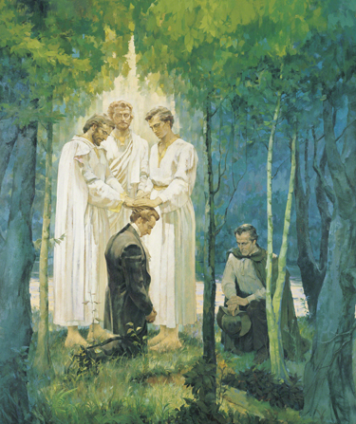
What Do You Know About The Priesthood?

Slide 3
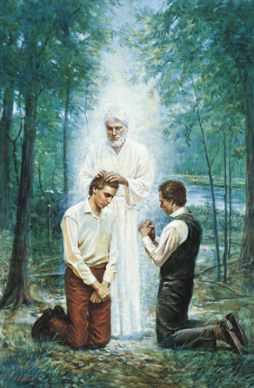
The priesthood is the eternal power and authority of our Heavenly Father.

Slide 4
Question: Who can hold the Priesthood?
How do they receive this power?

Slide 5
He gives worthy priesthood holders authority to administer ordinances of salvation. All of Heavenly Father’s children can qualify to receive these ordinances and access the power and blessings of the priesthood.

Slide 6
Hebrews 5:4 And no man taketh this honour unto himself, but he that is called of God, as was Aaron.

Slide 7
We believe that a man must be called of God, by prophecy, and by the laying on of hands by those who are in authority, to preach the Gospel and administer in the ordinances thereof.
Articles of Faith 1:5

Slide 8
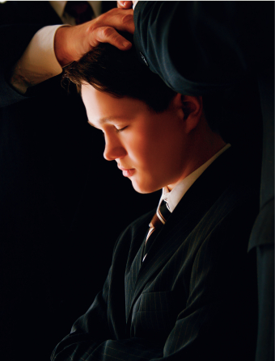
Answer:
Priesthood holders are called of God and ordained by one in authority

Slide 9
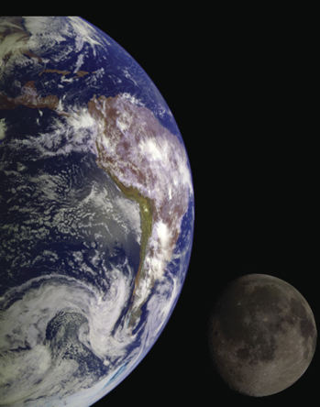
Through the priesthood, God created & governs the heavens & earth.
Question: If that is the power God has, what is the priesthood power like today?

Slide 10
“The power by which the heavens and earth were and are created is the priesthood...it is also the power the Savior used in His mortal ministry to perform miracles, to bless and heal the sick, to bring the dead to life, and, as our Father’s Only Begotten Son, to endure the unbearable pain of Gethsemane and Calvary.” M. Russell Ballard
This is the same priesthood on the earth today!
Have you ever thought about that?
This incredible power of God is the same priesthood held by your Dad, your brother, your friend or your neighbor!

Slide 11
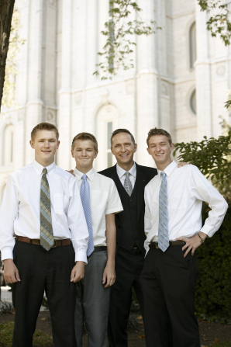
Question: After being ordained, how does the priesthood holder exercise this power?
D&C 121:34-36, D&C 121:41,42,45

Slide 12
What is “real”power & how do we obtain it?
The World’s View
Money
Job
Popularity
Good Looks
Possessions
Pride
Control
The Priesthood
Righteousness
Gentleness
Meekness
Love
Kindness
Purity
Faith

Slide 13
Answer: Priesthood holders should exercise the power of the priesthood with humility and charity, never dominion or control.
The power of the priesthood operates only on principles of righteousness.

Slide 14
The power of the priesthood is a sacred and essential gift of God.
The power of the priesthood comes only when those who exercise it are worthy and acting in accordance with God’s will.
If you are a priesthood holder, remember that the priesthood should be a part of you at all times and in all circumstances. It is not like a cloak that you can put on and take off at will. (True to the Faith)
We can do our part to encourage the priesthood holders in our lives to maintain worthiness at all times.

Slide 15
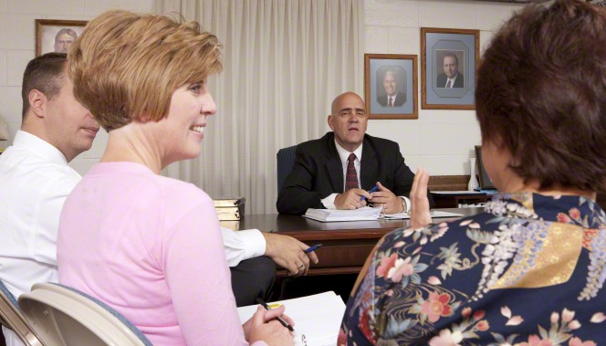
Question:
“If the power and blessings of the priesthood are available to all, why are the ordinances of the priesthood administered by men?” Elder Neil Anderson

Slide 16
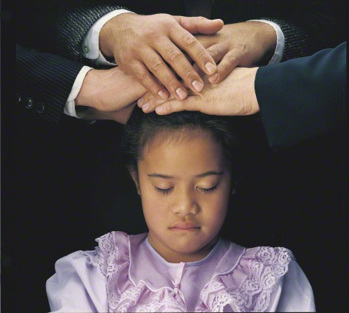
Although the authority of the priesthood is bestowed only on worthy male members of the Church, the blessings of the priesthood are available to all—men, women, and children. We all benefit from the influence of righteous priesthood leadership, and we all have the privilege of receiving the saving ordinances of the priesthood.

Slide 17
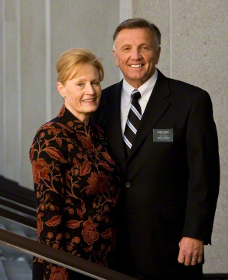
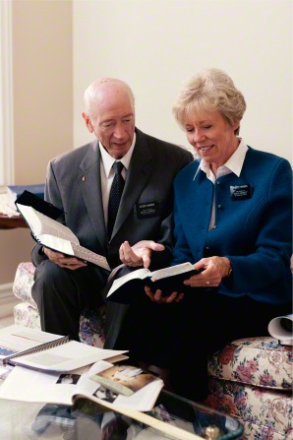
In our Heavenly Father’s great priesthood-endowed plan, men have the unique responsibility to administer the priesthood, but they are not the priesthood. Men and women have different but equally valued roles.

Slide 18
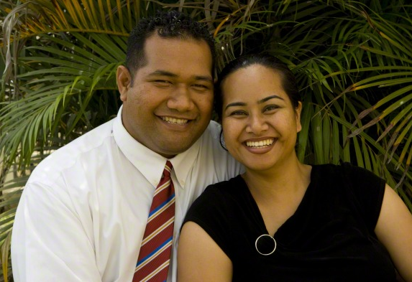
Just as a woman cannot conceive a child without a man, so a man cannot fully exercise the power of the priesthood to establish an eternal family without a woman. In other words, in the eternal perspective, both the procreative power and the priesthood power are shared by husband and wife.

Slide 19
Answer:
It is crucial for us to understand that Heavenly Father has provided a way for all of His sons and His daughters to have access to the blessings of and be strengthened by the power of the priesthood.

Slide 20
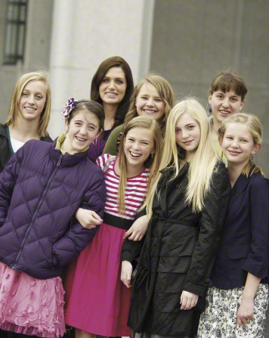
Question: Why Do I Need To Understand the Priesthood Principles?

Slide 21
Answer:
Sister Burton said Latter-day Saint women are privileged to live in this season of the history of the Church when questions are asked about the priesthood. “There is great interest and desire to know and understand more about the authority, power, and blessings associated with the priesthood of God,” she said. “We hope to instill within each of us a greater desire to better understand the priesthood. Latter-day Saint women cannot stand up and teach something they do not understand.

Slide 22
How Can We Better Know The Doctrine of the Priesthood For Ourselves? Sister Burton
First, seek to be worthy of the gift of the Holy Ghost. “Because the doctrine of the priesthood is best understood by revelation, it is essential to have the help of the Holy Ghost to reveal and distill the doctrine upon our souls,” she said.
Second, attend the holy temple. “We know that the temple is the most holy of any place of worship on the earth and is the ideal setting to learn about the priesthood by the spirit of revelation,” she said. “In the temple we are all taught together, make covenants with our Heavenly Father, and receive sacred priesthood ordinances together.”
Third, study the scriptures. “Searching, pondering, and studying the scriptures are invitations for the Holy Ghost to reveal to us important truths about the priesthood.”

Slide 23
Video
Priesthood Blessings are Available to All

