Slide 1
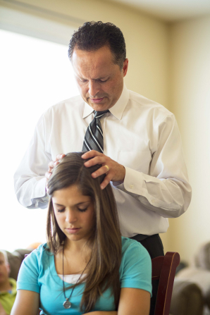
How do I receive the power and blessings of the priesthood in my life?

Slide 2
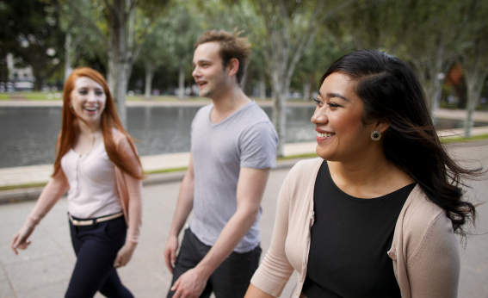
All Heavenly Father’s sons and daughters are equally blessed as they draw upon the power of the priesthood.
Elder Dallin H. Oaks of the Quorum of the Twelve Apostles taught: “While we sometimes refer to priesthood holders as ‘the priesthood,’ we must never forget that the priesthood is not owned by or embodied in those who hold it. It is held in a sacred trust to be used for the benefit of men, women, and children alike.”

Slide 3
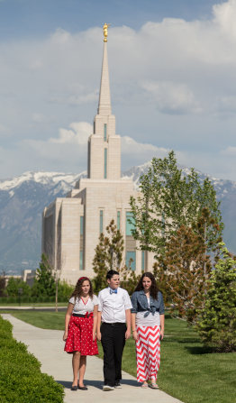
Sister Sheri L. Dew,
“Sisters, some will try to persuade you that because you are not ordained to the priesthood, you have been shortchanged. They are simply wrong, and they do not understand the gospel of Jesus Christ.
The blessings of the priesthood are available to every righteous man and woman. We may all receive the Holy Ghost, obtain personal revelation, and be endowed in the temple, from which we emerge ‘armed’ with power.

Slide 4
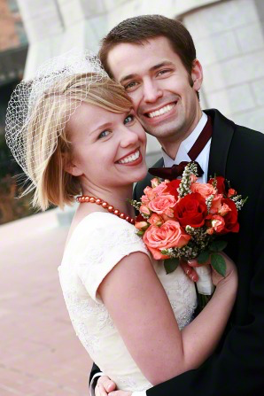
Sheri Dew Cont...
The power of the priesthood heals, protects, and inoculates all of the righteous against the powers of darkness.
Most significantly, the fullness of the priesthood contained in the highest ordinances of the house of the Lord can be received only by a man and woman together.”

Slide 5
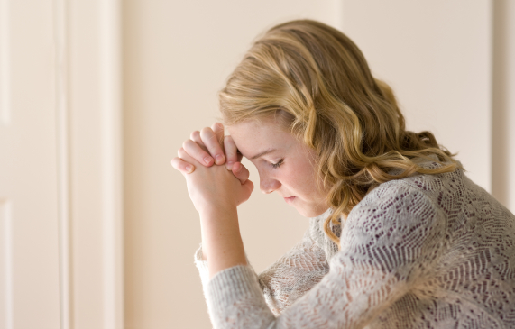
All Have Access
All have access to priesthood blessings regardless of their circumstances. These blessings can come through family members, priesthood leaders, and home teachers.

Slide 6
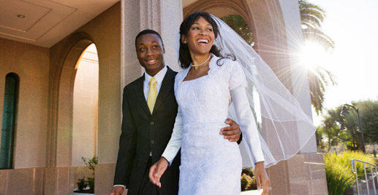
President Spencer W. Kimball
President Spencer W. Kimball said this: “When we speak of marriage as a partnership, let us speak of marriage as a full partnership. We do not want our LDS women to be silent partners or limited partners in that eternal assignment! Please be a contributing and full partner” (The Teachings of Spencer W. Kimball, ed. Edward L. Kimball [1982], 315).

Slide 7
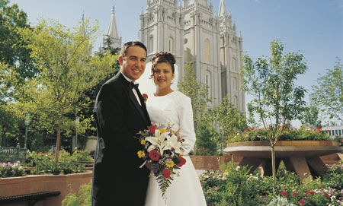
President Kimball (cont)
President Kimball also declared, “We have heard of men who have said to their wives, ‘I hold the priesthood and you’ve got to do what I say.’” He decisively rejected that abuse of priesthood authority in a marriage, declaring that such a man “should not be honored in his priesthood” (The Teachings of Spencer W. Kimball, 316). If men desire the Lord’s blessings in their family leadership, they must exercise their priesthood authority according to the Lord’s principles for its use

Slide 8
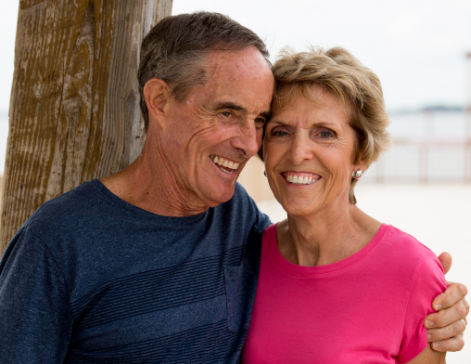
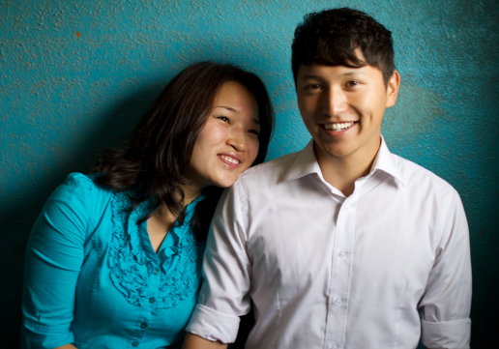
Respect
There exists today a great need for men and women to cultivate respect for each other as sons and daughters of God and reverence for our Father in Heaven and His priesthood—His power and authority.
He has a plan for us, and when we exercise our faith and trust in His plan, our reverence for Him and for His priesthood power and authority will be strengthened. Carole Stephens

Slide 9
Carole M. Stephens 1st Counselor in the General RS Presidency
In “The Family: A Proclamation to the World,” the First Presidency and the Quorum of the Twelve Apostles state: “All human beings—male and female—are created in the image of God. Each is a beloved spirit son or daughter of heavenly parents, and, as such, each has a divine nature and destiny.”1 To achieve this divine destiny, each son and daughter of God needs priesthood ordinances and covenants.

Slide 10
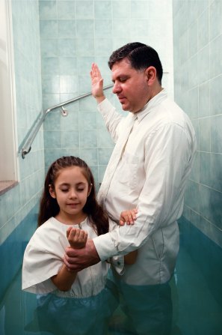
Baptism
We need baptism. When we are immersed in the waters of baptism, we covenant to take Christ’s name upon us, always remember Him, keep His commandments, and serve Him to the end, that we may always have His Spirit to be with us.

Slide 11
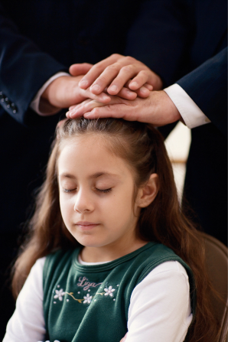
The Holy Ghost
We need the gift of the Holy Ghost. Through that ordinance, we can have access to the constant companionship of the Spirit.
The Holy Ghost is not restricted to men, nor to apostles or prophets; it belongs to every faithful man and woman, and to every child who is old enough to receive the gospel of Christ.”

Slide 12
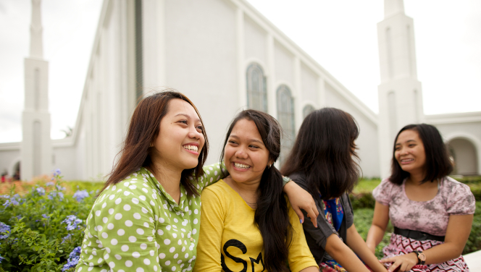
Temple Endowment
We need to receive the temple endowment. Elder M. Russell Ballard said: “When men and women go to the temple, they are both endowed with the same power, which by definition is priesthood power. … The endowment is literally a gift of power.”

Slide 13
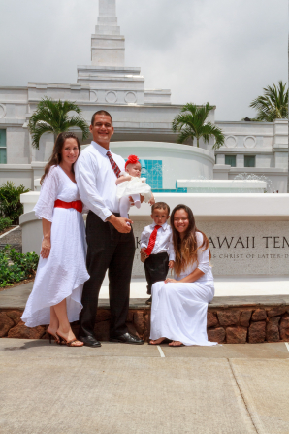
Sealing Ordinance
We need the sealing ordinance, which leads to eternal life, “the greatest of all the gifts of God.” This priesthood ordinance is received only by a man and a woman together. Elder Russell M. Nelson taught, “Priesthood authority has been restored so that families can be sealed eternally.”

Slide 14
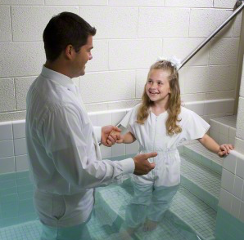
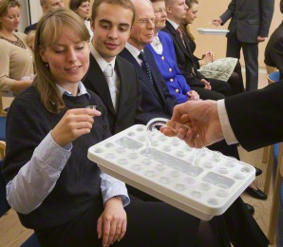
We need the opportunity to renew our covenants each week as we partake of the sacrament. Latter-day prophets and apostles have taught that when we worthily partake of the sacrament, we can renew not only our baptismal covenant but “all covenants entered into with the Lord.”

Slide 15
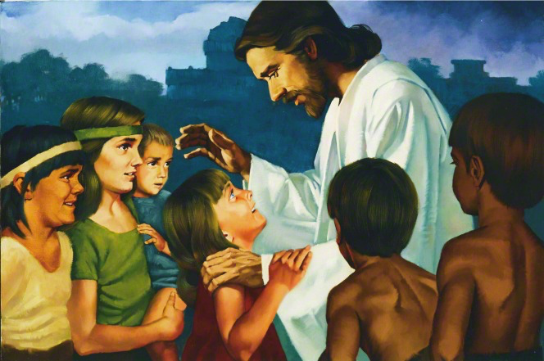
Neil A. Anderson
There are special blessings from God for every worthy person who is baptized, receives the Holy Ghost, and regularly partakes of the sacrament. The temple brings added light and strength, along with the promise of eternal life.
All of the ordinances invite us to increase our faith in Jesus Christ and to make and keep covenants with God. As we keep these sacred covenants, we receive priesthood power and blessings.

Slide 16
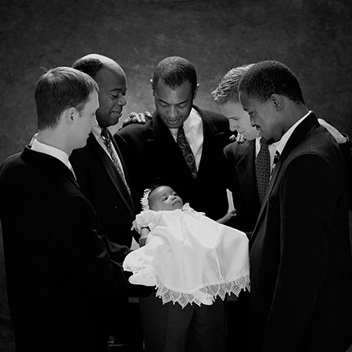
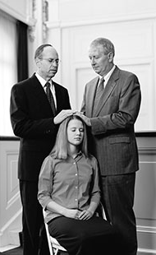
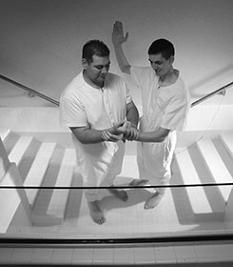
These priesthood ordinances and covenants provide access to the fullness of the blessings promised to us by God, which are made possible by the Savior’s Atonement. They arm sons and daughters of God with power, God’s power, and provide us with the opportunity to receive eternal life—to return to God’s presence and live with Him in His eternal family.

Slide 17
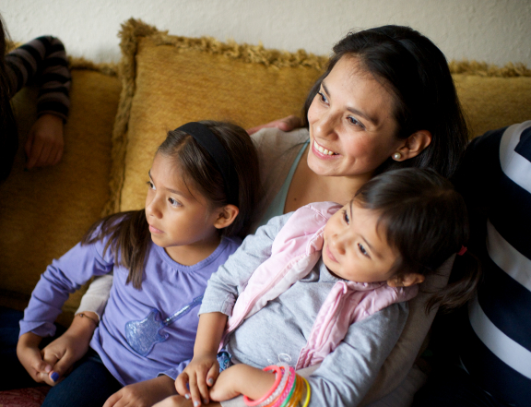
In the worldwide leadership training we were taught that sisters who don’t have priesthood holders in their homes need never feel alone. They are blessed and strengthened through the ordinances they have received and the covenants they keep.
They should not hesitate to reach out when help is needed.
Elder M. Russell Ballard taught that every woman in the Church needs to know that she has a bishop, an elders quorum president, a home teacher, and other worthy priesthood holders whom she can rely on to come into her home and assist her and give a blessing.

Slide 18
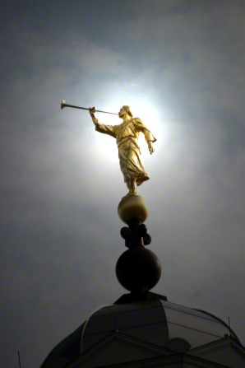
Personal Revelation, blessed by the ministering of angels, & to commune with God.”
Elder Ballard also taught: “Our Father in Heaven is generous with His power. All men and all women have access to this power for help in our own lives. All who have made sacred covenants with the Lord and who honor those covenants are eligible to receive personal revelation, to be blessed by the ministering of angels, [and] to commune with God.”
We all need each other. Sons of God need daughters of God, and daughters of God need sons of God.

Slide 19
Do We Know Who We Are?
Daughters of God, do we know who we are? Do we know what we have? Are we worthy to receive the power and blessings of the priesthood? Do we receive the gifts given to us with gratitude, grace, and dignity? Do we embrace our roles and responsibilities to strengthen homes as mothers, grandmothers, daughters, sisters, and aunts? Do we show respect for men, manhood, and fatherhood?

Slide 20
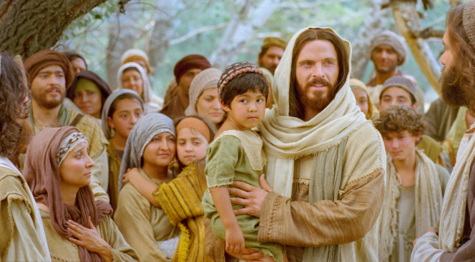
We are beloved spirit sons and daughters of heavenly parents, with a divine nature and destiny. Our Savior, Jesus Christ, loved us enough to give His life for us. His Atonement provides the way for us to progress on the path to our heavenly home, through sacred priesthood ordinances and covenants.
These priesthood ordinances and covenants were restored to the earth through the Prophet Joseph Smith, and today President Thomas S. Monson holds all the keys of the priesthood on the earth. Carole Stephens

Slide 21
The Priesthood
The priesthood is the power and authority of God given for the salvation and blessing of all—men, women, and children. Neil A. Anderson
A man may open the drapes so the warm sunlight comes into the room, but the man does not own the sun or the light or the warmth it brings. The blessings of the priesthood are infinitely greater than the one who is asked to administer the gift.

Slide 22
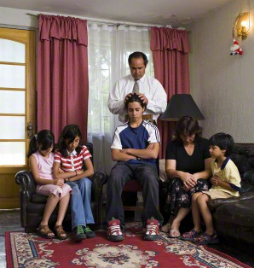
What We Know about the Priesthood
Some may sincerely ask the question, “If the power and blessings of the priesthood are available to all, why are the ordinances of the priesthood administered by men?”
When an angel asked Nephi, “Knowest thou the condescension of God?” Nephi answered honestly, “I know that he loveth his children; nevertheless, I do not know the meaning of all things.”
When we speak of the priesthood, there are many things we do know.

Slide 23
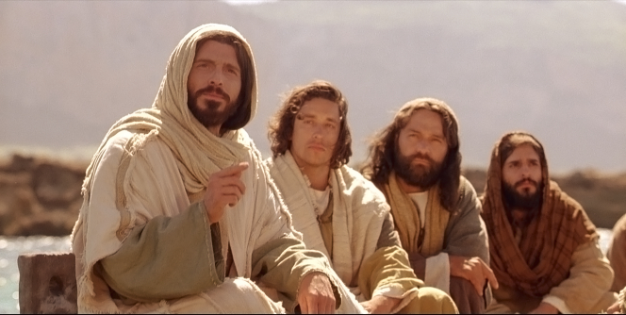
From The Beginning
We know that from the beginning the Lord established how His priesthood would be administered. “The Priesthood was first given to Adam.” Noah, Abraham, and Moses all administered priesthood ordinances. Jesus Christ was and is the Great High Priest. He called Apostles. “Ye have not chosen me,” He said, “but I have chosen you, and ordained you.” In our day heavenly messengers were sent from God. John the Baptist, Peter, James, and John restored the priesthood to the earth through the Prophet Joseph Smith. This is the way our Father in Heaven has administered His priesthood.

Slide 24
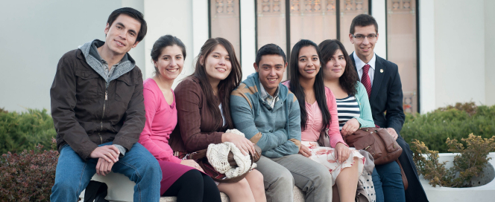
All Are Alike
We know that God loves all His children and is no respecter of persons. “He denieth none that come unto him, … male [or] female; … and all are alike unto God.”
As surely as we know that God’s love is “alike” for His sons and His daughters, we also know that He did not create men and women exactly the same. We know that gender is an essential characteristic of both our mortal and eternal identity and purpose. Sacred responsibilities are given to each gender.

Slide 25
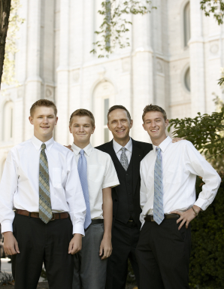
Worthiness
Unworthily administering or passing the sacrament, blessing the sick, or participating in other priesthood ordinances is, as Elder David A. Bednar has said, taking the name of God in vain. If one is unworthy, he should withdraw from officiating in priesthood ordinances and prayerfully approach his bishop as a first step in repenting and returning to the commandments.
We can be good examples to the Priesthood holders we know. We can encourage them to always maintain their worthiness.

Slide 26
Testimony & Promise
The power of God’s holy priesthood is found in The Church of Jesus Christ of Latter-day Saints. I testify that as you worthily participate in the ordinances of the priesthood, the Lord will give you greater strength, peace, and eternal perspective. Whatever your situation, your home will be “blessed by the strength of priesthood power” and those close to you will more fully desire these blessings for themselves.
As men and women, sisters and brothers, sons and daughters of God, we move forward together. This is our opportunity, our responsibility, and our blessing. This is our destiny—to prepare the kingdom of God for the return of the Savior. In the name of Jesus Christ, amen.

Slide 27
How do I receive the power and blessings of the priesthood in my life?
Through the priesthood, we can receive the ordinances of salvation, including baptism and confirmation and temple ordinances that seal our families eternally.
Keeping the covenants associated with these ordinances brings priesthood power—the power of God—into our lives. We can recognize this power operating in our lives as we sincerely repent and receive forgiveness, become more sensitive to the promptings and guidance of the Holy Ghost, and draw strength from the ordinances of the gospel.
Through the priesthood we can also receive special blessings of comfort and healing, including father’s blessings and patriarchal blessings. The promises in these blessings are realized through our faith and are available to all God’s children.

Slide 28
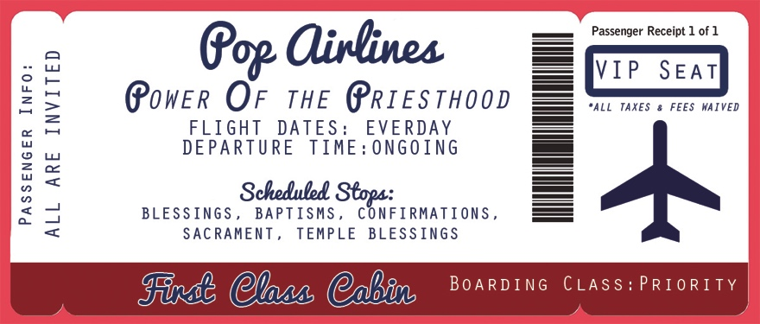
Our journey through this mortal life will be blessed immensely if we take advantage of the Power Of the Priesthood!
We all have Priority Tickets and VIP Seats! Hop aboard “POP” (Power Of the Priesthood) Airlines and enjoy the journey!

