Slide 1
The Resurrection

Slide 2
What is the Resurrection?
Resurrection is the reuniting of the spirit with the body in an immortal state, no longer subject to disease or death.
After resurrection, the spirit and body will never again be separated, and the person will become immortal. Every person born on earth will be resurrected because Jesus Christ overcame death. 1 Cor. 15:20–22.

Slide 3
Knowledge of the Resurrection Can Bring Hope

Slide 4
The Resurrection Brings Hope & Meaning to our Life
The resurrection is a pillar of our faith. It adds meaning to our doctrine, motivation to our behavior, & hope for our future. Dallin H. Oaks
How can knowledge of our future Resurrection impact our life today?

Slide 5
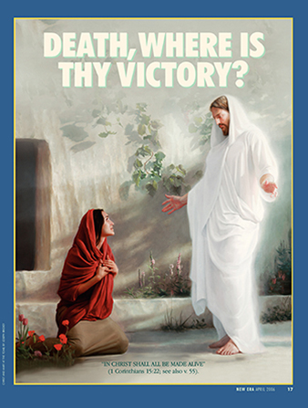
In Christ Shall All Be Made Alive
1 Corinthians 15:22 & 55

Slide 6
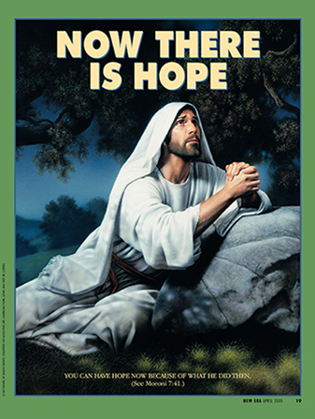
You Can Have Hope Now Because Of What He Did Then.
Moroni 7:41

Slide 7
Hope
The Resurrection is at the core of our beliefs as Christians. Without it, our faith is meaningless. The Apostle Paul said, “If Christ be not risen, then is our preaching vain, and [our] faith is also vain” (1 Corinthians 15:14).

Slide 8
The Resurrection Brings Hope
An understanding and testimony of the resurrection can give us hope and perspective as we experience the challenges, trials, and triumphs of life. We can find comfort in the assurance that the Savior lives and that through His Atonement, “he breaketh the bands of death, that the grave shall have no victory, and that the sting of death should be swallowed up in the hopes of glory” (Alma 22:14).

Slide 9
Knowledge of The Resurrection Can Sustain Us During Times of Suffering and of Death Harold B. Lee

Slide 10
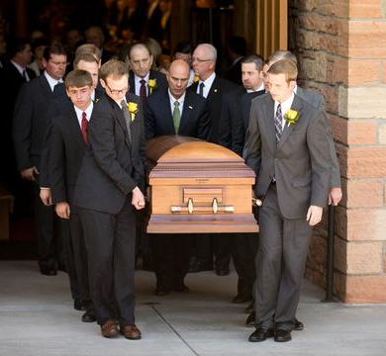
Death Is A Necessary Step
Death is a necessary step in your progression, just as your birth was. Sometime after your death, your spirit and your body will be reunited—never to be separated again. This is called resurrection, and it was made possible by the death and Resurrection of Jesus Christ (see 1 Corinthians 15:20-22).

Slide 11
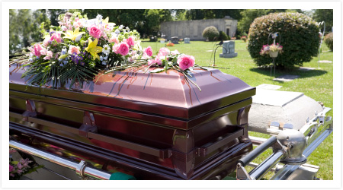
We Mourn Our Loved Ones
Irrespective of age, we mourn for those loved and lost. Mourning is one of the deepest expressions of pure love. It is a natural response in complete accord with divine commandment: “Thou shalt live together in love, insomuch that thou shalt weep for the loss of them that die.” (D&C 42:45.) Eternal perspective provides peace “which passeth all understanding.” (Philip. 4:7.) Russell M Nelson.

Slide 12
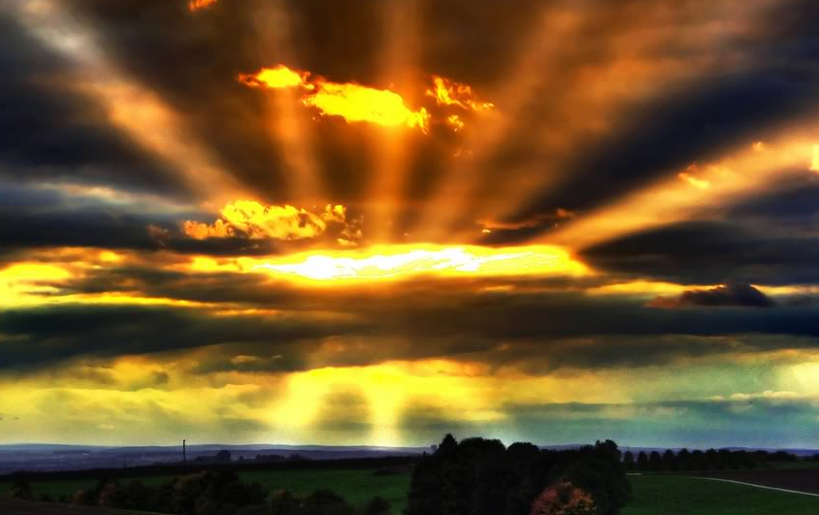
Death Is Not The End
Death is not the end. Death is really a beginning—another step forward in Heavenly Father’s plan for His children. Someday, like everyone else, your physical body will die.
But your spirit does not die, it goes to the spirit world, where you will continue to learn and progress and may be with loved ones who have passed on.

Slide 13
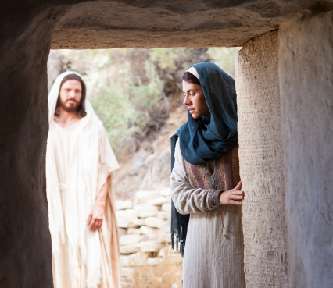
Physical Death is Temporary
The grip of physical death is temporary. It began with the fall of Adam; it ended with the atonement of Jesus the Christ. The waiting period in paradise is temporary, too. It ends with the resurrection. Russell M. Nelson

Slide 14
A Testimony of the Resurrection

Slide 15
Testimony: Jesus Is the Christ Ezra Taft Benson
I bear witness to you that Jesus is the Christ, the Savior and Redeemer of the world—the very Son of God.
He was born the babe of Bethlehem.
He lived and ministered among men.
His friends deserted Him.
His closest associates did not fully understand His mission, and they doubted. One of the most trusted denied knowing Him.
He was crucified on Calvary.
He asked forgiveness for His tormentors and then willingly gave up His life.
His body was laid in a borrowed tomb.
An immense stone was placed over the opening.
On the third day there was a great earthquake. The stone was rolled back from the door of the tomb. Some of the women, His devoted followers, came to the place with spices “and found not the body of the Lord Jesus” (Luke 24:3).
Angels appeared and said simply, “Why seek ye the living among the dead?
“He is not here, but is risen” (Luke 24:5–6).
There is nothing in history to equal that dramatic announcement: “He is not here, but is risen.”

Slide 16
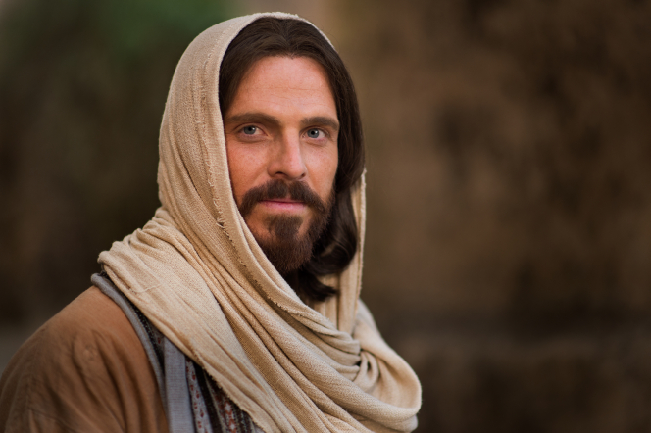
He Is Risen
The greatest events of history are those which affect the greatest number for the longest periods. By this standard, no event could be more important to individuals or nations than the Resurrection of the Master. The eventual resurrection of every soul who has lived and died on earth is a scriptural certainty, and surely there is no event for which one should make more careful preparation. Nothing is more absolutely universal than the resurrection. Every living being will be resurrected. “For as in Adam all die, even so in Christ shall all be made alive” (1 Cor. 15:22). … (Ezra Taft Benson)

Slide 17
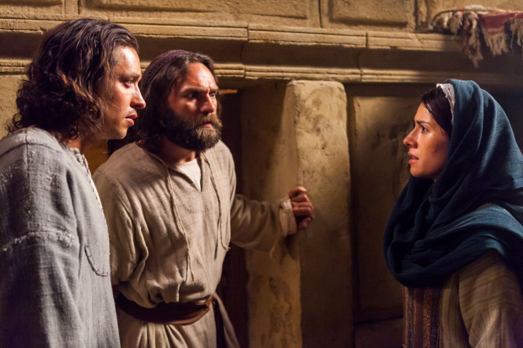
Joseph B. Wirthlin
The Resurrection transformed the lives of those who witnessed it. Should it not transform ours? We will all rise from the grave. On that day we will know the love of our Heavenly Father and will rejoice that the Messiah overcame all that we could live forever.

Slide 18
“Sunday Will Come” Video

Slide 19
Easter & The Resurrection
What do we celebrate at Easter?

Slide 20
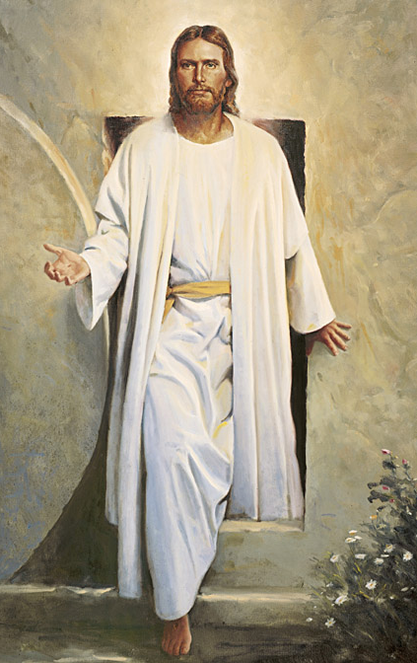
Why We Celebrate Easter
The day Jesus was resurrected was the first Easter.
We celebrate Easter each year to help us remember that Jesus was resurrected.

Slide 21
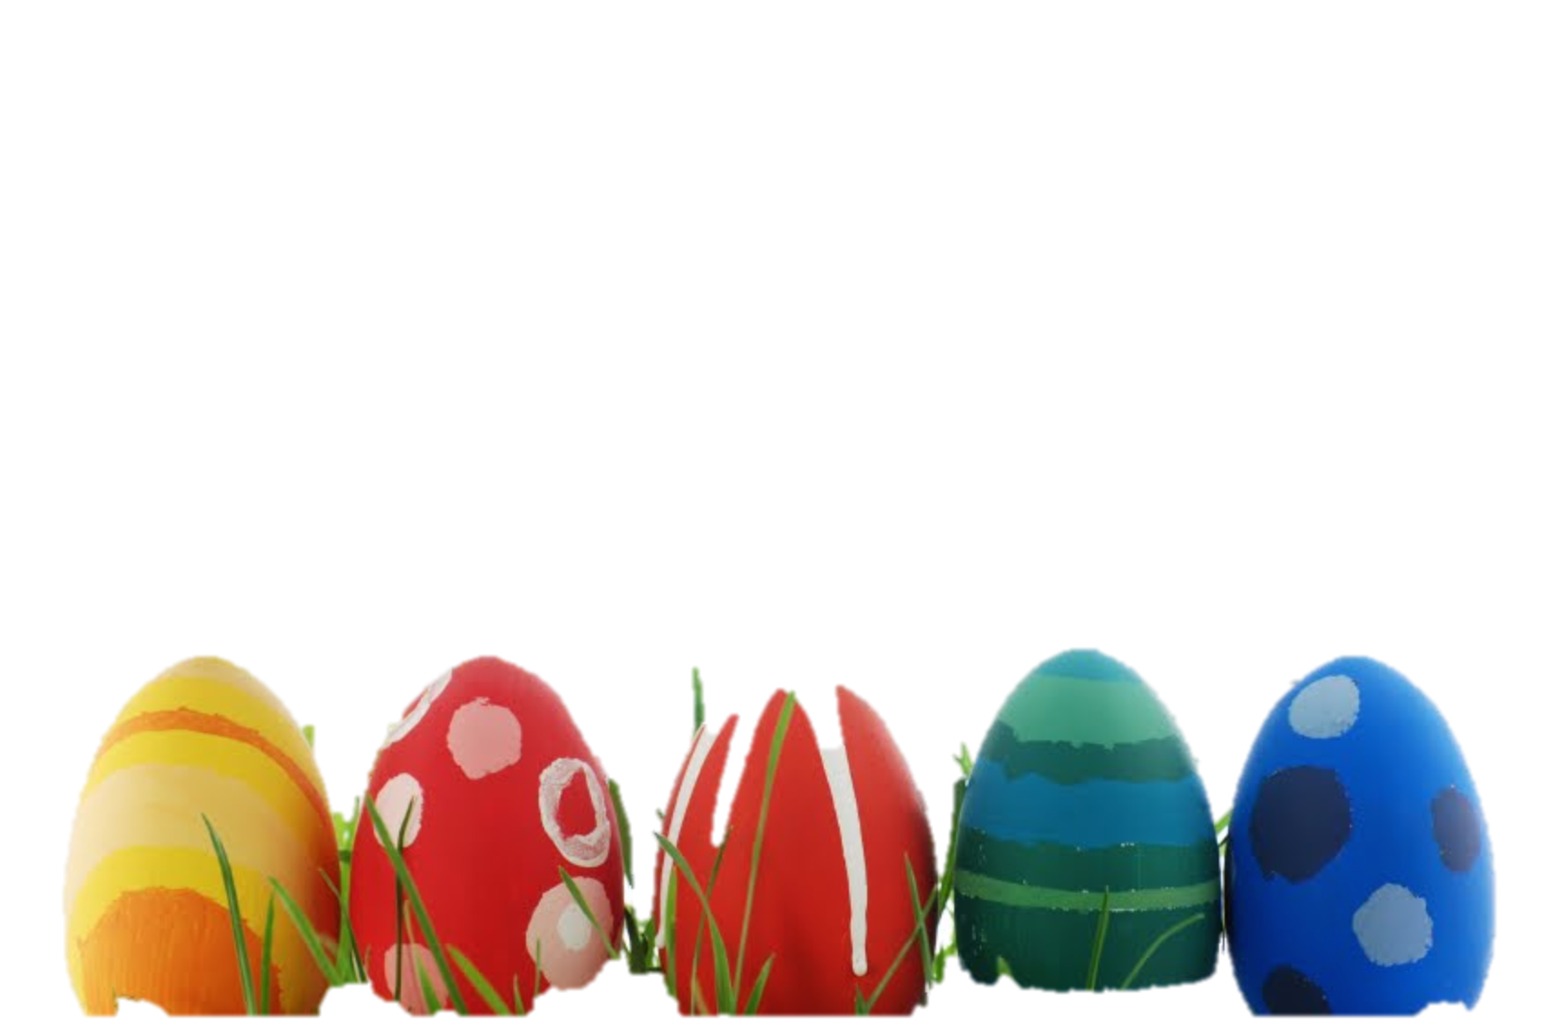
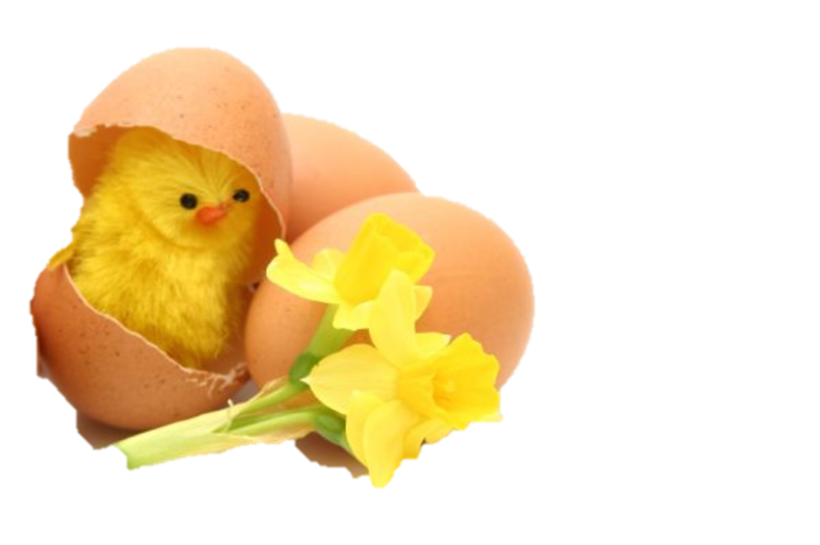
Easter can be fun with chicks and bunnies, but it’s really about the Resurrection of Jesus Christ. And He did it all for us. It is sad when people just forget about it. Jesus went through a lot of pain and suffering for me and all the world. It’s just wonderful! My family has the Easter bunny come a night early. Then our family can think about the true meaning of Easter on Sunday. (Alexis Age 9)
At this sacred time of the year, gospel-centered family activities should take precedence over the Easter Bunny, colored eggs, baskets, baby chicks, candy, special meals, and new clothes.

Slide 22
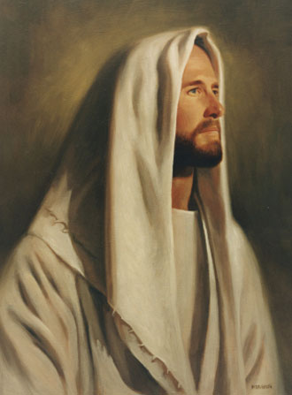
Focus on the Savior
Colored eggs, baby chicks, tasty food, & new clothes may be symbolic of new life. But focusing our attention on our Savior & his gifts of life through the Resurrection & the possibility for eternal life through his Atonement is the best way to make Easter a day of “divine worship” & to establish gospel-centered family activities worthy of this sacred day.

Slide 23
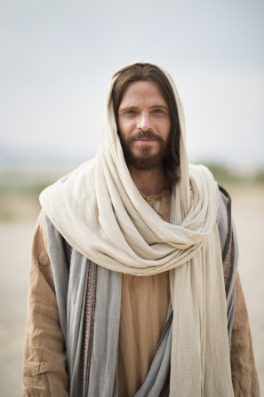
Miracle of Easter
Although the events of the first Easter happened almost two thousand years ago, the story of Jesus does not end there. Still he lives, and still he loves us. He has again set up his Church on the earth so that we can have the blessings of the gospel.
And that is the miracle of Easter. Jesus the Christ has triumphed over sin and death. He lives.

