Slide 1
How Can I Make My Prayers More Meaningful

Slide 2
Meaningful prayer
How can I make daily prayer more meaningful? It’s a good question, and it’s one that applies to all of us. President Hinckley used to say that sometimes when we pray it’s like we’re picking up a phone, ordering groceries, and then we hang up the phone—we put in our order, and we don’t think any more about it than that. But if we take a few minutes just to think about our particular need in a given moment, then prayer becomes more meaningful. (Elder D. Todd Christofferson)

Slide 3
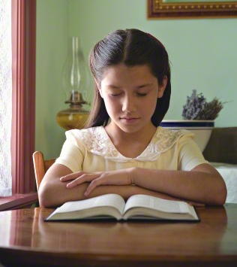
In 2 Nephi 32:9 it says: “Behold, I say unto you that ye must pray always, and not faint; that ye must not perform any thing unto the Lord save in the first place ye shall pray unto the Father in the name of Christ, that he will consecrate thy performance unto thee, that thy performance may be for the welfare of thy soul.”

Slide 4
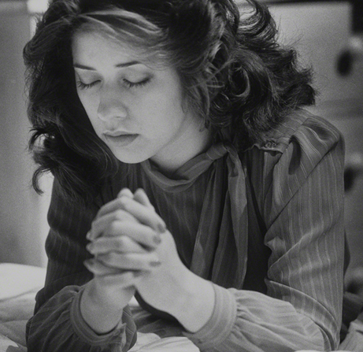
Make time for personal prayer
Personal, private prayer is an essential part of your spiritual development. At least every morning and every night, find a place that is free from distractions. Kneel in humility and commune with your Heavenly Father. Although sometimes you may need to pray silently, make an extra effort at times to pray vocally (see D&C 19:28; 20:51)

Slide 5
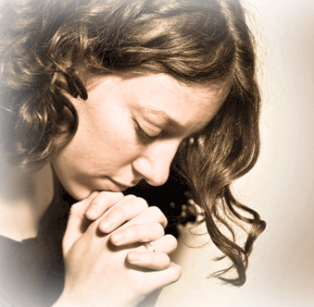
Prayer is a privilege
Prayer is a privilege and the soul’s sincere desire. We can move beyond routine and “checklist” prayers and engage in meaningful prayer as we appropriately ask in faith and act, as we patiently persevere through the trial of our faith, and as we humbly acknowledge and accept “not my will, but Thine, be done.” (Elder Bednar)

Slide 6
We pray to our Father in Heaven
Simply stated, prayer is communication to Heavenly Father from His sons and daughters on earth. “As soon as we learn the true relationship in which we stand toward God (namely, God is our Father, and we are his children), then at once prayer becomes natural and instinctive on our part”
Just like communication with our earthly Father, our Heavenly Father wants to hear from us regularly. He is concerned about us, he loves us. You wouldn’t say the same thing over and over to your earthly father...it’s important not to do that to our Heavenly Father.

Slide 7
A pattern of prayer
Elder David A. Bednar talked in a general conference about prayer & praying always (see “Pray Always,” Ensign, Nov. 2008, 41). He said if our morning prayers are looking out toward the day & what’s coming, we’re previewing the day in our prayer. In our evening prayers, we report to the Lord on what’s happened through the course of the day. We may be thanking Him for blessings received, we may be repenting of a few things that happened that were not right, & then there are all the prayers in between. It just becomes part of a stream of prayers. It’s all part of a pattern, and that goes on day in and day out and week after week and through the years. That’s what it means to have your heart drawn out in prayer to Him. (Elder Christofferson)

Slide 8
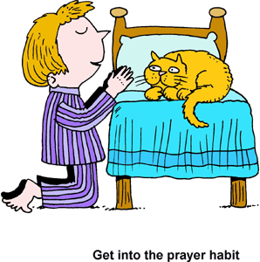
Avoid vain repetitions
Avoid “vain repetitions.” Jesus taught: “When ye pray, use not vain repetitions, as the heathen, for they think that they shall be heard for their much speaking” (3 Ne. 13:7).
If you’re not careful, it’s easy to get into a rut of saying the same things the same way in your prayers. Instead, be sincere when you pray, and think about what you are saying.

Slide 9
Pray with real intent
The prophet Mormon warned that if anyone “shall pray and not with real intent of heart . . . it profiteth him nothing, for God receiveth none such” (Moroni 7:9).
To make your prayers meaningful, you must pray with sincerity and “with all the energy of heart” (Moroni 7:48). Be careful to avoid “vain repetitions” when you pray (see Matthew 6:7).
Give serious thought to your attitude and to the words you use. Use language that shows love, respect,

Slide 10
Use language that shows love, respect, reverance, & closeness
The application of this principle will vary according to the language you speak. If you pray in English, for example, you should use the pronouns of the scriptures when you address God—Thee, Thou, Thy, and Thine, rather than the more common pronouns you, your, and yours.
Regardless of the language, the principle remains the same: When you pray, you should use words that appropriately convey a loving, worshipful relationship with God. You may have some difficulty learning the language of prayer, but you will gradually become more comfortable with it as you pray and read the scriptures.

Slide 11
Always give thanks
Always give thanks to your Heavenly Father. You should “live in thanksgiving daily, for the many mercies and blessings which he doth bestow upon you” (Alma 34:38). As you take time to remember your blessings, you will recognize how much your Heavenly Father has done for you. Express your thanks to Him.

Slide 12
Counsel with the Lord
Prayer becomes more meaningful as we counsel with the Lord in all of our doings, as we express heartfelt gratitude, and as we pray for others. Elder Bednar

Slide 13
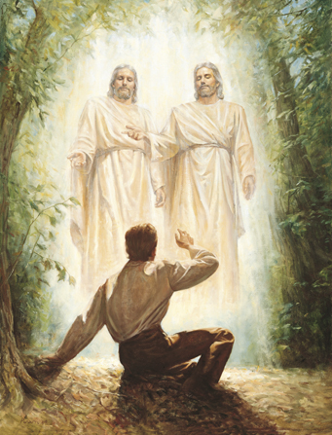
Ask in faith & act
The classic example of asking in faith is Joseph Smith and the First Vision. As young Joseph was seeking to know the truth about religion, he read the following verses in the first chapter of James:
“If any of you lack wisdom, let him ask of God, that giveth to all men liberally, and upbraideth not; and it shall be given him.
“But let him ask in faith, nothing wavering” (James 1:5–6).
Please notice the requirement to ask in faith, which I understand to mean the necessity to not only express but to do, the dual obligation to both plead and to perform, the requirement to communicate and to act. (Elder Bednar)

Slide 14
Accept God’s Will
The object of our prayers should not be to present a wish list or a series of requests but to secure for ourselves and for others blessings that God is eager to bestow, according to His will and timing. Every sincere prayer is heard and answered by our Heavenly Father, but the answers we receive may not be what we expect or come to us when we want or in the way we anticipate. (Elder Bednar)

Slide 15
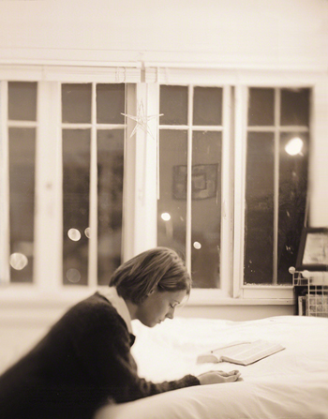
Take time to listen
Remember that prayer is two-way communication. As you close your prayers, take time to pause and listen. At times, Heavenly Father will counsel, guide, or comfort you while you are on your knees.

Slide 16
Pray for others
We shouldn’t just be praying about ourselves, because there are a lot of people in our sphere of acquaintance who have great needs as well, and we ought to be remembering them and what kind of help they need from the Lord. Those kinds of prayers are like when Enos prayed. He prayed about himself first and then about the Nephites and then the Lamanites—even his enemies were a part of his concern. That really makes prayer meaningful, to focus on others. (Elder Christofferson)

Slide 17
Pray always
Never give in to the idea that you are not worthy to pray. This idea comes from Satan, who wants to convince you that you must not pray (see 2 Nephi 32:8). If you do not feel like praying, pray until you do feel like praying.
The Savior has commanded, “Pray always, that you may come off conqueror; yea, that you may conquer Satan, and that you may escape the hands of the servants of Satan that do uphold his work” (D&C 10:5).

Slide 18
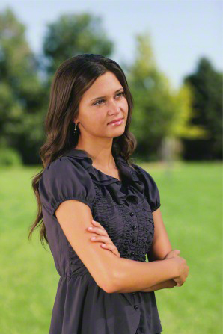
Pray continually
Although you cannot be continuously on your knees, always offering a personal, private prayer, you can let your heart be “full, drawn out in prayer unto [God] continually” (Alma 34:27; see also 3 Nephi 20:1).
Throughout each day, you can maintain a constant feeling of love for your Heavenly Father and His Beloved Son.
You can silently express gratitude to your Father and ask
Him to strengthen you in your responsibilities.
In times of temptation or physical danger, you can silently ask for His help.

Slide 19
Draw closer to God through prayer
Sometimes it’s a very, very simple prayer in a stressful crisis (“Help. Please help me.”). So we’re talking about our thoughts going to Heavenly Father. Our prayers can be brief through the course of the day, and it’s just what flows out of us naturally. The closer we get to Him, the more that happens automatically and we feel that closeness. It’s like having a friend and walking together through a hallway at school. You want to turn and talk to each other about what’s going on at the moment. And as you draw closer to God, that companionship, that friendship, if you will, tends to develop in the same way. (Elder Christofferson)

Slide 20
Make time for meaningful prayer
That being said, don’t forget that we ought to look for opportunities when we can have long prayers, when we can have a quiet time and will not be interrupted. We need a time where we can pray as long as we feel we want to and need to, where Heavenly Father can teach us and talk to us at length and not just always be responding to a quick prayer—that’s fine for the moment but not all we should ever do. (Elder Christofferson)

Slide 21
Video Presentation

Slide 22
