Slide 1
Why Is It Important To Study The Scriptures?

Slide 2
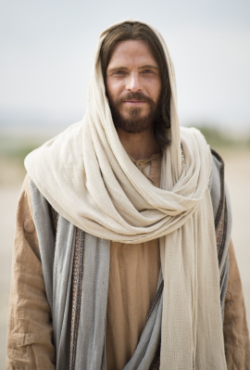
Come Unto Christ
The principal purpose of scriptures is to testify of Christ, helping us come unto Him and receive eternal life.
John 5:39
John 20:31

Slide 3
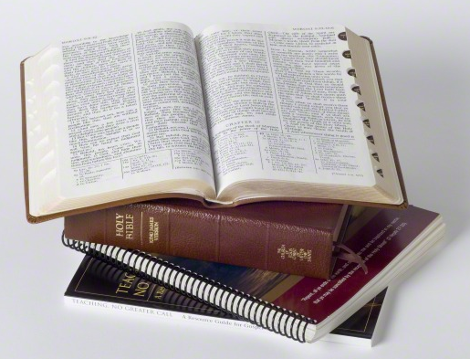
Study Daily
The scriptures contain the word of God. Latter-day prophets counsel us to study the scriptures every day, both individually and with our families.
“Daily, meaningful scripture study helps you be receptive to the whisperings of the Holy Ghost. It builds your faith, fortifies you against temptation, and helps you draw near to your Heavenly Father and His Beloved Son.” (True to the Faith)

Slide 4
How Do We Make Our Study Meaningful?
Develop a plan for your personal study of the scriptures.
Consider setting aside a certain amount of time each day to study the scriptures.
During that time, read carefully, being attentive to the promptings of the Spirit.
Ask your Heavenly Father to help you know what He would have you learn and do.

Slide 5
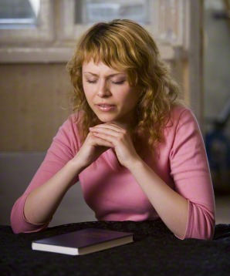
Always Begin With Prayer
Always begin with prayer, you’ll have a much easier time understanding and finding answers as you read. As you make daily scripture study a habit, be sure to have prayer become a consistent part of your pattern.

Slide 6
Elder D. Todd Christofferson gave the following insights about how we should study the scriptures:
“You should care more about the amount of time you spend in the scriptures than about the amount you read in that time.
I see you sometimes reading a few verses, stopping to ponder them, carefully reading the verses again, and as you think about what they mean, praying for understanding, asking questions in your mind, waiting for spiritual impressions, and writing down the impressions and insights that come so you can remember and learn more.
Studying in this way, you may not read a lot of chapters or verses in a half hour, but you will be giving place in your heart for the word of God, and He will be speaking to you”

Slide 7
Liken the Scriptures
They encourage us, as Nephi encouraged his brethren, to liken the scriptures to ourselves, finding ways that the sacred accounts of old apply in our lives today. See 1 Nephi 19:23

Slide 8
Liken the Scriptures
To liken the scriptures means to understand how the principles and doctrines apply to one’s own life and to use them to become more like the Savior.
Ultimately, likening the scriptures happens when the Spirit helps the person see the importance of a principle and how it could be a blessing to him or her personally. (Teaching the Gospel Handbook)
Ask yourself “How can I apply this scripture to my life?”

Slide 9
Call Upon Truths Anytime, Anywhere!
Learning, pondering, searching, and memorizing scriptures is like filling a filing cabinet with friends, values, and truths that can be called upon anytime, anywhere in the world. (Richard G. Scott)

Slide 10
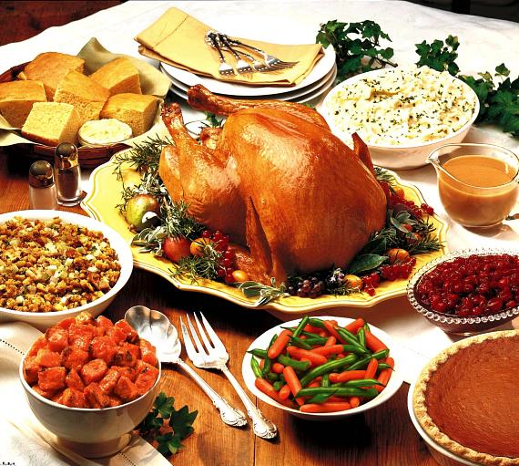
Feast
2 Nephi 32:3
“Angels speak by the power of the Holy Ghost; wherefore, they speak the words of Christ. Wherefore, I said unto you, feast upon the words of Christ; for behold, the words of Christ will tell you all things what ye should do.”
Think of scripture study like Thanksgiving Dinner...do you just take a tiny nibble hear or there or do you sit down and enjoy the feast?

Slide 11
Ask For Help
Ask Heavenly Father for help when you have questions or personal problems and then to go to the scriptures and search for the answers so the Holy Ghost may give you enlightenment. (Teaching the Gospel Handbook)

Slide 12
Video: The Book of Mormon: Messages from Heaven

Slide 13
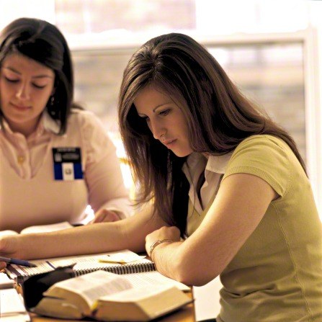
What are some of the ways the scriptures can help us?

Slide 14
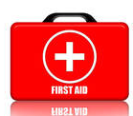
The Scriptures Can Heal Us
Pondering a passage of scripture can be a key to unlock revelation and the guidance and inspiration of the Holy Ghost. Scriptures can calm an agitated soul, giving peace, hope, and a restoration of confidence in one’s ability to overcome the challenges of life. They have potent power to heal emotional challenges when there is faith in the Savior. They can accelerate physical healing. (Richard G. Scott)

Slide 15
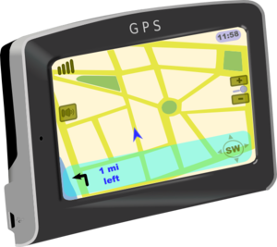
How are these items similar to the scriptures?
They provide direction and keep us from getting lost...just like the scriptures.

Slide 16
The Scriptures Can Protect Us
The scriptures hold the keys to spiritual protection. They contain the doctrine and laws and ordinances that will bring each child of God to a testimony of Jesus Christ as the Savior and Redeemer. (Boyd K. Packer)

Slide 17
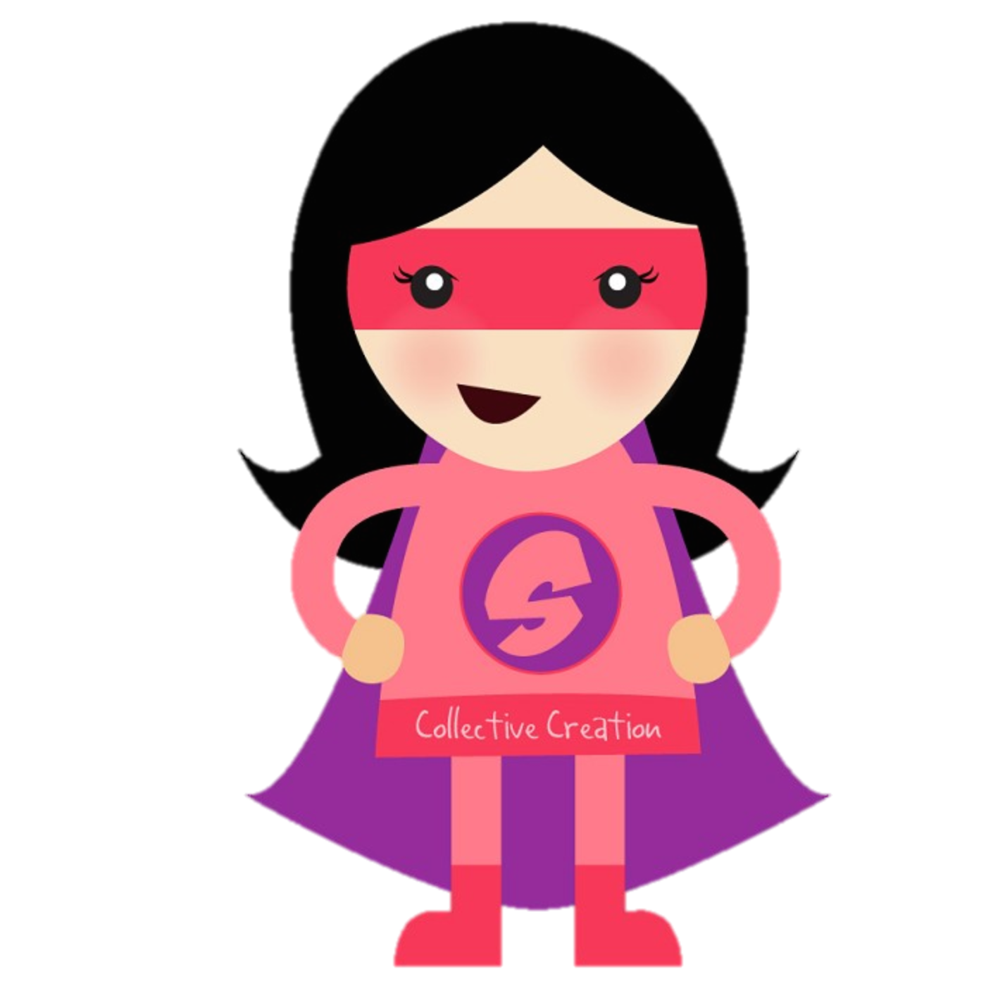
Scripture Power!
President Ezra Taft Benson (1899–1994) said,
“There is a power in the book which will begin to flow into your lives the moment you begin a serious study of the book. You will find greater power to resist temptation. You will find the power to avoid deception. You will find the power to stay on the strait and narrow path.
Who doesn’t need that type of power!?
Scripture Power!

Slide 18
But I’ve Already Read The Book Of Mormon!
You may have already read the Book of Mormon—the whole thing from cover to cover. You’ve recognized the Spirit as you’ve read it, and you know it’s true. So now what?
If you have a testimony of the Book of Mormon, you might ask why you need to keep reading it regularly on your own, especially if you already read the scriptures with your family and in seminary.
Good question, to which there are some good answers....

Slide 19
You Will Be Blessed
You will be richly rewarded for the time you spend studying the scriptures: “For he that diligently seeketh shall find; and the mysteries of God shall be unfolded unto them, by the power of the Holy Ghost, as well in these times as in times of old, and as well in times of old as in times to come” (1 Nephi 10:19).
There are always new things to learn from studying the scriptures over and over.
There are numerous ways you can choose to study.

Slide 20
Different Ways To Study:
Read cover to cover, in chronological order
Learn about a topic (ie: prayer, repentance, love)
Study a person or a prophet.
Seek answers to your questions.
Read about the Savior and His teachings.
Make a list of scriptures that mean something to you.
Can you think of any others?

Slide 21
Start Today!
However you choose to study the scriptures, your study will help strengthen your testimony and increase your understanding of the gospel. In other words, there is no one correct way to study the scriptures. So don’t be afraid to branch out and try some new approaches to the way you read.
(Successful Scripture Study, BY PAUL VANDENBERGHE, New Era Jan 2012)

