Slide 1
Christlike Love
How Can I Develop Christlike Love?

Slide 2
I have felt the most love from someone when...
On a few slips of paper, write “I have felt the most love from someone when ___________.” Hand these slips of paper to each of the young women before class begins, and ask her to think of how she would fill in the blank. Invite the young women to share their thoughts to begin the lesson.

Slide 3
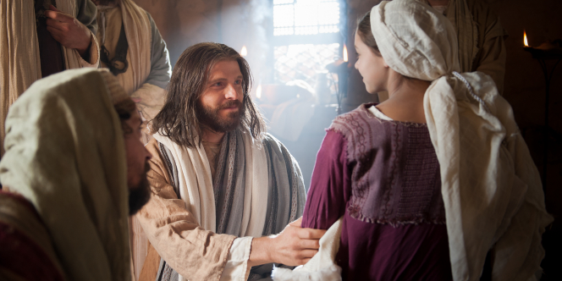
Pure Love of christ
The pure love of Christ, known as charity, is the highest, noblest, and strongest kind of love and the most joyous to the soul (see 1 Nephi 11:23).

Slide 4
charity
Moroni 7:45-48
45 And charity suffereth long, and is kind, and envieth not, and is not puffed up, seeketh not her own, is not easily provoked, thinketh no evil, and rejoiceth not in iniquity but rejoiceth in the truth, beareth all things, believeth all things, hopeth all things, endureth all things.
46 Wherefore, my beloved brethren, if ye have not charity, ye are nothing, for charity never faileth. Wherefore, cleave unto charity, which is the greatest of all, for all things must fail—
47 But charity is the pure love of Christ, and it endureth forever; and whoso is found possessed of it at the last day, it shall be well with him.
48 Wherefore, my beloved brethren, pray unto the Father with all the energy of heart, that ye may be filled with this love, which he hath bestowed upon all who are true followers of his Son, Jesus Christ; that ye may become the sons of God; that when he shall appear we shall be like him, for we shall see him as he is; that we may have this hope; that we may be purified even as he is pure. Amen.

Slide 5
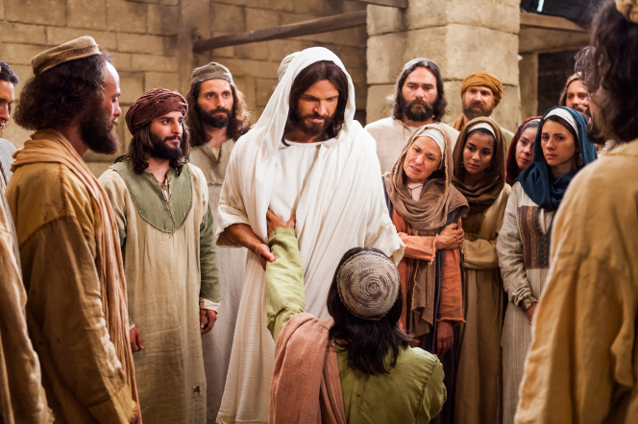
Our perfect example
Jesus Christ is the perfect example of charity. In His mortal ministry, He “went about doing good,” showing tender compassion for the poor, afflicted, and distressed (see Matthew 4:23; Acts 10:38).
Where would you find the Savior?
How has the Savior shown love to YOU personally?

Slide 6
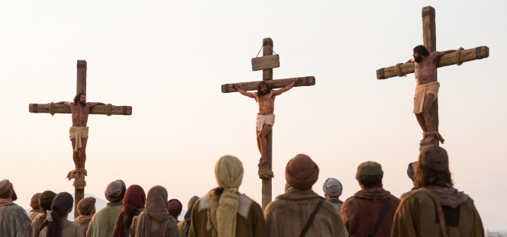
The atonement
His crowning expression of charity was His infinite Atonement. He said, “Greater love hath no man than this, that a man lay down his life for his friends” (John 15:13).

Slide 7
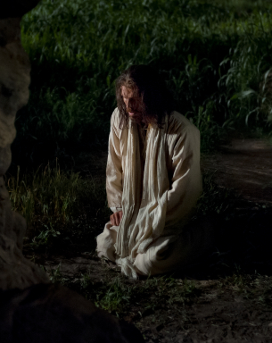
The atonement
This was the greatest act of long-suffering, kindness, and selflessness that we will ever know. With an understanding of the Savior’s enduring love, you can exercise faith and repent of your sins, confident that He will forgive you and strengthen you in your efforts to live the gospel. (True to the Faith)

Slide 8
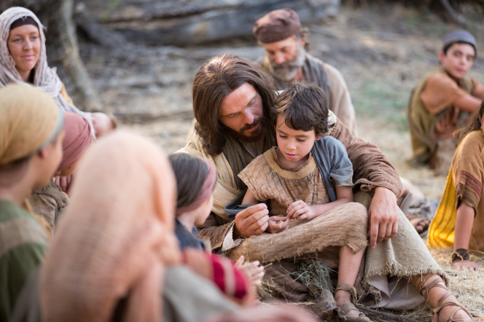
Love one another
The Savior wants you to receive His love, and He also wants you to share it with others. He declared to His disciples: “A new commandment I give unto you, That ye love one another; as I have loved you, that ye also love one another. By this shall all men know that ye are my disciples, if ye have love one to another” (John 13:34–35). (True to the Faith)

Slide 9
Jesus taught a higher law
As always, Christ is our exemplar. In His teachings as in His life, He showed us the way. He forgave the wicked, the vulgar, and those who sought to hurt and to do Him harm.
Jesus said it is easy to love those who love us; even the wicked can do that. But Jesus Christ taught a higher law. His words echo through the centuries and are meant for us today. They are meant for all who desire to be His disciples. They are meant for you and me: “Love your enemies, bless them that curse you, do good to them that hate you, and pray for them which despitefully use you, and persecute you.”

Slide 10
Self Test
My dear brothers and sisters, consider the following questions as a self-test:
Do you harbor a grudge against someone else?
Do you gossip, even when what you say may be true?
Do you exclude, push away, or punish others because of something they have done?
Do you secretly envy another?
Do you wish to cause harm to someone?
If you answered yes to any of these questions, you may want to apply the two-word sermon from earlier: stop it! (President Uchdorf)

Slide 11
Love is the very essence of the gospel
In a world of accusations and unfriendliness, it is easy to gather and cast stones. But before we do so, let us remember the words of the One who is our Master and model: “He that is without sin among you, let him first cast a stone.”
Brothers and sisters, let us put down our stones.
Let us be kind.
Let us forgive.
Let us talk peacefully with each other.
Let the love of God fill our hearts.
“Let us do good unto all men.”
Love is the very essence of the gospel, and Jesus Christ is our Exemplar. His life was a legacy of love. (President Monson)

Slide 12
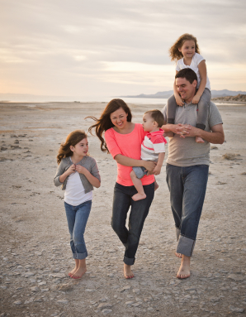
Love as he loves
In your relationships with family members and others, look to the Savior as your example. Strive to love as He loves, with unfailing compassion, patience, and mercy. (True to the Faith)
Is it easier to love your family or your friends?

Slide 13
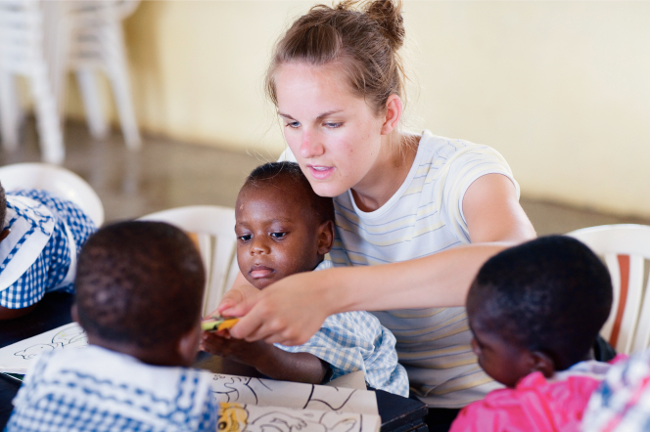
The joy of the lord’s service
As you continue to receive the Savior’s perfect love and as you demonstrate Christlike love for others, you will find that your love increases. You will experience the joy of being in the Lord’s service. (True to the Faith)

Slide 14
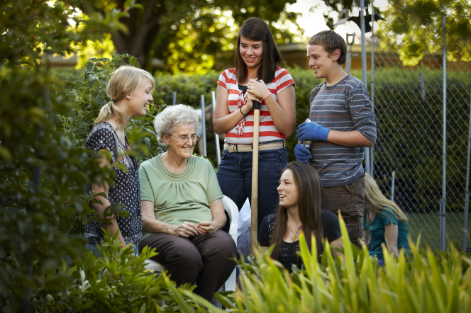
The holy ghost will guide you
The Holy Ghost will be your constant companion, guiding you in your service and in your relationships with others. You will be prepared to meet the Lord at the Judgment, when He will reward you according to your dedication to His work. (True to the Faith)

Slide 15
seek, pray & follow
To develop Christlike love, we must seek it, pray for it, and follow the example of the Savior in our thoughts, words, and actions.

Slide 16
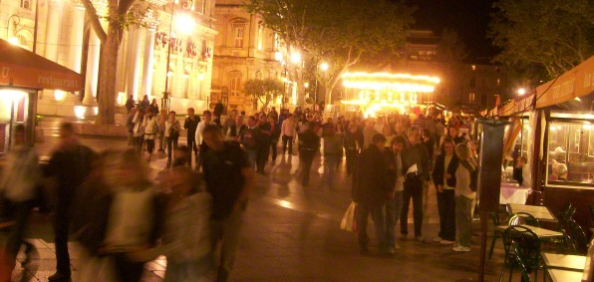
Love god & man
We cannot truly love God if we do not love our fellow travelers on this mortal journey. (President Monson)

Slide 17
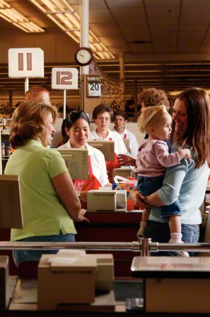
Our brothers & sisters
Every day of our lives we are given opportunities to show love and kindness to those around us. Said President Spencer W. Kimball: “We must remember that those mortals we meet in parking lots, offices, elevators, and elsewhere are that portion of mankind God has given us to love and to serve. It will do us little good to speak of the general brotherhood of mankind if we cannot regard those who are all around us as our brothers and sisters.”

Slide 18
Daily acts of love
Usually our love will be shown in our day-to-day interactions one with another. All important will be our ability to recognize someone’s need and then to respond. (President Monson)

Slide 19
Love at home
Some of our greatest opportunities to demonstrate our love will be within the walls of our own homes.
Love should be the very heart of family life, and yet sometimes it is not. There can be too much impatience, too much arguing, too many fights, too many tears.
President Gordon B. Hinckley said: “Why is it that the [ones] we love [most] become so frequently the targets of our harsh words? Why is it that [we] sometimes speak as if with daggers that cut to the quick?” The answers to these questions may be different for each of us, and yet the bottom line is that the reasons do not matter. If we would keep the commandment to love one another, we must treat each other with kindness and respect.

Slide 20
Compassionate & encouraging
I would hope that we would strive always to be considerate and to be sensitive to the thoughts and feelings and circumstances of those around us. Let us not demean or belittle. Rather, let us be compassionate and encouraging. We must be careful that we do not destroy another person’s confidence through careless words or actions. (President Monson)

Slide 21
Bullying: Stop It

Slide 22
Forgiveness is love
Forgiveness should go hand in hand with love. In our families, as well as with our friends, there can be hurt feelings and disagreements. Again, it doesn’t really matter how small the issue was. It cannot and should not be left to canker, to fester, and ultimately to destroy. Blame keeps wounds open. Only forgiveness heals.

Slide 23
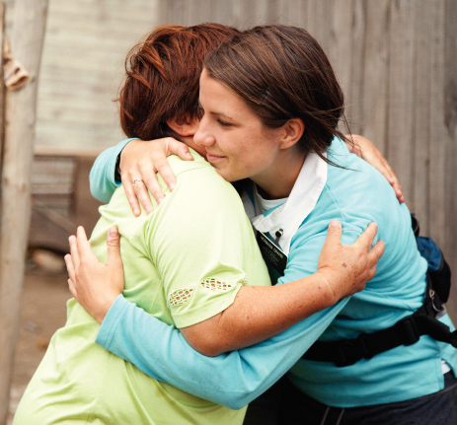
Express love to all
May we begin now, this very day, to express love to all of God’s children, whether they be our family members, our friends, mere acquaintances, or total strangers. As we arise each morning, let us determine to respond with love and kindness to whatever might come our way. (President Monson)

Slide 24
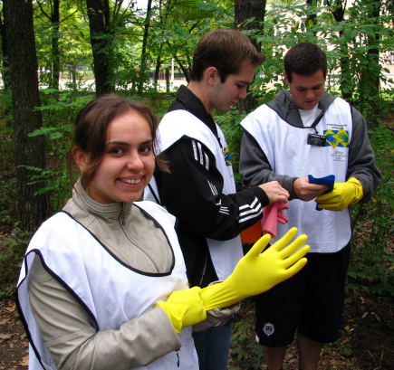
Pure love of christ
The more we allow the love of God to govern our minds and emotions—the more we allow our love for our Heavenly Father to swell within our hearts—the easier it is to love others with the pure love of Christ. (President Uchtdorf)

Slide 25
Opportunities to love
Read: Mosiah 4:16, 3 Nephi 12:44, Leviticus 19:18
What opportunities do we have to follow these commandments at home, at school, and in the community?
What obstacles might keep us from obeying these commandments?
How can we overcome these obstacles?
Watch “Bullying—Stop It” and discuss what we can do to live these commandments when we face similar situations.

Slide 26
Let us be known...
Brothers and sisters, there is enough heartache and sorrow in this life without our adding to it through our own stubbornness, bitterness, and resentment.
We are not perfect. The people around us are not perfect. People do things that annoy, disappoint, and anger. In this mortal life it will always be that way.
Part of the purpose of mortality is to learn how to let go of such things. That is the Lord’s way.
Lay your burden at the Savior’s feet. Let go of judgment. Allow Christ’s Atonement to change and heal your heart. Love one another. Forgive one another.
As members of The Church of Jesus Christ of Latter-day Saints, wherever we may be, let us be known as a people who “have love one to another.” (President Uchdorf)

Slide 27
