Slide 1
Why Do We Fast?
It’s more than just going hungry!

Slide 2
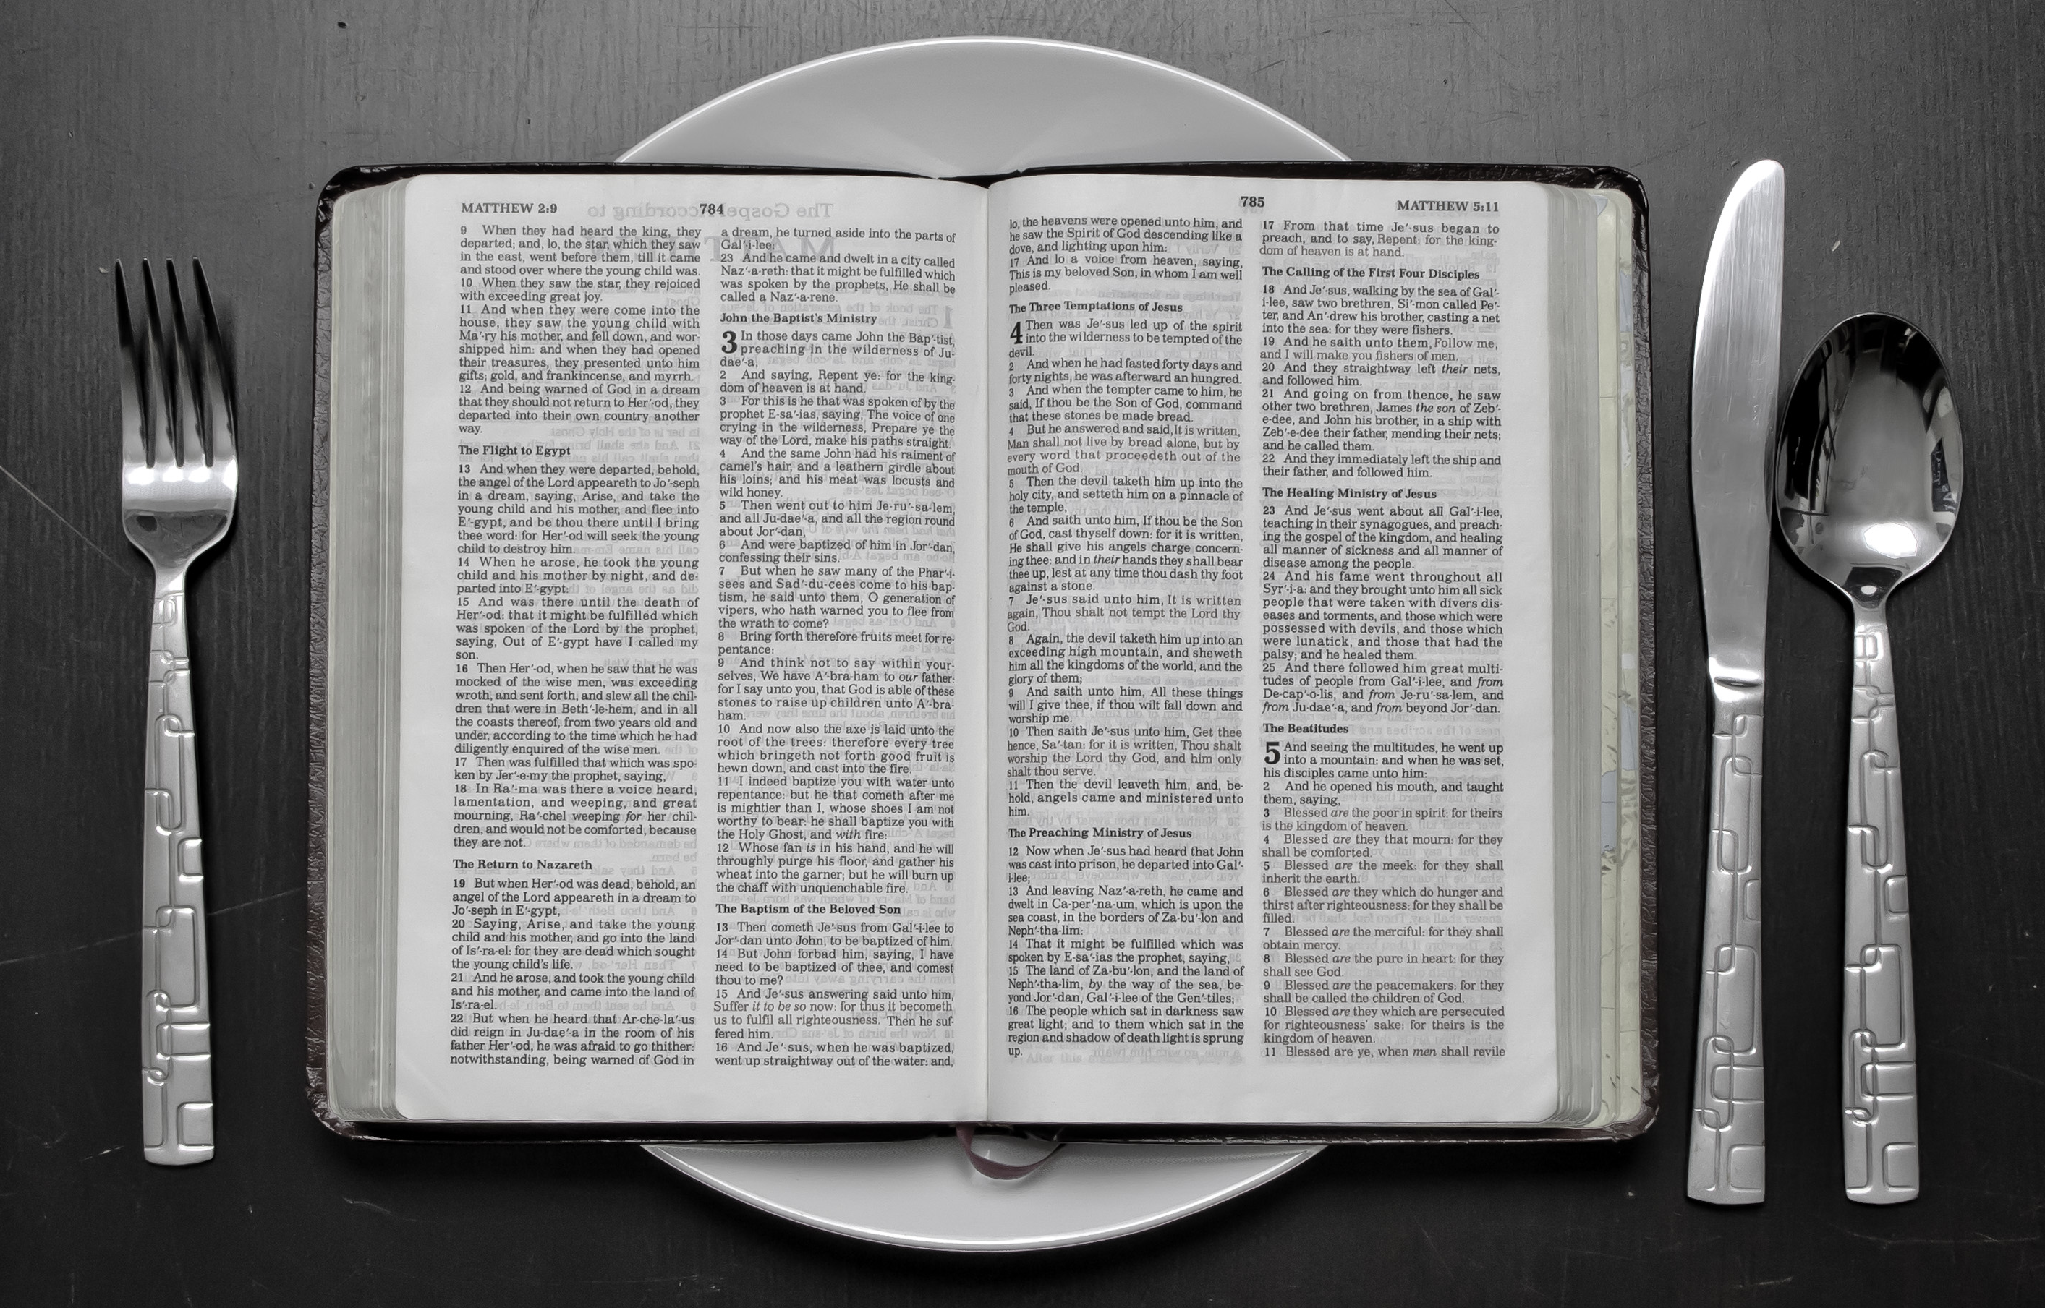
What is fasting?
To fast is to go without food and drink voluntarily for a certain period of time.
Fasting combined with sincere prayer can help you prepare yourself and others to receive God’s blessings.
It is a source of spiritual strength.

Slide 3
Why do we fast?
Through fasting we can feel closer to Heavenly Father and strengthen our testimony. Fasting also includes giving a generous fast offering to help those in need.
Read Alma 17:3

Slide 4
Be not as the hypocrites...
Matthew 16-18
16 ¶Moreover when ye fast, be not, as the hypocrites, of a sad countenance: for they disfigure their faces, that they may appear unto men to fast. Verily I say unto you, They have their reward.
17 But thou, when thou fastest, anoint thine head, and wash thy face;
18 That thou appear not unto men to fast, but unto thy Father which is in secret: and thy Father, which seeth in secret, shall reward thee openly.
Fasting can be difficult at times. No one likes to be hungry! We must do our best to have a cheerful countenance and a positive attitude.

Slide 5
We can fast for others
Alma 6:6
6 Nevertheless the children of God were commanded that they should gather themselves together oft, and join in fasting and mighty prayer in behalf of the welfare of the souls of those who knew not God.

Slide 6
Fasting can strengthen your testimony
Helaman 3:35
35 Nevertheless they did fast and pray oft, and did wax stronger and stronger in their humility, and firmer and firmer in the faith of Christ, unto the filling their souls with joy and consolation, yea, even to the purifying and the sanctification of their hearts, which sanctification cometh because of their yielding their hearts unto God.
Would you like to be stronger, more humble &
have a firm faith in Christ?
If I told you you could have all of those things AND have a soul full of joy, who wouldn’t want that?
We must yield our hearts to God through our regular fasts

Slide 7
We can fast when we need answers
Alma 5:46
46 Behold, I say unto you they are made known unto me by the Holy Spirit of God. Behold, I have fasted and prayed many days that I might know these things of myself. And now I do know of myself that they are true; for the Lord God hath made them manifest unto me by his Holy Spirit; and this is the spirit of revelation which is in me.
We are all entitled to personal revelation. When we fast and pray we can prepare ourselves to receive the spirit of revelation for ourselves.

Slide 8
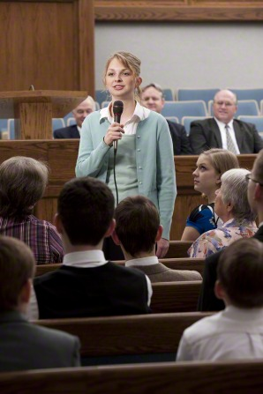
Fasting is a commandment
Fasting has always been a practice among God’s people. In our day it is a commandment given by the Lord to all members of the Church. In addition to occasional special fasts that we might have for personal or family reasons, we are expected to fast once a month on the first Sunday. (Carl B. Pratt)

Slide 9
What is a “proper” fast?
We are taught that there are three aspects to a proper fast day observance:
First, abstaining from food and drink for two consecutive meals or, in other words, 24 hours;
Second, attending fast and testimony meeting;
Third, giving a generous fast offering. (Carl Pratt)
The Church designates one Sunday each month, usually the first Sunday, as a day of fasting. In addition to observing the fast days set aside by Church leaders, you can fast on any other day, according to your needs and the needs of others. However, you should not fast too frequently or for excessive periods of time. (True to the Faith)

Slide 10
Fast with a purpose!
If we have a special purpose in our fasting, the fast will have much more meaning. Perhaps we can take time as a family before beginning our fast to talk about what we hope to accomplish by this fast. This could be done in a family home evening the week before fast Sunday or in a brief family meeting at the time of family prayer. When we fast with purpose, we have something to focus our attention on besides our hunger.

Slide 11
Fasting can help us personally
The purpose of our fast may be a very personal one. Fasting can help us overcome personal flaws and sins. It can help us overcome our weaknesses—help them become strengths. (Carl Pratt)
If you have a weakness or sin that you have struggled to overcome, you may need to fast and pray in order to receive the help or forgiveness you desire. (True to the Faith)

Slide 12
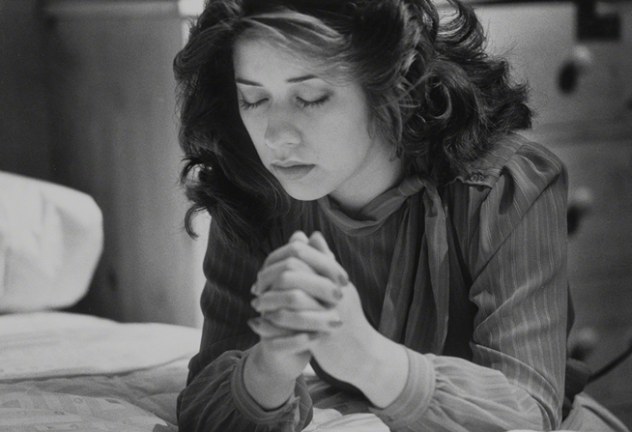
Fast with prayer
Throughout the scriptures the term fasting is usually combined with prayer. “Ye shall continue in prayer and fasting from this time forth” is the Lord’s counsel (D&C 88:76). Fasting without prayer is just going hungry for 24 hours. But fasting combined with prayer brings increased spiritual power.

Slide 13
Fast with prayer (cont...)
Let us begin our fasts with prayer. That prayer should be a natural thing as we speak to our Heavenly Father concerning the purpose of our fast and plead with Him for His help in accomplishing our goals.
Likewise, let us end our fasts with prayer. We would thank the Lord for His help during the fast and for what we have felt and learned from the fast.
In addition to a beginning and ending prayer, we should seek the Lord often in personal prayer throughout the fast. (Carl Pratt)

Slide 14
Fasting shows gratitude
Fasting is one way of worshiping God and expressing gratitude to Him. (True to the Faith)

Slide 15
Do we take our fast for granted?
I fear, that too many of us are either not fasting on fast day or we are doing so in a lackadaisical manner.
Lackadaisical means: without spirit, lazy
If we are guilty of taking our fast day for granted or simply fasting Sunday morning instead of making it two complete meals—24 hours—we are depriving ourselves and our families of the choice spiritual experiences and blessings that can come from a true fast. (Carl Pratt)

Slide 16
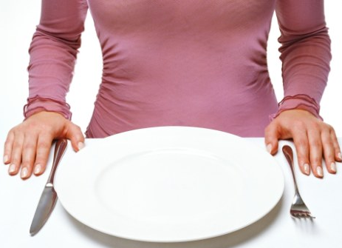
Questions & answers
Question: I know we are encouraged to fast and pray. I’ve tried fasting, and, frankly, I don’t get that much out of it. Why do we do it?

Slide 17
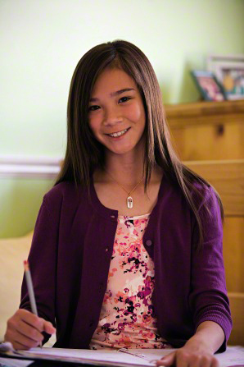
Answers...
Answer #1: “Fasting is for spiritual upliftment,” ...“Just as faith without works is dead, fasting without a positive attitude towards it is dead and brings us no rewards.” (Elder Ifiok E. Okon)

Slide 18
Answers...
Answer #2:
Fasting is a sacrifice, but it is a fairly minor sacrifice when compared to the blessings you can receive. Fasting is a way to teach us to turn away from the things of the world, even though food is a very good and necessary thing, and to focus on the things our spirits need.
When we control our appetite for food, we can learn to control other bodily appetites. We can come to understand that our actions do not have to be controlled by how our body feels. We can choose the things of the Spirit.

Slide 19
How can I improve my fast?
During your next fast, try these steps:
• Pray before beginning your fast.
• Fast with a purpose, and think often about the purpose of your fast.
• Remain cheerful and patient.
• Offer a prayer of gratitude at the end of your fast.

Slide 20
Not So Fast! BY DANIELLE NYE POULTER, New era 2008
On most fast Sundays I didn’t have too much of a problem making it to dinnertime without eating. But this morning I had awakened starving! I decided to sneak up to the kitchen and get just a little snack before church.
I poked my head into the pantry and checked my options. “No, no, no,” I whispered to myself as my eyes flicked over wheat crackers and unripe bananas. Then I spied it—my absolute favorite cereal. It was sweet and crunchy, and all I needed was a handful to tide me over until dinner.
My hand brought out a fistful of cereal. My mouth watered in anticipation, but before I could pop that first sweet piece in, I froze.
Continued on next slide...

Slide 21
Not so fast...(continued)
I froze because I felt a gentle but persistent nudge to my conscience. I knew I didn’t really need to worry about my parents catching me eating when I was supposed to be fasting. I was old enough to decide for myself whether I would fast or not. So what was it going to be?
As I contemplated that delicious-looking handful of cereal, I realized it didn’t matter whether I actually took a bite. If my heart wasn’t in my fast, I might as well not be doing it at all. I had been kidding myself spiritually.
Even if I didn’t get caught with my contraband cereal, I would know, and more importantly, the Lord would know that a little treat was more important to me than my spiritual well-being.
Continued on next slide...

Slide 22
Not so fast...(continued)
The pieces of cereal clattered back into the box as I released my clenched hand. I said a silent prayer of gratitude for the lesson I had just learned. From then on when the first Sunday of the month came around, I would know I was fasting for the right reasons, my own reasons, and not because my parents or leaders expected me to.
As I walked back through the kitchen and down to my room, I didn’t creep along on tiptoe like I had on the way up. This time, I walked with my head held high. The Spirit had taught me the blessings of a sincere fast, and I had chosen it for myself.

Slide 23
Choose for yourself!
Going without food will just make you hungry. Fasting, done with a specific purpose and accompanied by prayer, will bring you closer to God and give you blessings and spiritual strength.
We are all old enough to choose for ourselves...What will you choose next time you are asked to fast?

Slide 24
