Slide 1
How Do The Things I Say Affect Those Around Me?

Slide 2
LANGUAGE: Uplifting Language
How we communicate reflects our understanding of who we are as children of God. Our language can either uplift and encourage others, or it can hurt and offend them. When we use uplifting language, we invite the Holy Ghost to be with us.

Slide 3
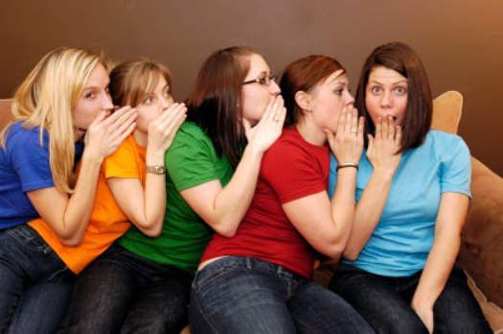
Speak Kindly
Speak kindly and positively about others. Choose not to insult others or put them down, even in joking. Avoid gossip of any kind, and avoid speaking in anger. When you are tempted to say harsh or hurtful things, leave them unsaid. (FTSOY)

Slide 4
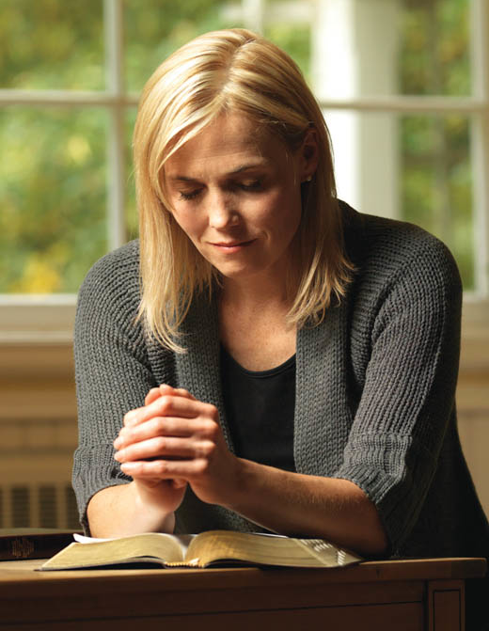
Reverence & Respect
Always use the names of God and Jesus Christ with reverence and respect. Misusing the names of Deity is a sin. When you pray, address your Father in Heaven in reverent and respectful language. (FTSOY)

Slide 5
No Profanity
Do not use profane, vulgar, or crude language or gestures, and do not tell jokes or stories about immoral actions. These are offensive to God and to others.

Slide 6
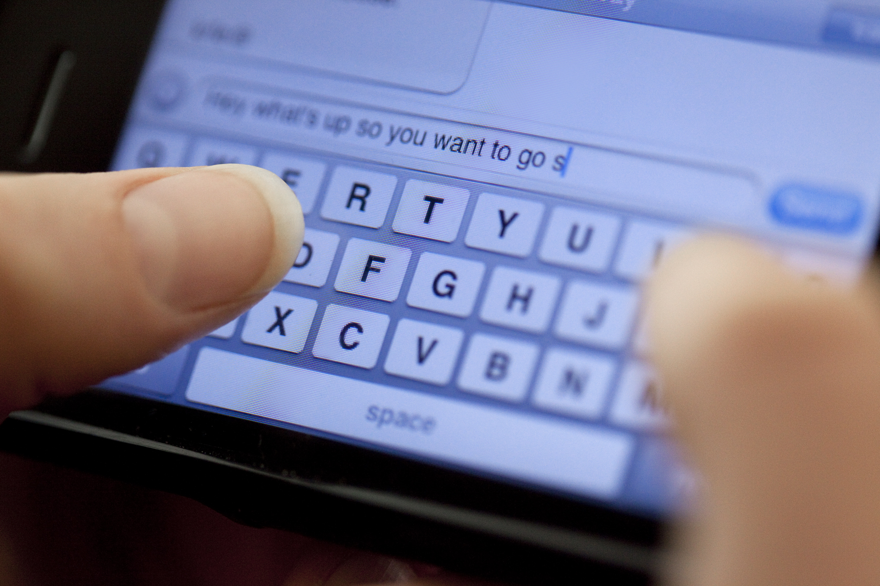
ALL forms of communication!
Remember that these standards for your use of language apply to all forms of communication, including texting on a cell phone or communicating on the Internet.

Slide 7
Read Ephesians 4:29-32
Words We Read
Words We Hear
Words We Write
Words We Speak
How do you feel about the kind of language that you read, hear, and use?
How do words invite or discourage guidance from the Holy Ghost?

Slide 8
Negative = Negative
Negative speaking so often flows from negative thinking, including negative thinking about ourselves. We see our own faults, we speak—or at least think—critically of ourselves, and before long that is how we see everyone and everything. No sunshine, no roses, no promise of hope or happiness. Before long we and everybody around us are miserable. (Elder Holland)

Slide 9
Think Positive
Elder Orson F. Whitney once said: “The spirit of the gospel is optimistic; it trusts in God and looks on the bright side of things. The opposite or pessimistic spirit drags men down and away from God...
Speak hopefully. Speak encouragingly, including about yourself. Try not to complain and moan incessantly.

Slide 10
Things We Say...
...Some things we say can be destructive, even venomous—! The voice that bears profound testimony,...prayer, and sings the hymns of Zion can be the same voice that berates and criticizes, embarrasses and demeans, inflicts pain and destroys the spirit of oneself and of others in the process. (Elder Holland)

Slide 11
Faith, Hope & Charity
Our words, like our deeds, should be filled with faith and hope and charity...With such words, spoken under the influence of the Spirit, tears can be dried, hearts can be healed, lives can be elevated, hope can return, confidence can prevail. (Elder Holland)

Slide 12
FRIENDS:Choose Good Friends/Be a Good Friend
Choose friends who use good language. Help others improve their language by your example. Be willing to politely walk away or change the subject when those around you use inappropriate language. (FTSOY)

Slide 13
Friends
Our friends have a great influence on our habits and on our ability to stay clean. President Hinckley warned the youth to “Choose your friends carefully. It is they who will lead you in one direction or the other. … While you should be friendly with all people, select with great care those whom you wish to have close to you.”

Slide 14
Single Most Important Event...
One young woman had an experience soon after President Hinckley’s fireside when she began to question her friendship with some people.
“As I approached this group of people that I called my friends and that I had spent half my life with, their aura seemed different, confusing, and unappealing. They were taking turns telling bad jokes and the spirit that I encountered there was one I did not want to be a part of. I hesitated to leave my friends and stayed for half a joke and then made up my mind to not be a part of this demeaning situation.”
She went on to explain that although it was difficult leaving her group of friends, it was well worth it.
“As I look back on that minute in time, that thought of walking away was probably the hardest thing I have ever had to do. Now I find it to have been the single most important event in my life. I am now in a different crowd of people.
I think differently, and most importantly I act differently because of my change of friends.”

Slide 15
From Other Youth... (lds.org)
Alexis Cydney H. - United States
I know that when it comes to language it doesn't just mean swearing, it also means gossiping, bringing other people down, and bullying. I know bringing other people down will never help you become a better person.
Mary C. – United States
What we tell ourselves is also important. We need to be positive about ourselves and others. We need to see ourselves and others as Heavenly Father sees us.
Heidi A. - United States
Keep your language clean. If you don't, it can attract the wrong type of people.
Brynn W. - United States
How we speak and interact with others says a lot about our character and who we are. When we are examples and refrain from using slang terms as well as swear words, it helps your self confidence grow and people around you will notice.
K'lee Nicole P. - United States
I don't cuss. But there are other things I need to work on, like being angry in my speech towards others, and one that a lot of girls have a hard time with, gossiping.

Slide 16
START TODAY: You Can Change
If you have developed the habit of using language that is not in keeping with these standards—such as swearing, mocking, gossiping, or speaking in anger to others—you can change. Pray for help. Ask your family and friends to support you in your desire to use good language.

Slide 17
If you have the habit, how do you break it? You begin by making a decision to change. The next time you are prone to use words you know to be wrong, simply stop. Keep quiet or say what you have to say in a different way. As you practice such restraint, it will become easy.
Remember that it is the same voice which prays to the Lord on the one hand which, on the other hand, may be [tempted] to speak language foul and filthy.
Don’t swear. Don’t profane. Avoid so-called dirty jokes. Stay away from conversation that is sprinkled with foul and filthy words. You will be happier if you do so, and your example will give strength to others. President Hinckley

Slide 18
Dare to be Different
I have watched some youth use inappropriate language because they thought it would help them fit in and others use it because of a desire to stand out. In fact, these seem to be the major reasons why youth slip into this habit.
I am most impressed with those youth who “dare to be different,” Larry M. Gibson

Slide 19
(CM) CM Squared Project
2
My dad and I came up with the idea of “clean mouth/clean mind.” The next night in family home evening, we talked about the importance of having a clean mouth and a clean mind in everything we do. Mom abbreviated the “clean mouth/clean mind” phrase to (CM)², and we set a rule to keep a clean mouth and a clean mind at work, school, and play. We even made shirts with (CM)² printed on them.

Slide 23
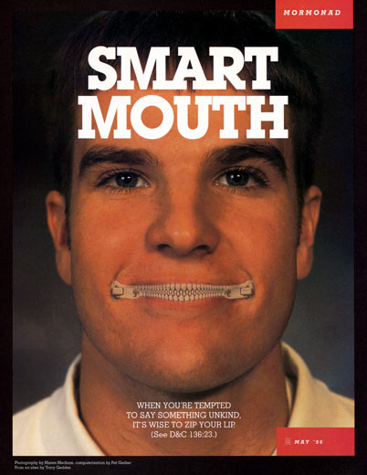

Slide 24
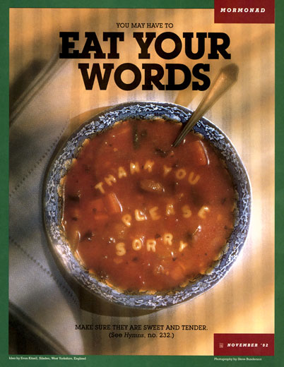

Slide 26
Larry M. Gibson
What we feel in our hearts is what we think about, and what we think about is what we speak about. Thus, it is true that the words we use reflect the feelings of our heart and who we really are.
It is my hope that we will use our words not to profane or gossip but to show that we are followers of our Savior, even Jesus Christ.

